Slide 1
A “BIT” About Protecting International Investments
Charles (“Chip”) B. Rosenberg

Slide 2
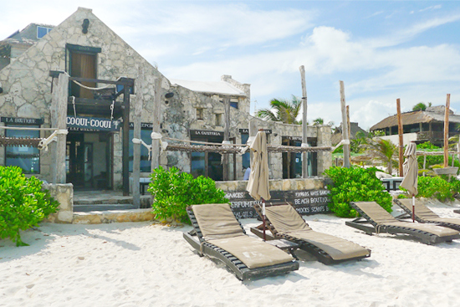
Tulum, Mexico

Slide 3
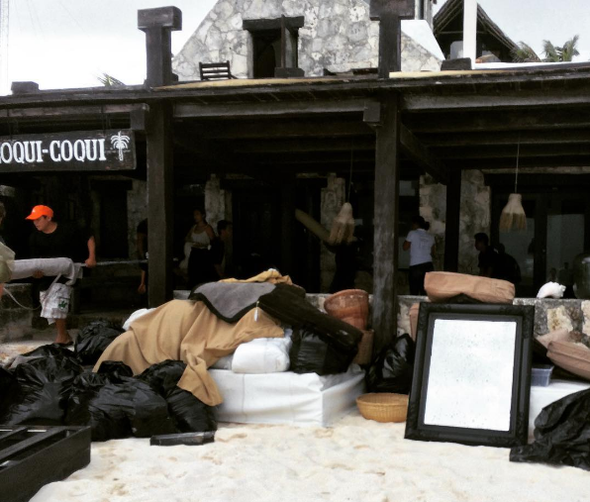
Tulum, Mexico

Slide 4
Local courts

Slide 5
“BIT” arbitration
Bilateral investment treaty between two countries that protects “investments” by “investors” of one country that are made in another country

Slide 6
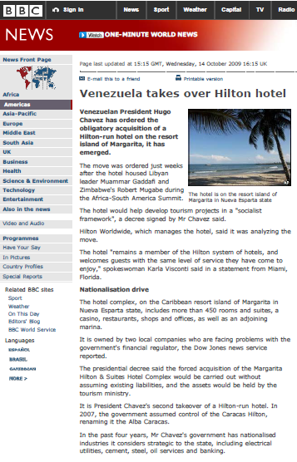
Not just relevant to boutique hotels
“Venezuelan President Hugo Chavez has ordered the obligatory acquisition of a Hilton-run hotel on the resort island of Margarita, it has emerged.”

Slide 7
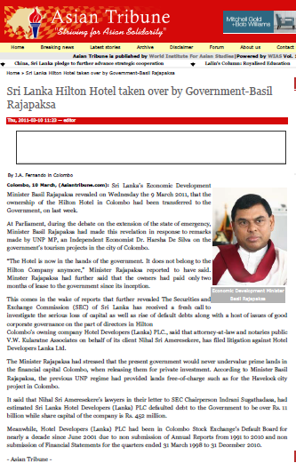
And not just in Latin America
“The Hotel is now in the hands of the government. It does not belong to the Hilton Company anymore.”
Notes:
March 2011

Slide 8
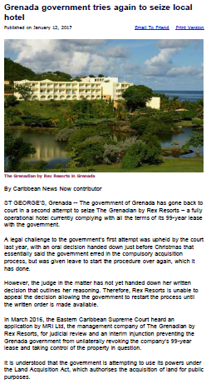
And not just Hilton
“The government of Grenada has gone back to court in a second attempt to seize The Grenadian by Rex Resorts.”

Slide 9
Take-away
Hospitality companies investing abroad or considering investing abroad should know a “BIT” about protecting international investments

