Slide 1
Kristen R. Catasús
Associate, Gray-Robinson, P.A.
Nationwide Alcohol Beverage Practice Group
Federal and State Trade Practice Compliance
Sales, Marketing, Advertising
Licensing
Other Regulated Industries
Food Law
Cannabis

Slide 2
Best Practices in: Alcohol Beverage Trade Practices
The Hospitality Law Virtual Seminar
October 6, 2021

Slide 3
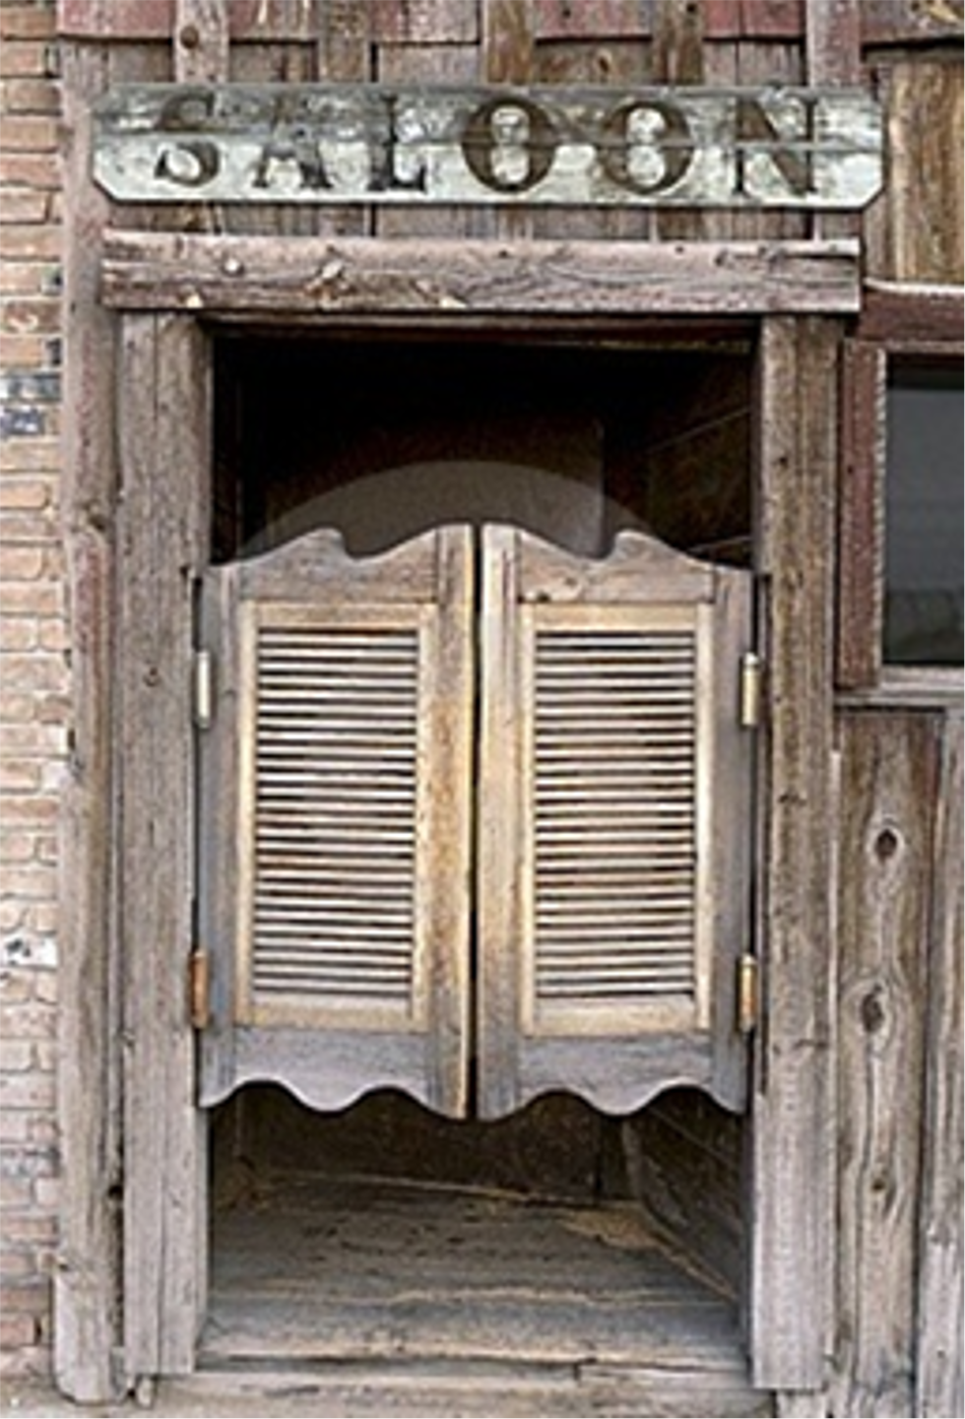
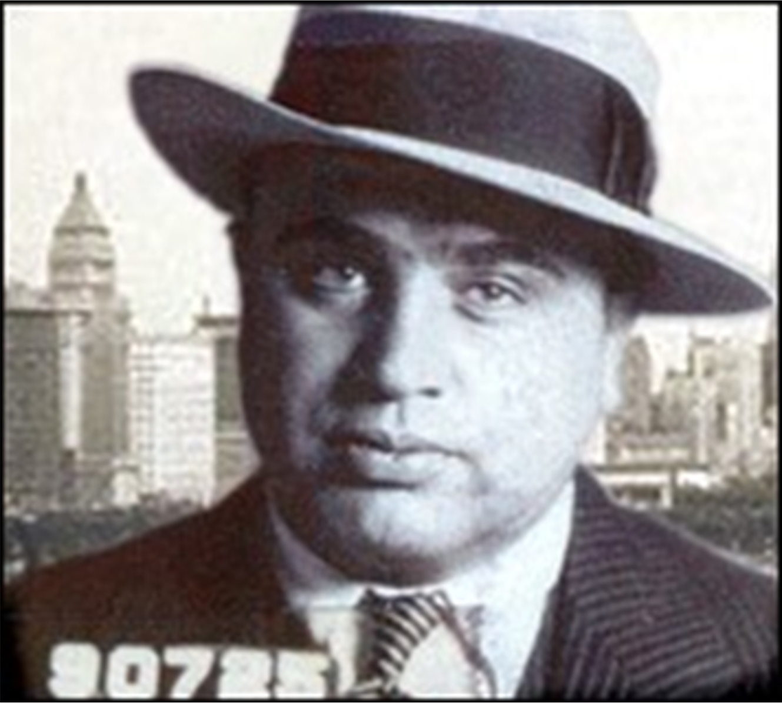
Tied-House Laws
Prohibition
Three tier system & cozy relationships between them
General prohibition – no overlapping
ownership, nothing “of value” to a retailer
Exceptions: consumer sampling,
advertising specialties, signage, etc.

Slide 4
Oversight
Federal
FAA Act
CFR
TTB
State
State ABC authority
Police/Enforcement
Office of the Governor
Statutes and Regulations
Advisory Documents
Emergency Orders
Local
Municipal Code
Emergency Orders

Slide 5
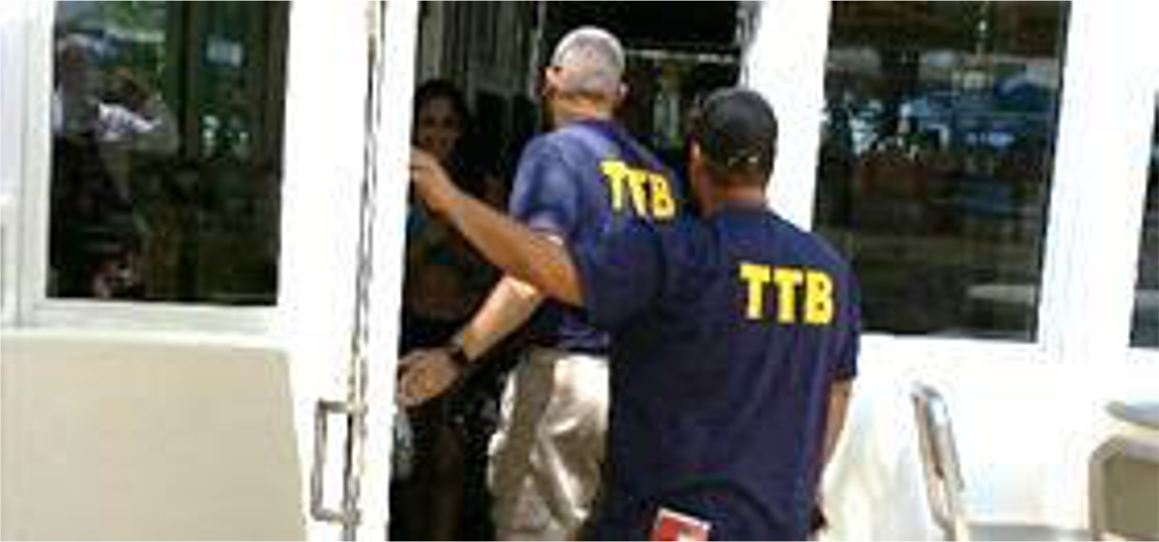
Ramped-Up Enforcement
TTB $5 Million appropriation
Tied House (“pay-to-play,” slotting fees)
Exclusive Outlet
Commercial Bribery
Consignment Sales
State cooperation
Covid-19
What is requested during investigation?

Slide 6
What is being scrutinized?
Slotting Fees
Sponsorship Agreements
Alcohol Delivery
Use of Third Parties
Entertainment
Incentive Programs
Covid-19 Procedures

Slide 7
Potential Consequences of Non-Compliance
Violations of FAA Act Trade Practice prohibitions:
Criminal charges against any person who violates the Act
Fines/Offers in Compromise
(2020) 20 retailers across New Jersey paid a combined $2.3 million for their roll in a discriminatory trade practices investigation which involved manipulating retailer incentive programs and credit extensions
(2020) Anheuser-Busch $5,000,000 OIC for trade practice violations relating to sponsorship agreements and concessionaires
(2020) Chain liquor store fined $22,500 by New York SLA for impermissible distribution of gift cards
(2020) CA ABC accepted 644 offers in compromise totaling over $2.1 million dollars
(2019) TTB accepted $2.5 million offer in compromise from major beer manufacturer as part of a joint operation conducted with Florida Division of Alcoholic Beverages and Tobacco, Miami District Office, Washington State, and New York City.
Suspensions
(2020) TABC completed a sweep of more than 1700 bars and restaurants and issued multiple warnings, 30 day suspensions, and 60 day suspensions for Emergency Order violations

Slide 8
How to Prevent Enforcement Issues
Know the law-but if you don’t, make sure you get a lawyer who does!
Internal Education and compliance programs
Document, Document, Document
Quid Pro NO!
Management Companies/Concessionaires & Sponsorship
Voluntary Disclosure – potential cost & penalty reduction

Slide 9
Questions?
Kristen.Catasus@Gray-Robinson.com 305-420-3941

