Slide 1
Evaluating Your Ethics & Compliance Culture: Check the Box, or Test and Track?
Juliette Gust and guest Teri Quimby

Slide 2
Juliette Gust
CO-FOUNDER & PRESIDENT, ETHICS SUITE
SCOTTSDALE, AZ
Former Director of Fraud Investigations for global hospitality company with ~180,000 employees in more than 100 countries
Led more than 2,000 investigations spanning 75 countries and has advised on more than 10,000 employee ethics line reports
Co-Founder of Ethics Suite’s anonymous employee reporting and case management platform

Slide 3
Teri Quimby
FORMER STATE REGULATOR
Michigan
Former Commissioner of the Michigan Liquor Control Commission (MLCC).
Recipient of Best Practices Award from the National Association of Licensing and Compliance Professionals (NALCP) for Extraordinary Innovation, Dedication and Leadership, and Award of Appreciation from the National Liquor Law Enforcement Association (NLLEA)
Author of Government Agencies: Effective Compliance and Ethics Programs are Necessary for Public Trust (SCCE’s The Complete Compliance and Ethics Manual 2022) and many other publications.

Slide 4
Improve and Evolve
An effective Ethics & Compliance Program (“Program”) cannot be a “set it and forget it” paper policy with annual acknowledgment.
U.S. Department of Justice Criminal Division’s (“DOJ”) guidance on the Evaluation of Corporate Compliance Programs states that a “hallmark of an effective compliance program is its capacity to improve and evolve.”
Proactive efforts to promote improvement and sustainability may:
avert problems down the line, and
emphasize revisions to programs from lessons learned.

Slide 5
Continuous Improvement, Testing & Review
Programs: continuously monitor and test, based on risk, to ensure that all Program elements are working as intended.
Program resources should include at a minimum:
Internal Audit function that tests controls and follows up on recommendations for improvement;
Compliance oversight to review monitoring and testing data and implement program updates as needed; and
Reporting and survey function that provides Program-related analytics and conducts organization-wide polls on the effectiveness of the Program, as well as overall compliance culture.

Slide 6
Misconduct: Prevention, Detection & Correction
Program elements to must be reviewed periodically to ensure they are functioning as intended.
These include:
Prevention: established code of business conduct and corresponding policies, communication, and training;
Detection: internal controls, risk management, and whistleblower channel; and
Correction: remediation steps, and consistently applied disciplinary measures.

Slide 7
Regulator Perspective
Regulators want to see a commitment to an effective Program.
The continuous nature of monitoring, review, and revision needs to be evident.
What are you doing to document your efforts?

Slide 8
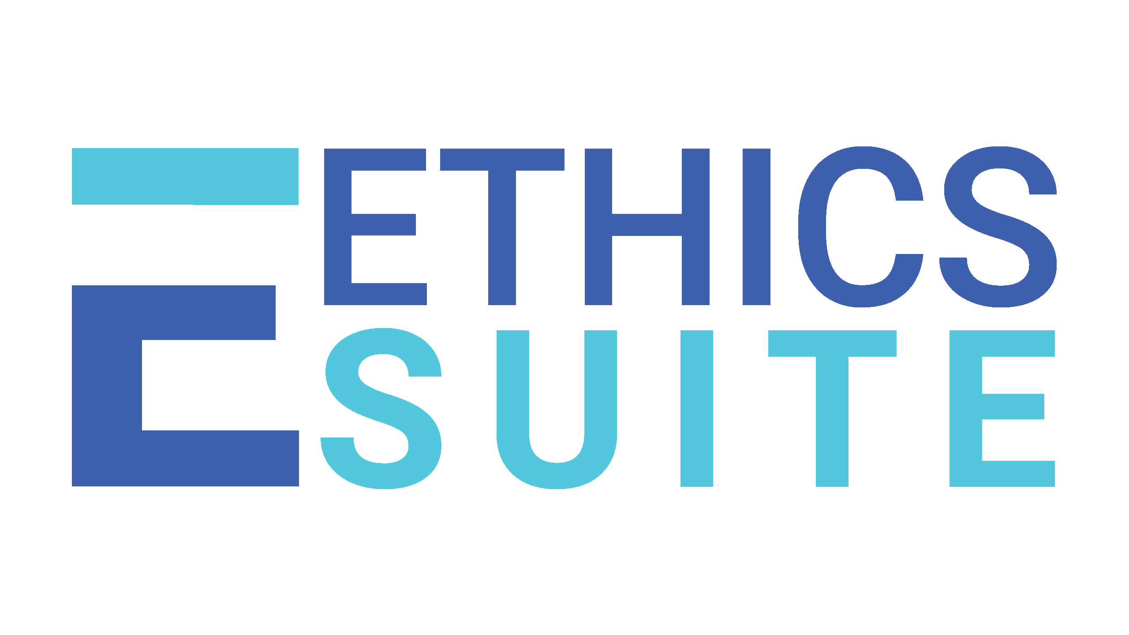
jgust@ethicssuite.com teri@teriquimby.com
www.ethicssuite.com

