Slide 1
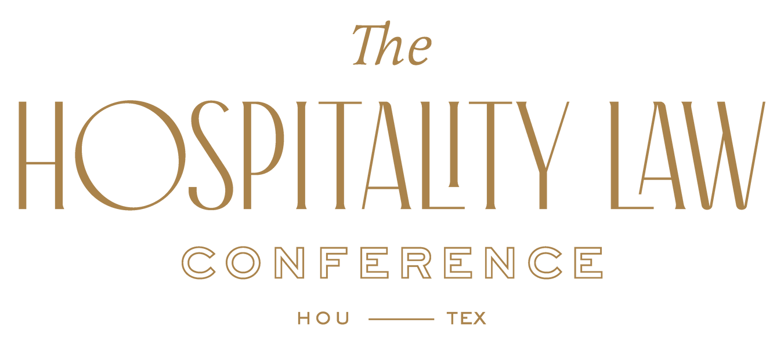
Arlington, Virginia
Hotel / Restaurant Safety & Security Risks to Owners, Operators & Insurance
Sal Caccavale, Principal Paul Frederick, Co-Founder
Global Hospitality Security Solutions, LLC Hospitality Security Advisors, LLC
Claire K. Robinett, Attorney
Hagwood & Tipton
October 12, 2022

Slide 2
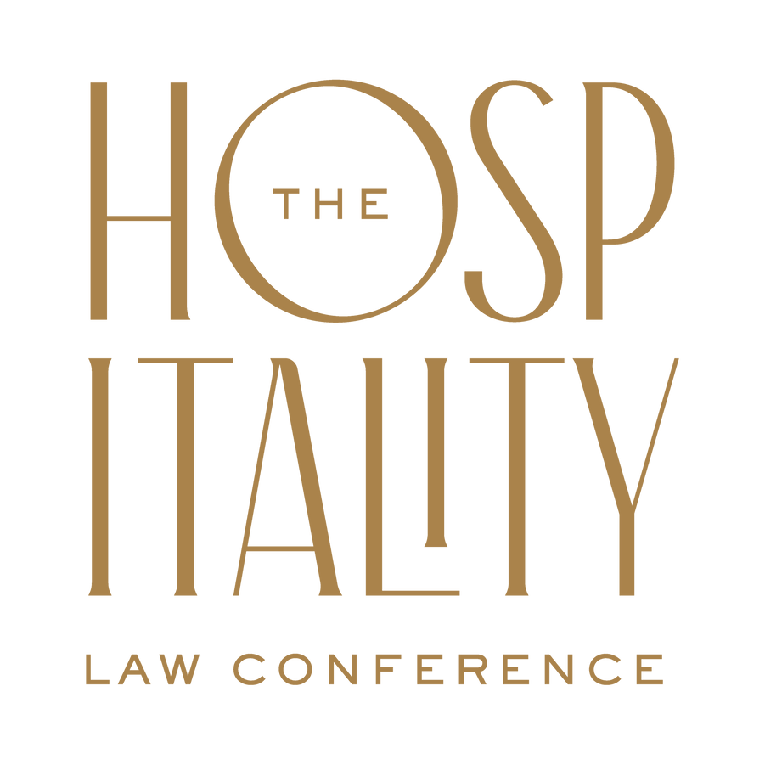
Hotel / Restaurant Safety & Security Risks to Owners, Operators & Insurance
Investment and Ownership Groups
Management Firms
Insurance Carriers
Franchisors

Slide 3
Hotel / Restaurant Safety & Security Risks to Owners, Operators & Insurance
Ownership Risk
Listed as Co-Defendants
Management Contract Exclusion
Counsel Motions to Release Other Parties
Notes:
Motion to Release ownership, brand or insurance leaves a singular party stranded to absorb the entirety of the claim.
Plaintiffs could be successful keeping owner in lawsuit if they can prove the owner refused to spend $$ on important safety issues.

Slide 4
Management Company Exposure
Contractually Obligated
Duty of Care
Workers Typically Under Management Employ
Notes:
Duty of care presents a peculiar security problem of its own. Having the means necessary to fulfill this obligation varies with the circumstances of each case - Wisconsin SUPREME Court in Peters v. Holiday Inns, Inc. (1979). Where employees are under the employ of the management firm, the firm absorbs those actions, financially and legally.

Slide 5
Litigated Hotel Cases
Marchionda v. John Q. Hammons Management, LLC and Atrium TRS, LP
Incident Date: 04/2014 Settlement Date: 02/13/2019 Settlement: Confidential
Embassy Suites – Hilton Franchise
John Q. Hammons – Management Company
Atrium TRS – Owner
* Plaintiff only sued management company and owner
Notes:
Incidents involving front desk issuing guest room keys to non-registered persons to an occupied room. Have ALL employees received training on how to report suspicious situations?

Slide 6
Insurance Exposure
Insurance Experience
Legal Fees
Ownership & Control of Claim
Impact of Litigation
Notes:
Causations, in part: vulnerable guest room door lock systems; inadequate ID of persons requesting guest room keys; lack of surveillance in common areas; insufficient lighting, fencing, walkways, inadequate security personnel and guest room security devices; poor or no preemployment screening program.
Important policies enforced for proper subrogation of claims.

Slide 7
Litigated Hotel Cases
Kathleen Dawson v. Hilton Management, LLC
Incident Date: 03/12/2017 Verdict Date: 11/23/2021 Jury Award $44m
Hilton Houston Americas
Hilton Managed
City of Houston (Houston First Corporation) – Owner
* No litigation against the Houston Police Dept or the owner of hotel City of Houston
Notes:
Incidents involving front desk issuing guest room keys to non-registered persons to an occupied room. Have ALL employees received training on how to report suspicious situations?

Slide 8
Franchisor Exposure
Brand Standards/Guidelines
Degree of Distance with Franchisee
Level of Policy Enforcement
Reputation
Notes:
Brand Standards are often vague or broad in description to cover multiple codes or laws in many jurisdictions, not property specific. Regular Quality Assurance (QA) reviews are undertaken by the Brand, again, in broad terms, not specific to the property, to eliminate specific and granular guidance. Example – Most Security and Safety Brand Standards are Design and Technology related, ie. lighting, locks, doors, etc..
Many franchisees that do not have corporate security and safety guidance in this area leave themselves at risk for not developing policies and procedures.
The Brand Standards may state that the franchisee must have Emergency Procedures and Policies for guest privacy, but more than likely will not dictate what those policies should be.

Slide 9
Litigated Restaurant Cases
Wendy’s v. Anna Alaya
Incident Date: March 2005 Verdict Date: March 2016 Sentence: Confinement & Restitution
Wendy’s - Franchisor
Wendy’s Monterey Road, San Jose, CA - Franchise
Damages to Wendy’s alleged at $1,000,000.00 per day / $21 million total
Alaya had 13 previous civil actions in California and Nevada
Notes:
Incidents involving front desk issuing guest room keys to non-registered persons to an occupied room. Have ALL employees received training on how to report suspicious situations?

Slide 10
Considerations for All Stakeholders
Contracts and Reviews
Indemnity Clauses
Hold Harmless Agreements
Regular Review of Claims
Loss Control Prevention Reviews
Notes:
Image and milieu: If the image is negative, the property is stigmatized and its residents more likely to be victimized. If an area surrounding the hotel is perceived as an unsafe zone characterized by panhandlers, littering, and graffiti, this hotel will likely suffer a greater victimization risk than those in areas without such problem. Preparing workers to use individual panic devices while working in guest rooms.
LP audits to review exterior lighting, overgrowth of landscaping, anti-vortex covers in pools and hot tubs (diving boards, depth measurements, life saving equipment), remote exterior entrances are locked, guest room doors equipped and functioning with safety features, Innkeeper’s Act posted.
Brand Standards offer broad scope safety or security direction. Regardless, must be compliant. Are LP reviews looking for basic ADA Rule? Human trafficking training? Suspecting behavior, how and whom to report unusual activity. Innkeeper’s Act postings as directed by
Safety & Security reviews to assess fitness centers, pools, water parks, guest room security features, kitchens, laundry and housekeeping, telephone accessibility with Kari’s Law.

Slide 11
Litigated Hotel Cases
Erin Andrews v. Marriott International, et.al
Incident Date: 2008 Verdict Date: 03/07/2016 Jury Award: $55m
Marriott at Vanderbilt University - Franchise
Windsor Hotel Capital – Management Company
West End Hotel Partners – Owner
* Marriott Corporate was dismissed from the case.
Notes:
Incidents involving front desk issuing guest room keys to non-registered persons to an occupied room. Have ALL employees received training on how to report suspicious situations?

Slide 12
Considerations for All Stakeholders
Preparation & Education of Security Policies & Procedures
Compliance with Brand Standards
Liaison with Local Law Enforcement and Fire Officials
Enforcement of Risk Management Recommendations
Regular Loss Run Reviews
Notes:
Image and milieu: If the image is negative, the property is stigmatized and its residents more likely to be victimized. If an area surrounding the hotel is perceived as an unsafe zone characterized by panhandlers, littering, and graffiti, this hotel will likely suffer a greater victimization risk than those in areas without such problem. Preparing workers to use individual panic devices while working in guest rooms.
LP audits to review exterior lighting, overgrowth of landscaping, anti-vortex covers in pools and hot tubs (diving boards, depth measurements, life saving equipment), remote exterior entrances are locked, guest room doors equipped and functioning with safety features, Innkeeper’s Act posted.
Brand Standards offer broad scope safety or security direction. Regardless, must be compliant. Are LP reviews looking for basic ADA Rule? Human trafficking training? Suspecting behavior, how and whom to report unusual activity. Innkeeper’s Act postings as directed by
Safety & Security reviews to assess fitness centers, pools, water parks, guest room security features, kitchens, laundry and housekeeping, telephone accessibility with Kari’s Law.

Slide 13
WE APPRECIATE YOUR TIME AND ATTENTION!
Thank you!
Salvatore Caccavale, Principal
+ 480 272 4922
Sal@GlobalHospitality2S.Com
www.GlobalHospitalitySecurity.Com
Paul Frederick, CPP - President
+ 203-703-8321
paulf@hospitalitysecurityadvisors.com
http://www.hospitalitysecurityadvisors.com/
Claire K. Robinett , Attorney
Hagwood & Tipton
601 608 6208 dr | 601 362 3642 fx
www.hatlawfirm.com
3

