Slide 1
Hacking into Cyber Claims
Jessica A. Eldridge
Senior Vice President & Practice Director Of Cyber - Forensic Accounting

Slide 2
Jessica A. Eldridge
Senior Vice President &
Practice Director Of Cyber - Forensic Accounting
North Kingston, Rhode Island
Specialize in the financial evaluation of damages:
business interruption, extra expense, inventory claims, employee dishonesty/fidelity losses, personal injury, subrogation, and litigation support services
Key Expertise:
Cyber, Property Damage, Builder’s Risk & Soft Costs, Fee Funds, Stock & Contents, Lost Wages, Fidelity
Some Industry Experience :
Hospitality, Casinos, Colleges and Universities, construction, Government, Healthcare, Manufacturing, Professional Services, Retail

Slide 3
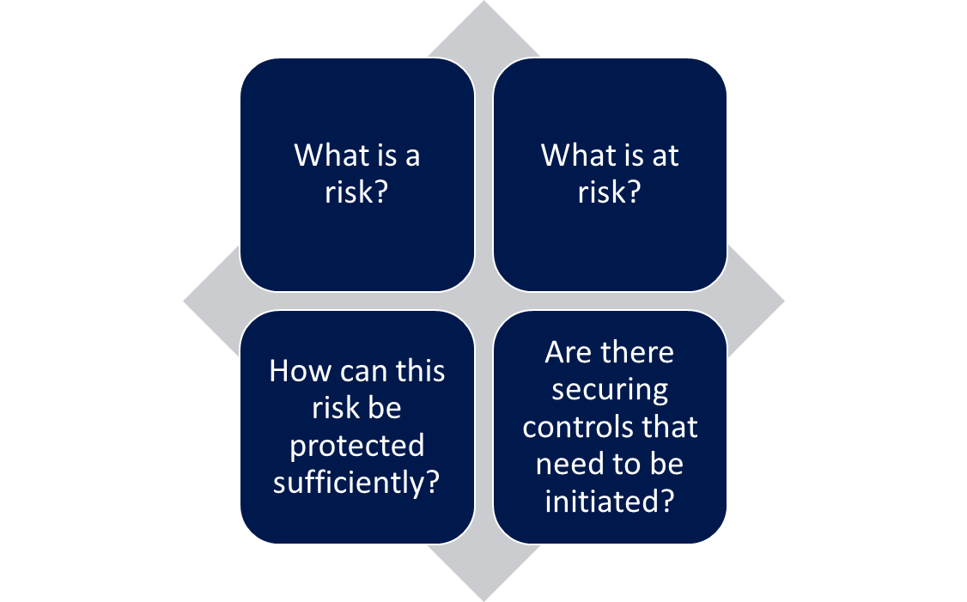
Have you experienced a Cyber attack within the last year?

Slide 4
The lifecycle…

Slide 5
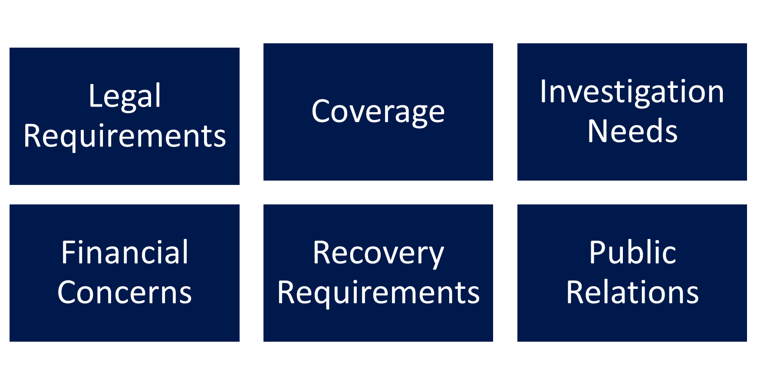
Initial Findings: What are the concerns

Slide 6
Business Interruption Loss Calculations
Understand: Loss, Policy Provisions & Insured’s Operations
Request Appropriate Records
Calculate Lost Revenue
Deduct Saved Costs & Include Extra Expenses
Apply Applicable Deductibles

Slide 7
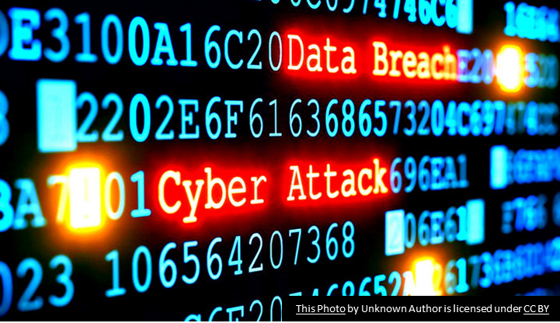
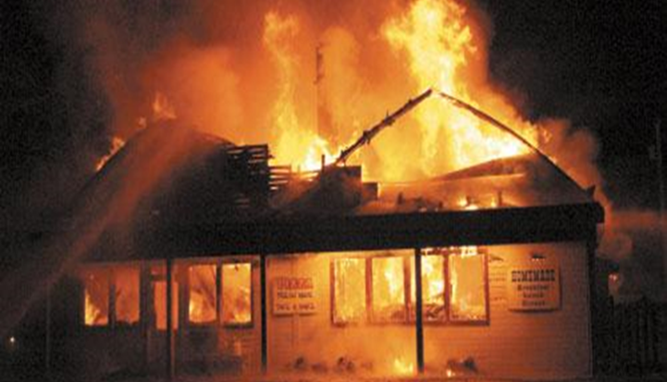
Similarities and Differences between Cyber and Non-cyber Claims

Slide 8
Closing & Questions

Slide 9
Jessica A. Eldridge
Senior Vice President & Practice Director Of Cyber –
Forensic Accounting
401-301-8565
jeldridge@jsheld.com

