Slide 1
Asking a Guest to Leave the Premises and Bias – How the 2018 Starbucks Incident Changed the Hospitality Industry
Rob Schnitz – Kabat Chapman & Ozmer, LLP

Slide 2
Rob Schnitz
Partner, Kabat Chapman & Ozmer, LLP
Chicago & Los Angeles
Former SVP/Associate General Counsel for Hyatt Hotels Corporation
Teaches Hospitality Law at DePaul University
General Counsel for the National Domestic Violence Hotline

Slide 3
What Happened at Starbucks?

Slide 4
Asking a Guest to Leave
Question
Did you know it’s against the law to discriminate against a customer based on their race?

Slide 5
Asking a Guest to Leave
Question
So, how did this happen?

Slide 6
Asking a Guest to Leave
The Answer Involves:
Shotguns
Highways
Woolworths
Alexander Graham Bell
Facebook
A guy named Ray Oldenberg

Slide 7
Shotguns: The Law of Trespassing

Slide 8
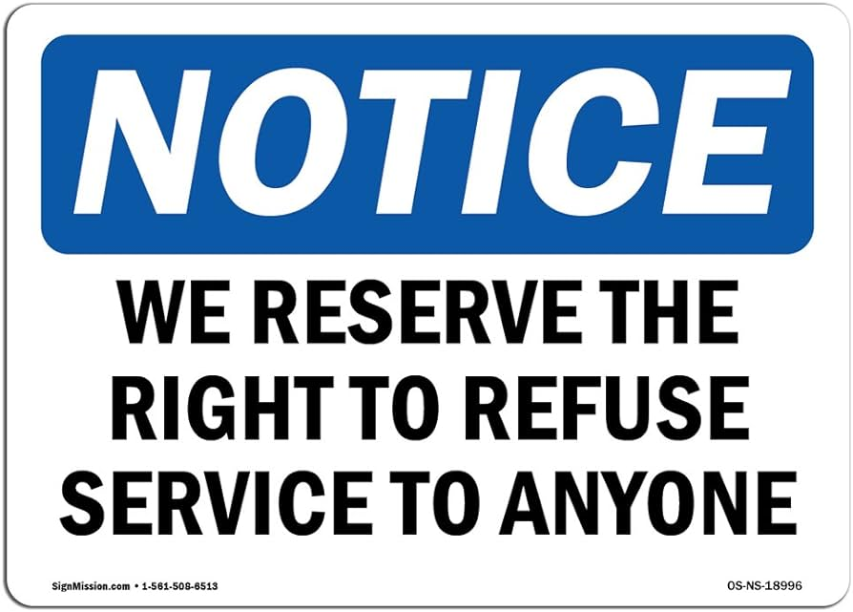
Welcome to our Establisment?

Slide 9
Highways and Woolworths
The Interstate Highway Act – 1956
The Civil Rights Act - 1964

Slide 10
Technology Changes Everything
Smart phones
Videos
Social Media

Slide 11
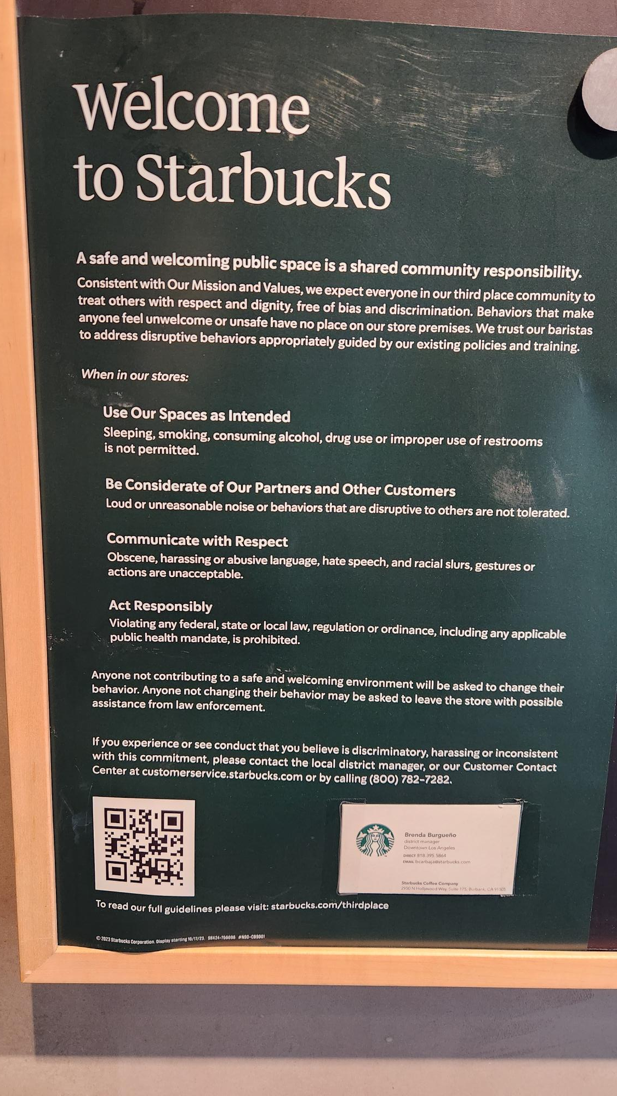
Ray Oldenberg – Third Spaces

Slide 12
Take Action
What does your invitation say?
Is staff/security trained on trespass?
Should you call the police?
Could bias be impacting the decision?
Do you conduct bias training?

Slide 13
Rob Schnitz
Kabat Chapman & Ozmer LLP
Atlanta, Chicago & Los Angeles
rschnitz@kcozlaw.com
312-282-3699

