Slide 1
National Labor Relations Board Update: What Hospitality Employers Should Be Focused On
Robert T. Bernstein

Slide 2
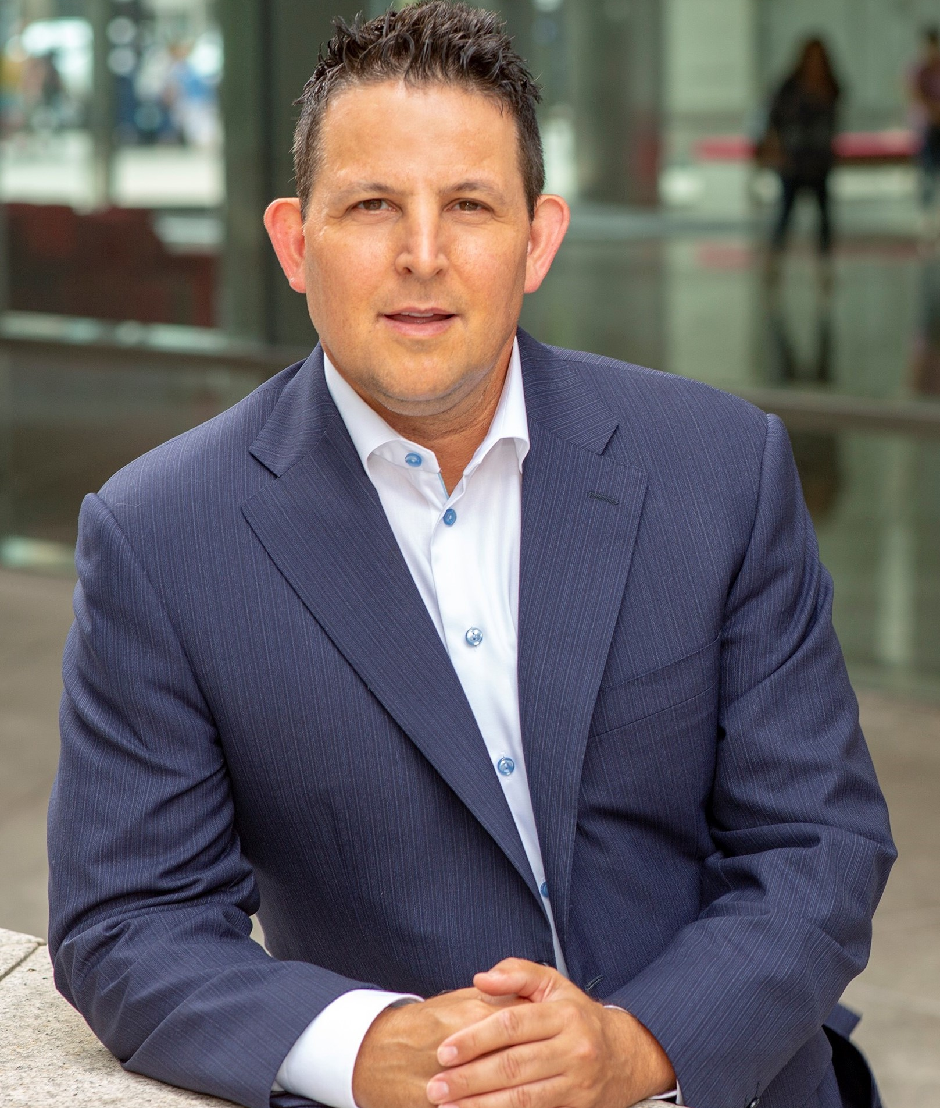
Robert T. Bernstein
Partner, Laner Muchin, Ltd.
515 N. State Street, Suite 2400, Chicago, IL 60654
Equity partner with Laner Muchin in Chicago.
Legal practice concentrated in handling a variety of employment and traditional labor matters and disputes, as well as collective bargaining negotiations, on behalf of management.
Advisory Council Member and presenter for the Illinois Restaurant Association and active member and presenter on behalf of the Illinois Hotel & Lodging Association.

Slide 3
Biden Years were good for Unions
• Unions won 79% of all elections in2024, up from 76% during 2023.
• The number of election petitions increased to 3,286 during 2024 compared to 2,593 for 2023.
• Unfair labor practice charges rose to 21,292 during 2024, an increase from 19,869 during 2023.
• Well-publicized union successes at the bargaining table
- 38% in pay increases over four years at Boeing
- 61% in pay increases over six years for dock workers

Slide 4
Current Status of Union Membership (Highlights from US Bureau of Labor Statistics 2024)
16 million workers are represented by a union (little change from 2023).
11% of workers are represented by a union (little change from 2023).
32% of public-sector workers
6% of private-sector workers (a decline of 184,000, offsetting an increase in 2023.
The highest unionization rates are in education, training, and library occupations (32.3 percent) and protective service occupations (29.6 percent).
Men continue to have higher union membership rate (10.2 percent) than women (9.5 percent).
Black workers remain more likely to be union members than White, Asian, and Hispanic workers.

Slide 5
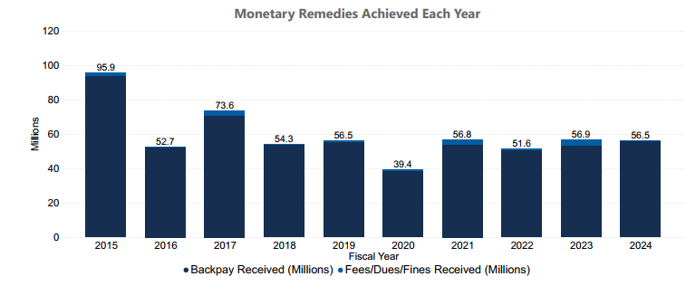
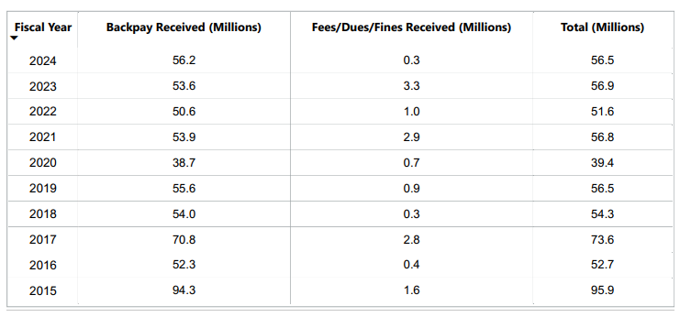
Statistics provided on www.nlrb.gov

Slide 6
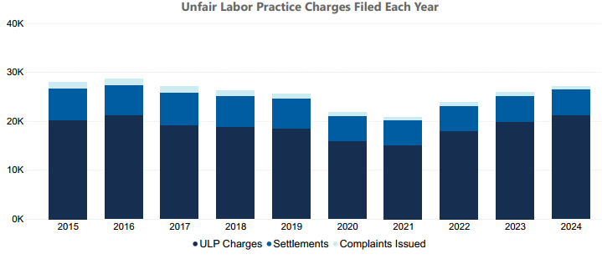
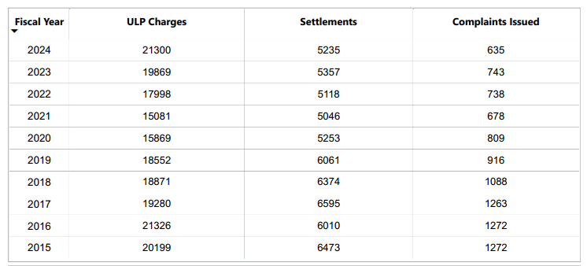
Statistics provided on www.nlrb.gov

Slide 7
A quick primer on the National Labor Relations Board
The NLRB has federal preemption over all private sector union matters.
Applies to union and non-union workplaces.
Five Board Members
Appointed by the President and confirmed by the Senate.
Typically, three members are from the President’s party; the remaining two members from the opposition party.
Members typically serve staggered 5-year terms.
Regional Offices and Administrative Law Judges address day-to-day unfair labor practice charges and union representation petitions.
Current Board members are:
Chair Marvin Kaplan (Republican) – term expires Aug. 2025
David M. Prouty (Democrat) – term expires Aug. 2025.

Slide 8
The NLRB General Counsel
The Prosecutor who functions independently from the Board.
investigating and prosecuting unfair labor practice cases
Oversees the NLRB’s regional offices –
Providing direction about which kinds of cases to prosecute and which issues to prioritize.
Although the Board adjudicates cases, the General Counsel determines which cases to prosecute and provides guidance on legal interpretations
Appointed by the President for a four-year term with Senate consent
On Jan. 27, President fired Biden GC Jennifer Abruzzo and appointed William Cowen to serve as Acting GC.
On March 25, Crystal Carey nominated as new General Counsel
Attorney from Morgan Lewis which represents Amazon for labor matters.
Awaits senate confirmation

Slide 9
Current Status of NLRB
No Quorum
Powerless to adjudicate cases or set (or overturn) legal precedent or policy.
Quorum = 3 members
Dozens of ALJ cases are “Pending Board Decision”
Biden NLRB regulations and precedent remain in effect nationwide.
The last time Board lacked quorum was Jan. 2012 through Aug. 2014.
BUT Regional Offices and Administrative Law Judges are still functioning
Regional Offices continue to accept and process unfair labor practice charges and representation petitions, and pursuant to existing procedures, regions can take action in federal court, including seeking Section 10(j) injunctive relief.
On April 15, two DOGE employees were detailed to the NLRB agency from the General Services Administration “part-time for several months” and are working largely remotely.

Slide 10
NLRB under the Trump Administration
Acting GC Cowen rescinded twenty-nine prior General Counsel Memoranda, most of which were issued during the Biden administration. This includes memoranda regarding:
Remedies for ULPs
Noncompete and other restrictive covenants
Severance agreements
Mandatory employer meetings,
Status of college athletes,
Electronic and algorithmic employee monitoring.
Pay attention to state laws
Acting GC Cowen’s view is NLRA preemption does not allow states to regulate areas that NLRB regulates – e.g. state anti-captive audience laws.
It is unclear whether NLRB will assist the Cal. Chamber and California Rest. Assn. lawsuit challenging the California Captive Audience Meeting ban set forth under CA law. (Illinois too. )
Acting GC Bill Cowen is a big proponent of settlement and plans to re-empower Regional Directors to handle settlement.
• Approximately 30 of approximately 1300 NLRB employees accepted the first deferred resignation program. Stay tuned.
• Federal Mediation and Conciliation Service no longer offering mediation services for bargaining.

Slide 11
Constitutional Challenge to NLRB
Amazon, SpaceX, USC, Trader Joe’s have all alleged unconstitutionality.
First Challenge: Presidential right to remove NLRB Members without “cause.” The 1935 Wagner Act states that Board members may only be removed “for neglect of duty or malfeasance in office, but for no other cause.”
Second Challenge: Presidential constitutional right to remove Administrative Law Judges without cause and employer constitutional right to a jury trial.
Unprecedented removal of NLRB Member Gwynne Wilcox without “cause”:
Fired soon after GC Abruzzo fired.
Her term was set to expire in 2028
President Trump has asserted “for cause” termination violates the Constitution’s “Take Care” clause, which vests the authority to remove principal officers in the executive branch.
Although the Supreme Court upheld limits on a president’s ability to oust similar officers in 1935 Humphrey’s Executor more recent decisions have called this ruling into question
On April 9, 2025, the Supreme Court issued a brief order, staying the District Court’s order reinstating Wilcox. No reasoning given.
Could affect other agencies.
Federal Reserve Board Chair Jerome Powell - “It’s a situation that we’re monitoring carefully . . . That’s a case that people are talking about a lot. I don’t think that that decision will apply to the Fed, but I don’t know.”

Slide 12
Predictions
After the Dust Settles:
There will be a Republican Board with drastically differently policies and decisions; consistent with historical political cycles.
NLRB and General Counsel will start issuing pro-management policies, directives and decisions (and rescinding those from Biden era):
Ordering union recognition without an election will be rare;
Work rules and handbook policies will not face such heightened scrutiny;
Captive audience speeches will be allowed;
Internal NLRB financial and staffing issues will continue / grow
Regional Offices of the Board are over-worked and this will only get worse if budget takes a major hit.
Case processing will slow down and Regions may be more willing to settle on favorable terms with employers.

Slide 13
A Wildcard?
Teamsters and UAW vocal support for tariffs, and Teamsters decision not to endorse in presidential election.
To reward Teamsters for not endorsing Harris, President Trump nominated Lori Chavez-DeRemer as Secretary of Labor, a supporter of expanding union rights.
Trump pushed to settle longshoremen strike.
Senators Cory Booker (D-NJ) and Josh Hawley (R-MO) led a bipartisan group introducing legislation to speed up first contracts for new unions.

Slide 14
UNITE HERE remains active
October 2024:
2,000 San Francisco hotel workers on strike – including at the Palace Hotel
Hotel workers went on waves of strikes in Boston, Strikes affected hotels like Hilton Boston Logan Airport, Hilton Boston Park Plaza, and Omni Parker House
4,400 Hilton, Hyatt, and Marriott hotel workers were on strike nationwide.
March 10, 2025:
500 food service and hospitality workers at Northwestern University went on strike. Higher education and associated service providers remain a hotbed of union activity.
April 24, 2025:
UNITE HERE and Houston city leaders announced an initiative to advocate for a $23 minimum wage for hospitality workers

Slide 15
Recent Hospitality NLRB Cases
Yotel Boston v. UNITE HERE Local 26 (January 13, 2025) (Boston)
ALJ found hotel unlawfully withdrew recognition of union
Hotel received petition with signatures of 19 of 27 bargaining unit employees requesting to leave the union.
Hotel ordered to bargaining with union and barred from challenging majority status for a period of time.
Lodi Café v. Restaurant Workers Union (New York City)
Celebrity chef and hotel consortium – joint employers
Union challenged election loss
ALJ rejected most allegations but found employer violated NLRA by:
(a) Telling employees that management know about their text messages, social media posts, or other communications relating to union or other protected activities.
(b) Soliciting employees’ complaints and offering to remedy them

Slide 16

Robert T. Bernstein, Partner
Laner Muchin, Ltd.
515 N. State Street, Suite 2400
Chicago, IL 60654
(312) 467-9800
rbernstein@lanermuchin.com

