Slide 1
Fraud Uncovered: Five Case Studies in Hotels and Restaurants
Juliette Gust

Slide 2
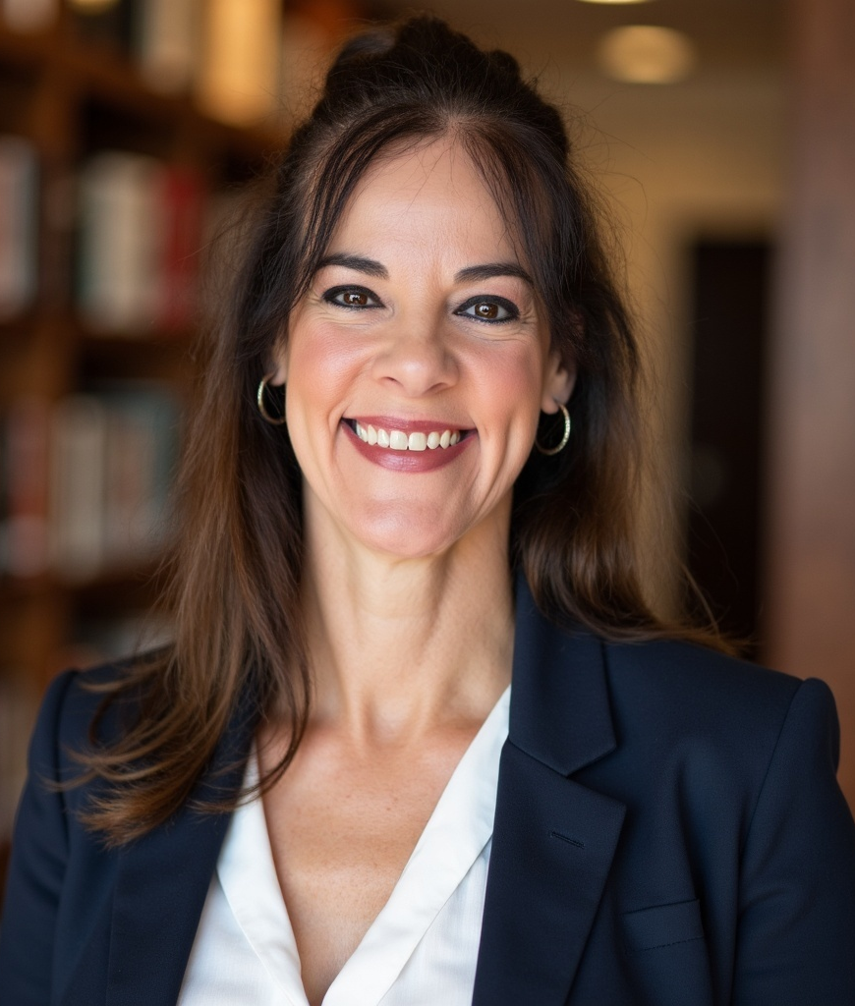
Juliette Gust
CO-FOUNDER & PRESIDENT, ETHICS SUITE
Scottsdale, AZ
Former global Director of Fraud Investigations for Starwood Hotels & Resorts, with ~180,000 employees in more than 100 countries
Provider of an anonymous employee reporting and case management system and related consulting services. Hotline subscribers in more than 90 countries representing 20+ industries
Certified Fraud Examiner since 2007 - has advised on more than 11,000 employee ethics line reports and led more than 2,200 investigations spanning 75 countries
Former manager/GM/Multi-Unit GM with Carlson Restaurants, Dave & Busters, The Cheesecake Factory, Broadway Restaurants, Caesars Palace, Rio Suites

Slide 3
A Vulnerable Industry
Diverse revenue streams
High volume
Cash and credit transactions
Average employee turnover rate of 80%+
Employees who engage in unethical or illegal behavior influence others to participate in similar misconduct. Theft peer effects on new employees are strongest in the first month of employment.**
Manager intervention only when theft is repeated and substantial.**
*https://modernrestaurantmanagement.com/finding-solutions-for-top-barriers-to-qsr-stability//
**https://static1.squarespace.com/static/5a80912b29f18728e17d5164/t/5d94ac1c305d4917a63220c8/1570024482749/PeerCheatPost.pdf

Slide 4
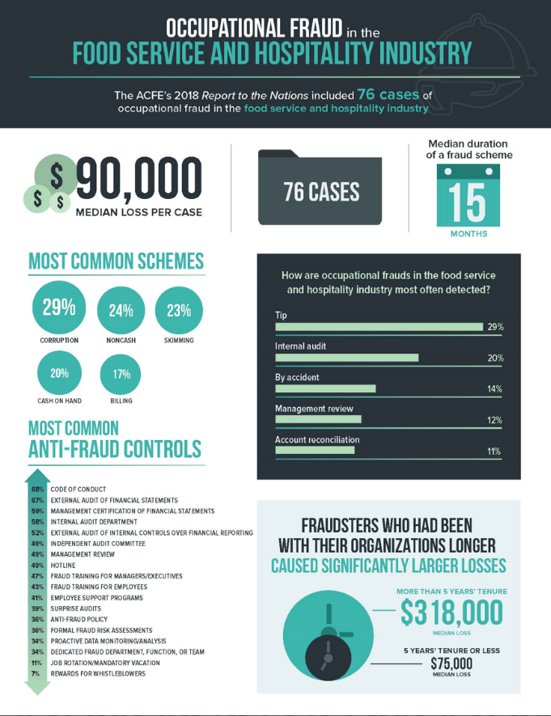
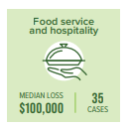
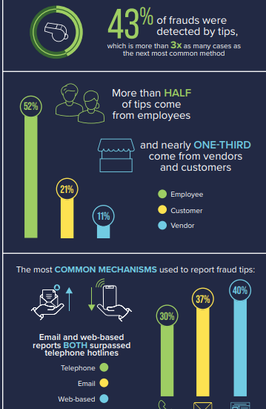
Current Impact
Each instance of fraud cost roughly $90,000 and lasted 15 months before it was identified.
Lack of reporting options for employees to report concerns about fraud.
2019 Report to the Nations on Occupational Fraud and Abuse. Copyright 2019 by the Association of Certified Fraud Examiners, Inc.
Notes:
Partner gave owner $10k gift
Misallocated expenses from restaurant to restaurant

Slide 5
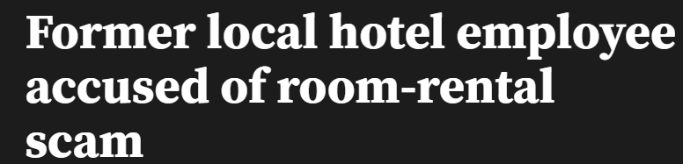
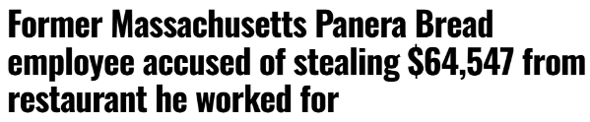
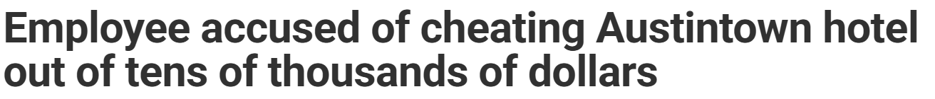
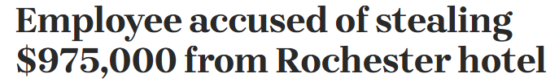
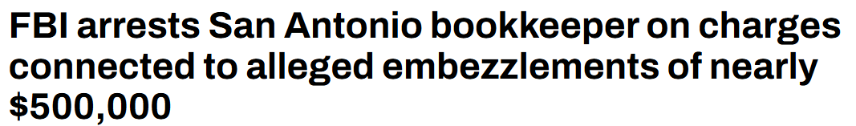
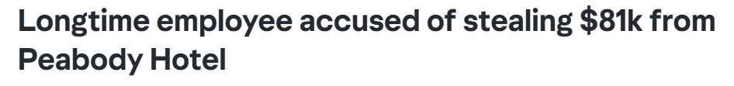
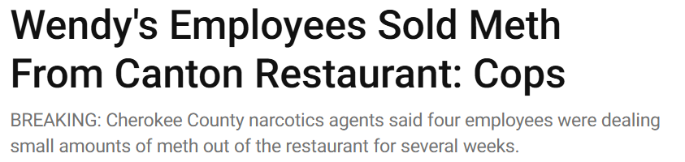
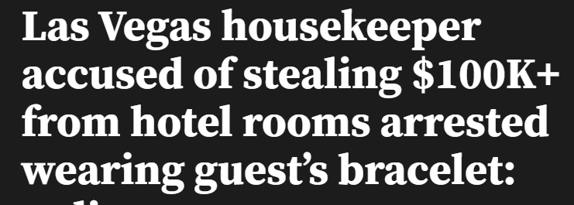
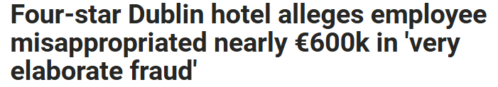
Current Incidents

Slide 6
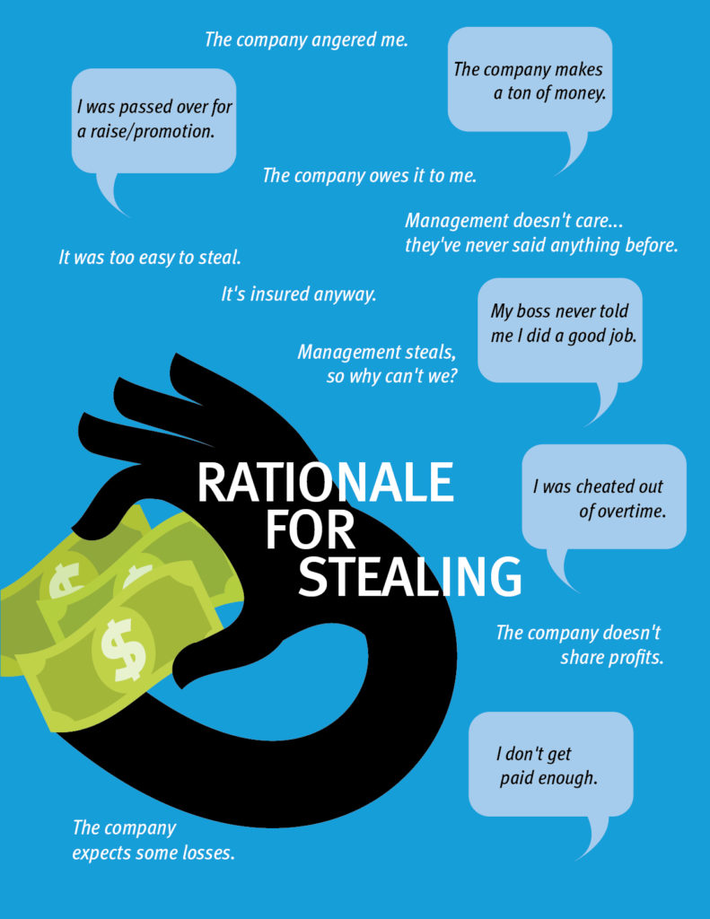


Understanding the Fraud Triangle
The best and most widely accepted model for explaining why people commit fraud is the fraud triangle, developed by criminologist Dr. Donald Cressey, whose research focused on people he called “trust violators.”

Slide 7
What Can We Do?
Restaurant employees who engage in unethical or illegal behavior influence others to participate in similar misconduct:
Review onboarding and training materials;
Give each employee a variety of options for reporting witnessed misconduct or theft as part of the onboarding process and refresh at least annually; and
Ensure that ALL reports are addressed promptly.
Look for Red Flags:
Employee lifestyle changes: expensive cars, jewelry, homes, clothes.
Refusal to take vacation or sick leave.
Vendors / suppliers will only deal with this individual.
Consider the “Fraud Triangle”:
Know your staff and their needs.
Internal controls, segregation of duties, surprise audits and spot checks.
Leaders involved in Code of Conduct training and discussions about the value of integrity.

Slide 8

The Great Sea Cucumber Caper
Hotel imported North Korean sea cucumbers for their food and beverage operations.
Potential violation of U.S. Office of Foreign Asset Control and United Nations Security Council sanctions, and Countering America’s Adversaries Through Sanctions Act (CAATSA) enacted in 2017, imposes fines on companies importing products made by North Korean labor.
Human rights issues with North Korean workers involved in production, including forced labor and physical and sexual abuse.
Export of labor and goods to raise funds for its weapons programs prohibited.
General Manager and Executive Chef claimed that discerning guests demanded the product.
The issue was identified by an anonymous tip.

Slide 9
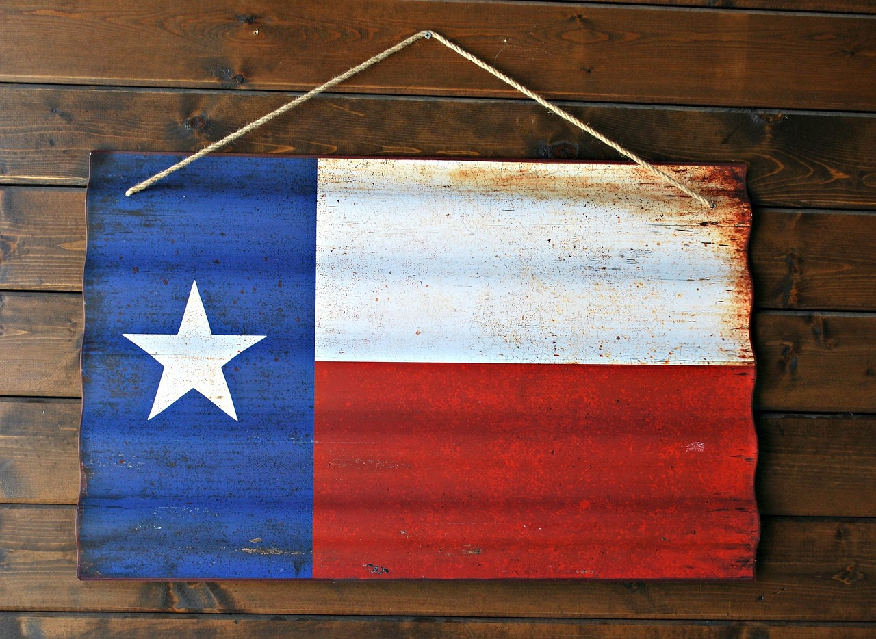
The Best Little Housekeeping Supervisor in Texas
A Housekeeping Supervisor “hired” 33 ghost employees, which were paid more than $3M over a three-year period.
In addition, the Supervisor collected SSNs and used them to record actual employees working overtime under different names - and without paying overtime rates.
The Supervisor was a much-loved and trusted employee. They were given awards and offers for promotion, which were turned down because “I love my job.”
The ghost employees were “hired” by a third party using the information provided by the Supervisor, and the third party allowed the Supervisor to schedule the employees and distribute their paychecks.
Identified because the Supervisor forgot to change the names of those employees working with two SSNs for one pay period, leading to significant overtime costs and scrutiny from the hotel controller.

Slide 10
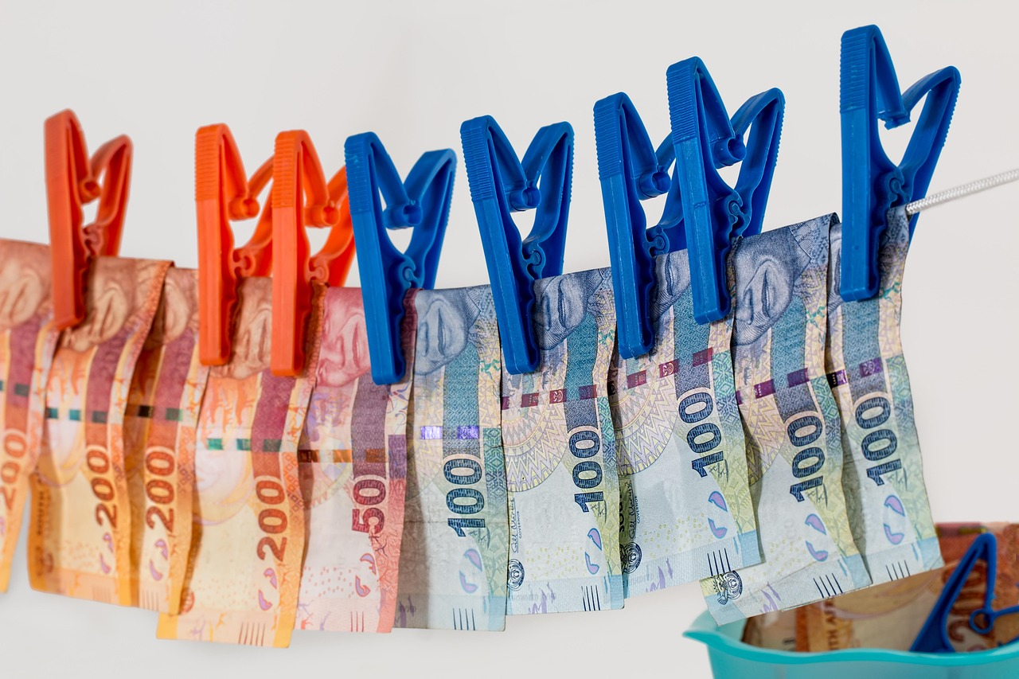
Mexican Money Bags
Mexican government official on vacation in the U.S. reserved several rooms for family and friends and paid in advance by wire transfer.
During their stay, a member of the family approached the front desk with a pillowcase full of cash and asked to add the additional amount to their folio, even though they already had paid more than was currently owed.
The Front Desk accepted the money and added it to the folio.
The guest then asked for the overage to be wired back to Mexico, which the DOF attempted but mis-typed the account number. Only then was the GM alerted because of the failed wire.

Slide 11

Whatever Guest Wants, Guest Gets
A meeting planner for a federal and state funds grantee requested that all food and beverage items be invoiced as audio/visual items because the grant funds were not permitted to be used for food and beverage.
Meeting sales staff for two hotels agreed to this process.
Identified through an anonymous tip.
Sales personnel stated that “unless the CEO himself tells me not to do something for a guest” they will do it.

Slide 12
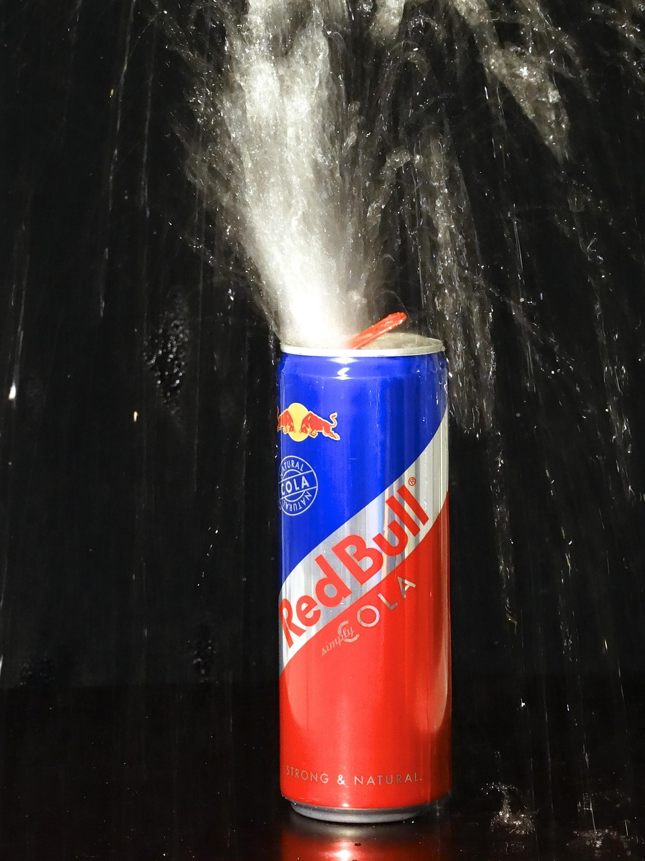
A Load of Bull
Hotel gift shop employee cash theft of more than $1M.
Employee increased inventory counts to cover shortfalls.
Inventory counts showed 28,000 Red Bull cans and 26,000 Red Baron Pizza boxes.
Employee was allowed to operate without oversight.
Petty cash counted upon employee’s departure also short funds.
Had anyone looked at the inventory counts even once, it would be obvious that the (very) small gift shop storage area couldn’t possibly fit so much inventory.

Slide 13

Juliette Gust, President
jgust@ethicssuite.com
www.ethicssuite.com
Social = @ethicssuite

