Slide 1
100 Top Hospitality Cases 2024-2025
Karen Morris, Esq. and Diana S. Barber, JD

Slide 2
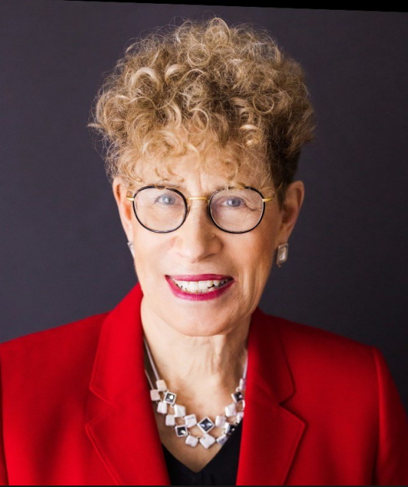
Karen Morris
Municipal Judge, Professor, Lawyer
Author, Hotel, Restaurant and Travel Law: a Preventative Approach
Columnist, Hotel Management Magazine

Slide 3
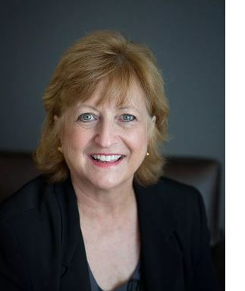
Diana Barber
Lecturer, Georgia State University
Co-Author, Hospitality Law w/ Stephen Barth
Columnist, Georgia Hotel & Lodging Association

Slide 4

Americans with Disabilities Act
#2 Washburn v. Mesquite Gaming, LLC

Slide 5

Contracts
#14 Virgin Hotels San Francisco, LLC v. 250 Fourth Development

Slide 6

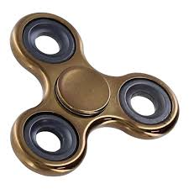
Arbitration
#10 Unite Here Local v. Chicago Hotel Collection

Slide 7

Contracts
#15 Bre Hotels & Resorts LLC v. Ace American Insurance Co.

Slide 8

Discrimination (Public Accommodation)
#20 Mosely v. Marriott International, Inc.

Slide 9

Employment (Discrimination)
#27 Johnson v. The Westin NY at Times Square/Marriott International, Inc.

Slide 10

Discrimination (Public Accommodation)
#21 Powells v. 1600 West Loop South, LLC.

Slide 11


Negligence (Assumption of Risk)
#65 Joyner v. Drury Hotels Co., LLC

Slide 12

Diversity Jurisdiction (Amount in Controversy)
#25 Vahle v. Choice Hotels

Slide 13

Negligence (Negligent Hiring)
#66 Turrentine v. Super 8 Belleville, Wyndham Hotels & Resorts

Slide 14

Employment (FLSA)
#35 Spears v. Bay Inn & Suites Foley, LLC

Slide 15

Negligence (Food)
#69 Whitlock v. Whataburger #481

Slide 16


Expert Testimony
#48 Faxel v. Wilderness Hotel & Resort v. ProSlide

Slide 17

Negligence (Slip & Fall)
#78 Dipaolo v. Fairmont Olympic Hotel

Slide 18
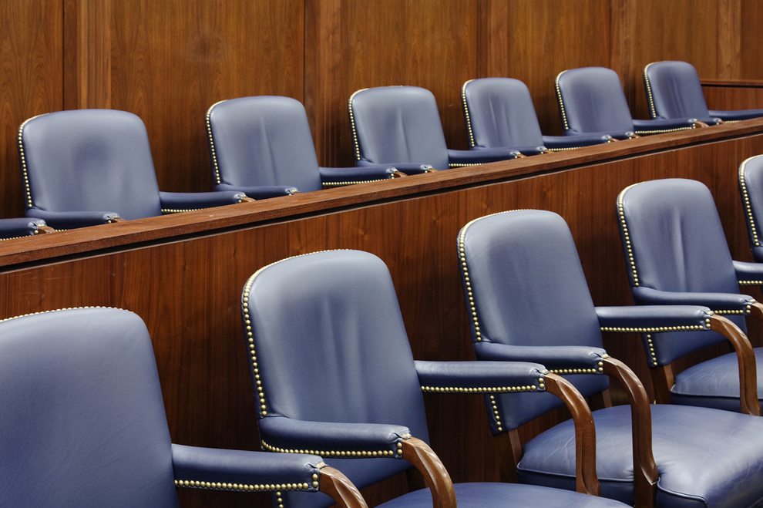

Franchise Agreements
#58 Covington v. Dickey’s Barbecue Restaurant, Inc.

Slide 19

Negligence (Slip & Fall)
#80 Castanda v. Waterford Hotel Group, LLC

Slide 20
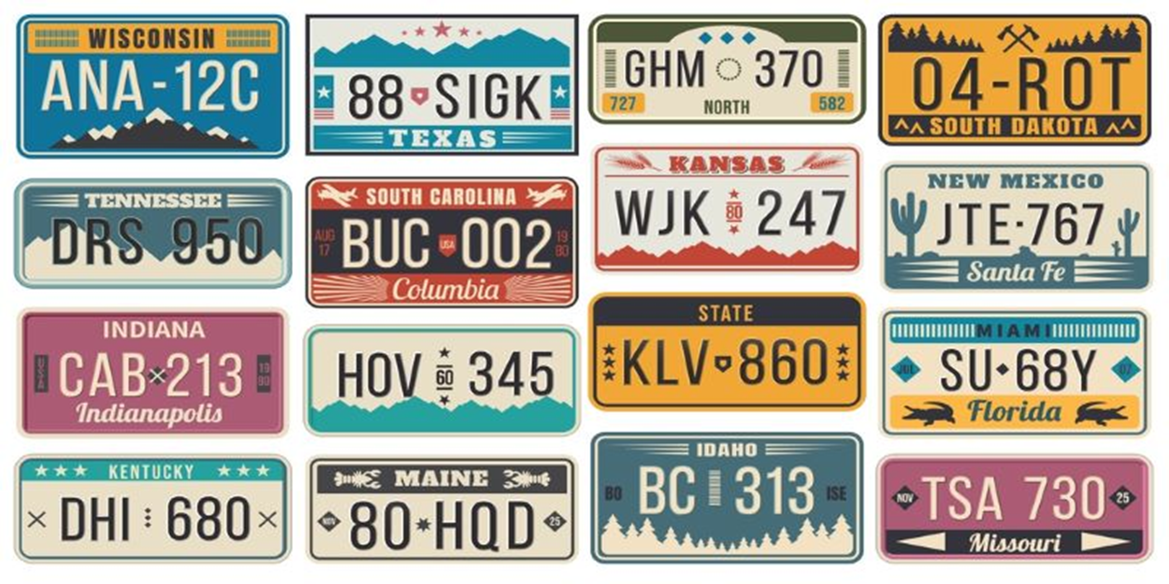
Jurisdiction
#62 Martin v. Holiday Inn Hotel & Suites

Slide 21

Standing
#89 Travelers United, Inc. v. Hyatt Hotels Corp.

Slide 22

Negligence (Infliction of Emotional Distress)
#67 Scheffer v. Jamerson

Slide 23

Trafficking (Sex/Human)
#97 Doe v. Wyndham Hotels & Resorts, Inc.

Slide 24
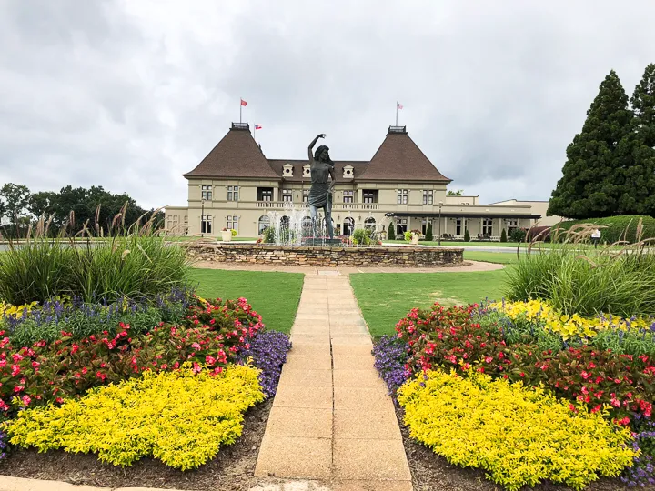
Venue
#100 Filsoof v. Wheelock Street Capital, LLC

Slide 25

Diana & Karen

