Slide 1
Emotional Intelligence for Lawyers and Entrepreneurs
Stephen Barth

Slide 2

Stephen Barth
FOUNDER, HOSPITALITYLAWYER.COM
HOUSTON, TX
Author of Hospitality Law and coauthor of Restaurant Law Basics.
An attorney and Founder of HospitalityLawyer.com, the annual Hospitality Law Conference series, and the Global Travel Risk Summit Series.

Slide 3


Breathe
Notes:
Health span vs life span

Slide 4

Notes:
Hotel bath tubs
Revenue management alienates our customers and turns them into competitors

Slide 5

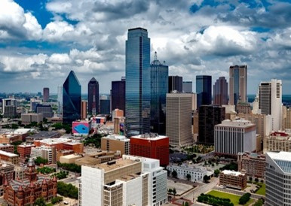

Mr. Jake

Slide 6

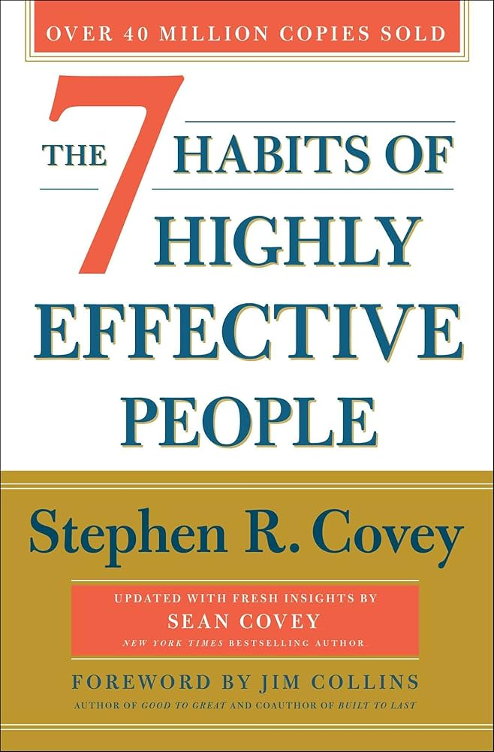

Trust

Slide 7
SELF-ADVANCING
or
PUTS THE ORGANIZATION FIRST

Slide 8
Owners
General Managers
Supervisors
Employees
Customers

Slide 9
Customers
Employees
Supervisors
General Managers
Owners

Slide 10

People
&
Culture

Slide 11

ARTIFICIAL INTELLIGENCE

Slide 12

MACHINE LEARNING

Slide 13
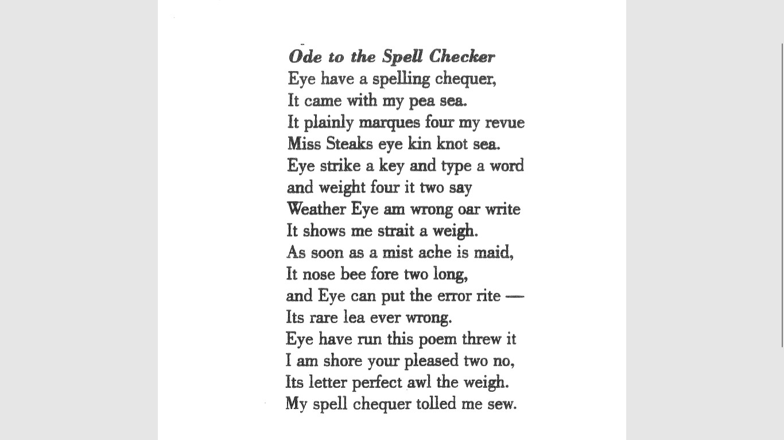

Slide 14
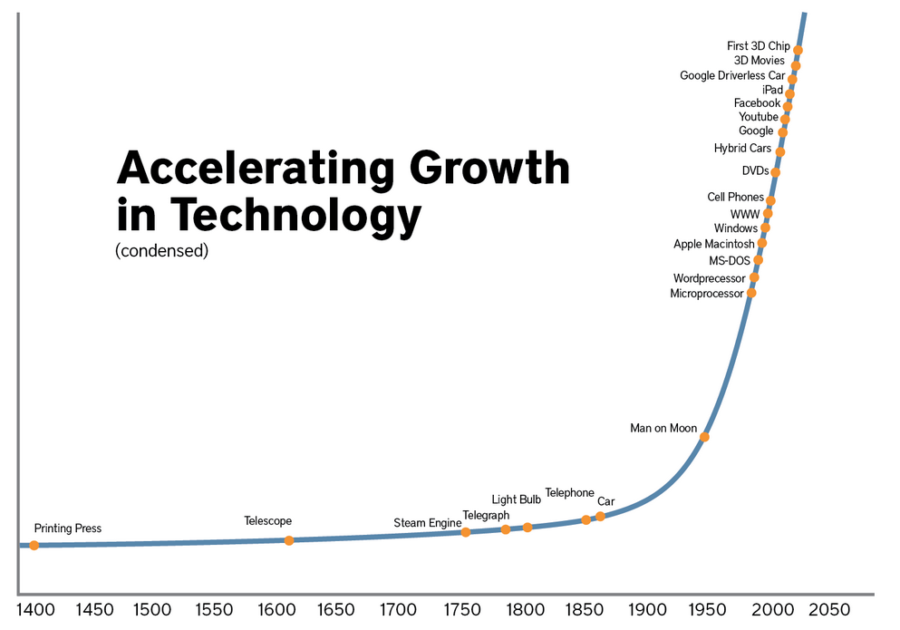
AI
Streaming
The Cloud
Exponential Progression of Technology

Slide 15
Infinite Variables
but
the Primary Constant is Change

Slide 16
Enhanced Personal and Professional Relationships for Lawyers and Entrepreneurs
EI
=

Slide 17

Cost
One Minute a day
Notes:
Add a digital clock with 1 minute – bring on a click

Slide 18
Rescript - from our habitual reactions currently embedded in our subconscious - into proactive responses

Slide 19
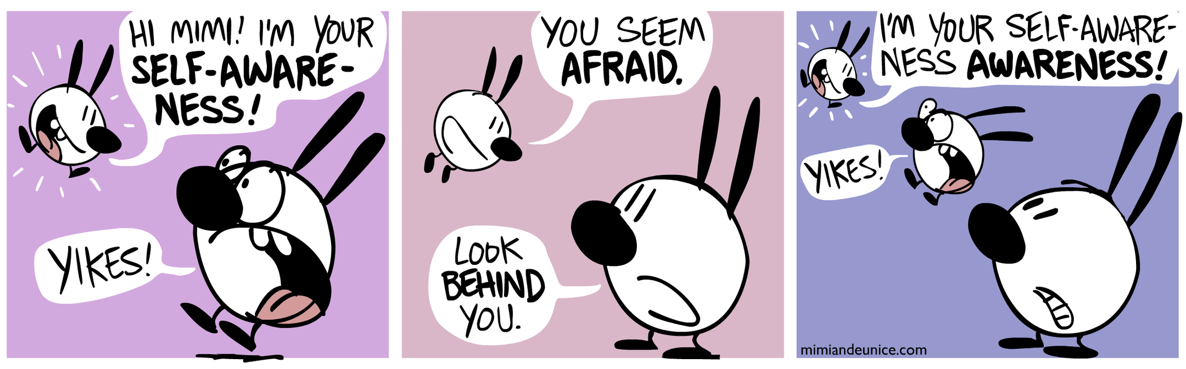
SELF AWARENESS
OUR EMOTIONS
OUR REACTIONS
EMOTIONAL COMPETENCE

Slide 20

SELF MANAGEMENT
Emotions do not interfere with progress
Be pro-active instead of reactive
Recover from emotional distress
RESILIENT
EMOTIONAL COMPETENCE

Slide 21
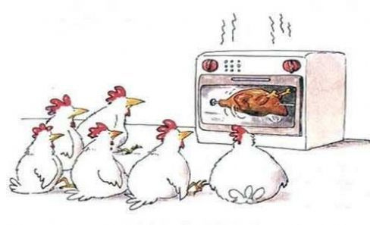
SOCIAL AWARENESS
Empathy: Listening and Understanding Others’ Points of View
EMOTIONAL COMPETENCE

Slide 22
LISTENING

Slide 23
CONFLICT RESOLUTION

Slide 24
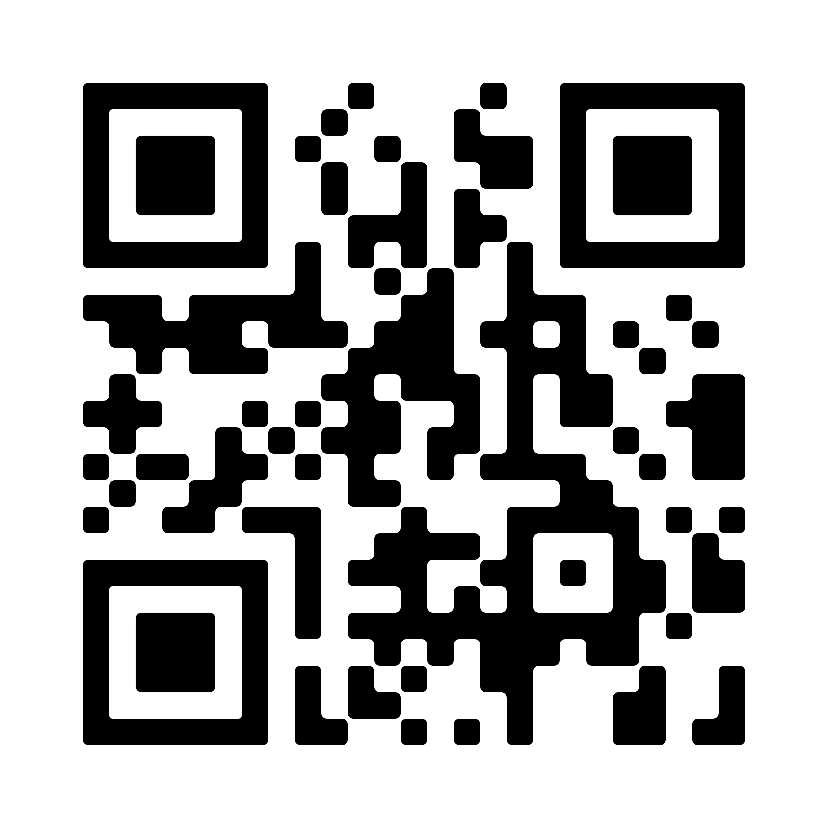
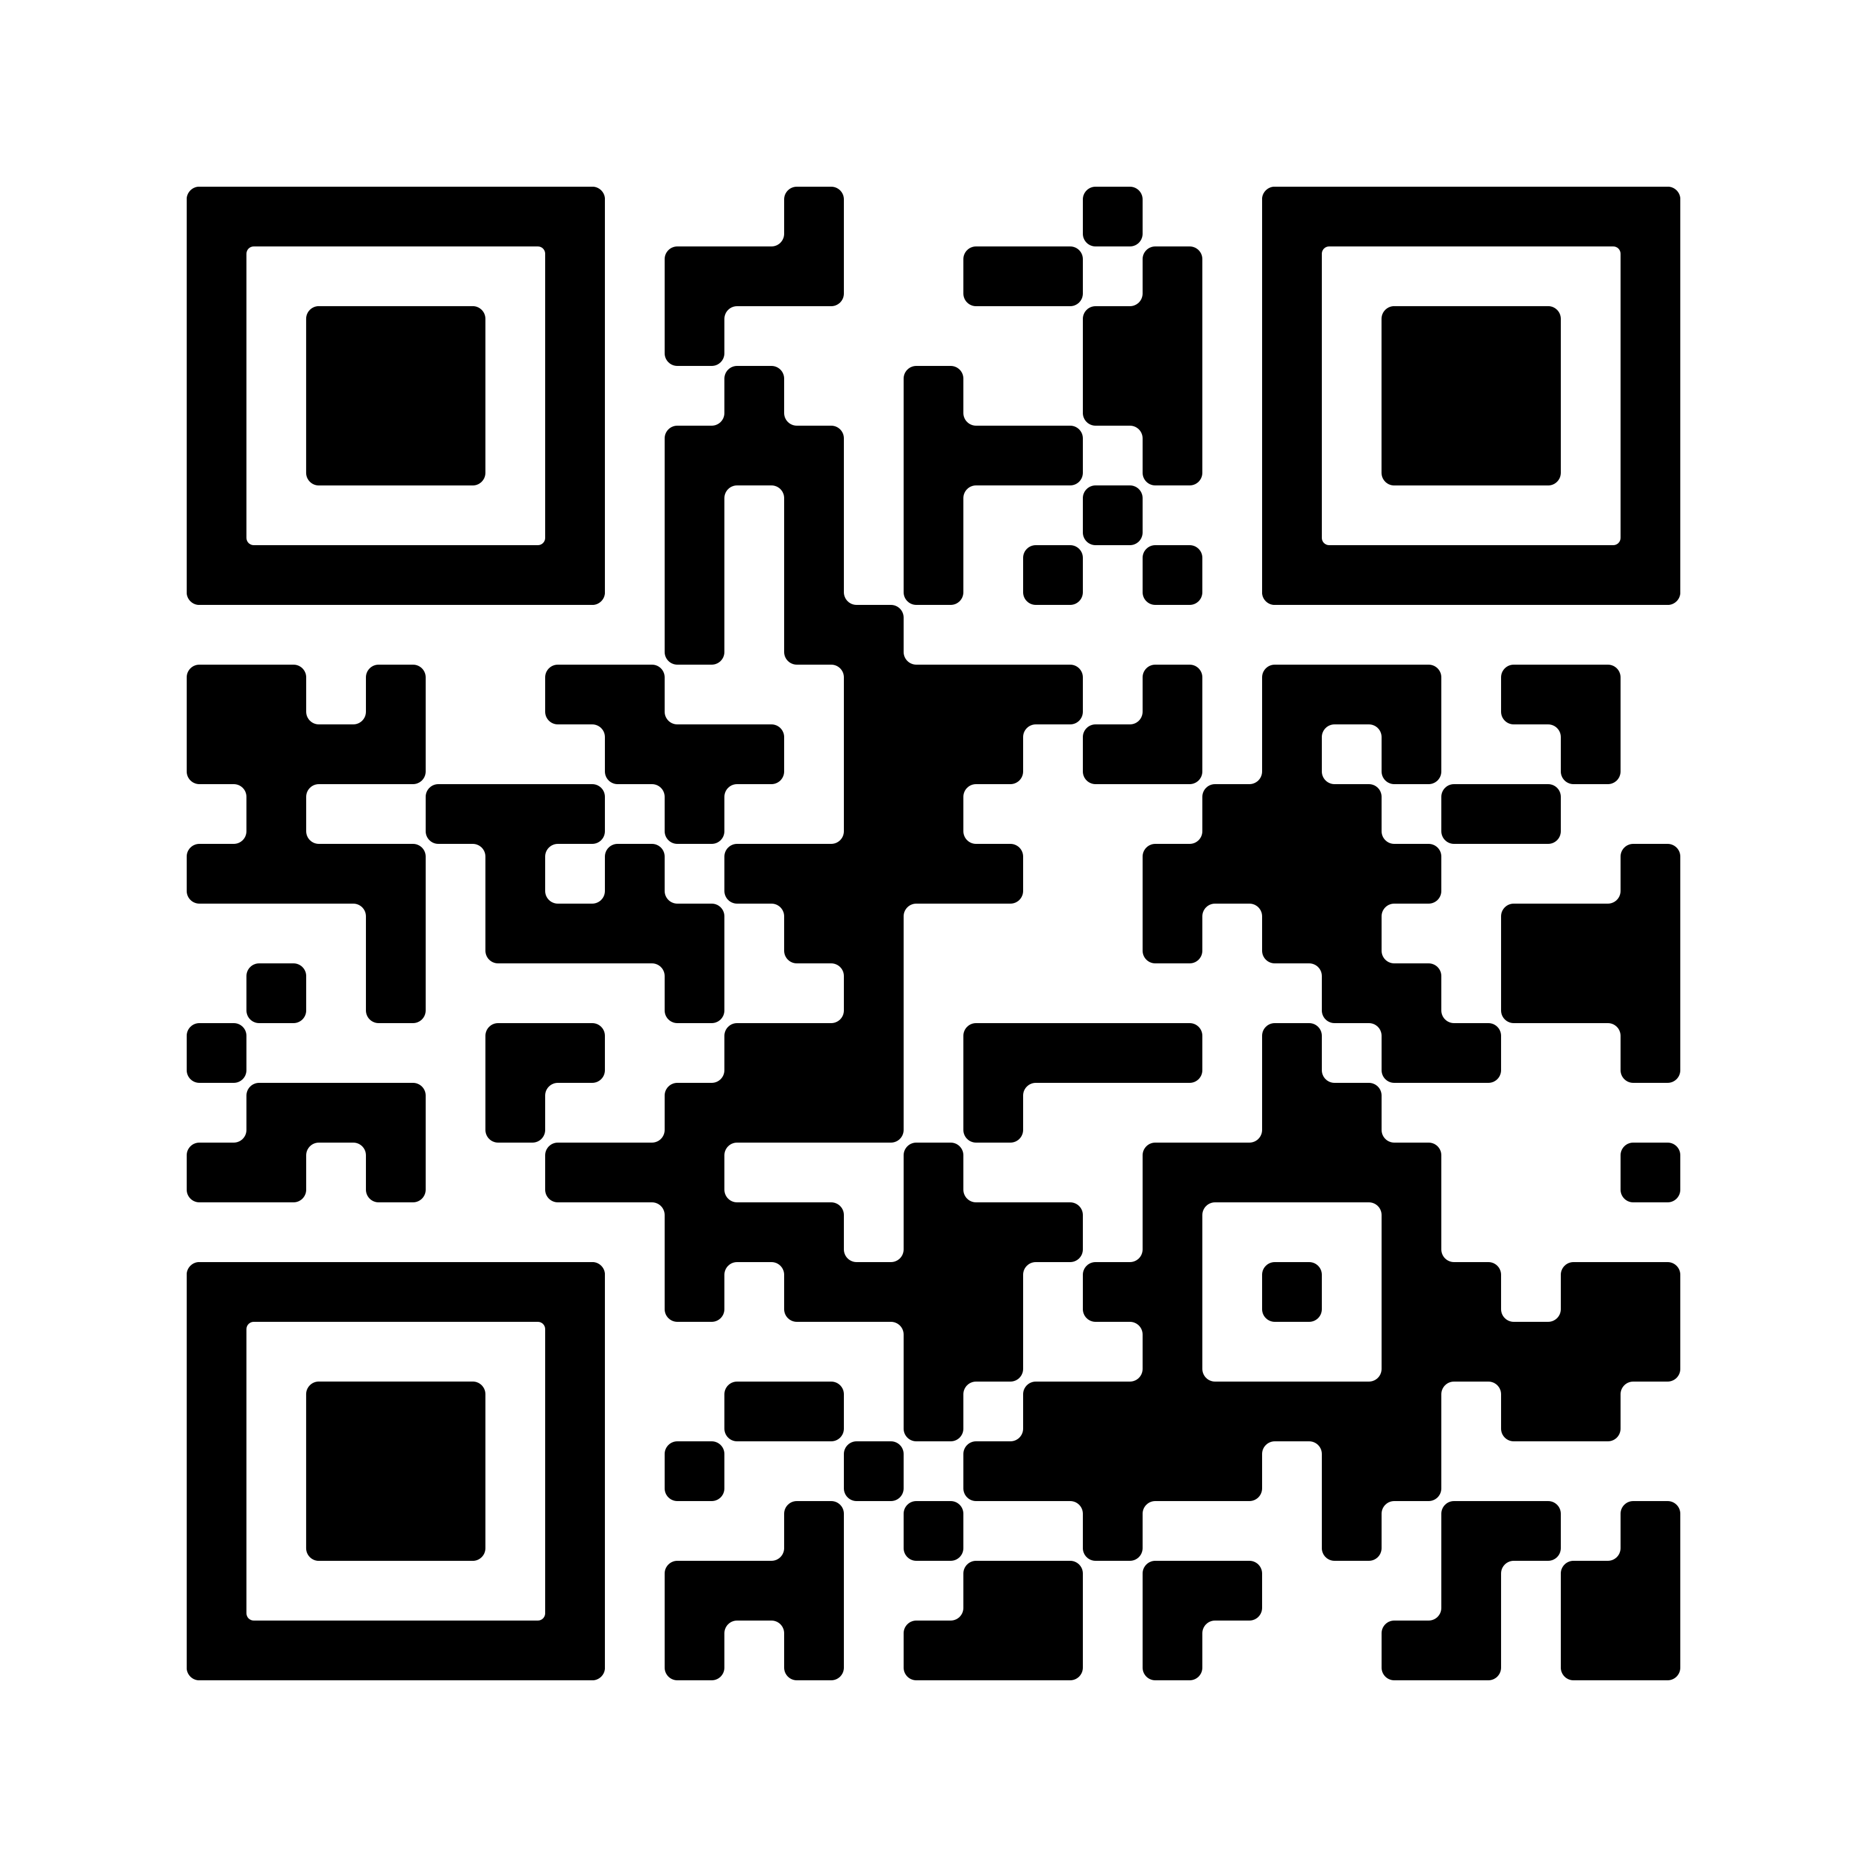
BOOKMARKS
Emotional Evolved People
Managing Your Emotional Energy

Slide 25
THE PROFESSOR

Slide 26




HOSPITALITY LAWYER
@HOSPITALITY_LAW
HOSPITALITYLAWYER.COM

