Slide 1
Franchisor/Franchisee Relationships – Tips For Getting Along
Marisa Rauchway, Esq.

Slide 2

Marisa Rauchway
Team Leader – Franchise Law, CSG Law
Practice Group Leader, Litigation, CSG Law
NEW JERSEY / NEW YORK
Marisa serves as a strategic legal advisor and partner to the local, regional and national franchise community across a wide range of industries, including hospitality.
She advises prospective franchisees throughout the purchase process and routinely reviews franchise disclosure documents and negotiates franchise and multi-unit/area development agreements. operators, and franchisors.
Marisa represents franchise, retail and distributor clients in both pre-litigation and litigation matters throughout the country and abroad, in all facets of disputes between and among franchisees, franchisors, and members of the supply chain industry.

Slide 3
Problems Between Brand And Franchisees Often Stem From Misunderstandings
The key to avoiding these misunderstanding is to know what you are signing up for
Do you know what is in your Franchise Agreement?
Do you know what is in your Franchise Disclosure Document?
What is common/”standard” for one brand may differ with another brand

Slide 4
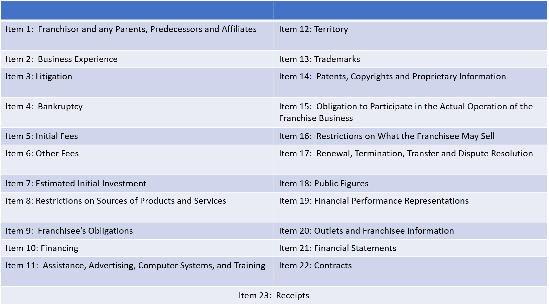
Franchise Disclosure Document: A Treasure Trove of Information (But Not All Inclusive)

Slide 5
Common Issues Between Brand and Franchisor
Termination/Liquidated Damages
Territory Restrictions
Restrictions on Products/Services
Ongoing Costs/Initial Investment
Franchisor’s obligations
Franchisee’s obligations
Renewal agreement
Franchisor ability to modify system
Non-compete provisions

Slide 6
You Have Reviewed the FDD: Now What?
Question the brand on any areas of concern
Question the brand on any areas for potential negotiation
Create business plans based on full knowledge of what has been disclosed (proactive vs. reactive)
Speak to other franchisees

Slide 7
When Issues Arise: What Can You Do?
Communication is KEY
Where possible, propose mutually beneficial business solutions as issues arise
Both franchisors and franchisees benefit by finding solutions to help franchisees succeed

Slide 8
Last Resort: Formal Dispute Resolution
When all else fails, know the required dispute resolution process, often outlined in your franchise agreement
Internal Dispute Resolution Process
Mediation
Arbitration
Court
Sometime there are exceptions, depending on jurisdiction

Slide 9

mrauchway@csglaw.com

