Slide 1
Surfing the Silver Tsunami finding opportunities as veteran restaurant owners look to step back
David T. Denney

Slide 2


David Denney
Founder, DENNEY LAW GROUP
A Nose-to-Tail Law Practice ®
Dallas, Texas
GDRA President, July ‘19 – Dec. ’20; Emeritus Board Member
TRA Board Member, 2018 – 2023; Emeritus Board Member
Represents independent restaurants, bars, caterers, ghost kitchens, food halls, chefs, bev alcohol manufacturers, etc.
Spartan Race Team: Bourbon, Bacon, & Biscuits

Slide 3
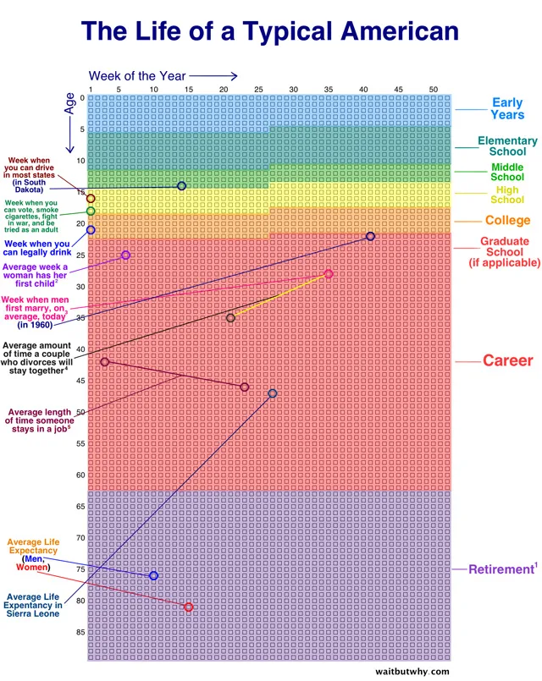

Slide 4
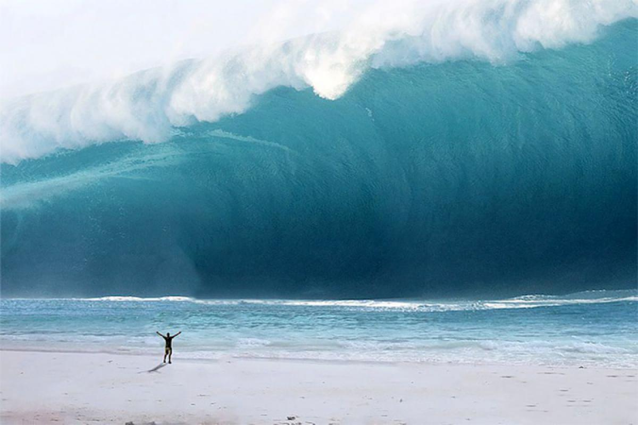
What is the Silver Tsunami??

Slide 5
As founders look to sell their businesses to younger operators, those younger operators (and even first-time buyers) are on the hunt to purchase established concepts with staying power and strong community goodwill.
This session will discuss strategies for capitalizing on these growing opportunities, including how to prepare the business for sale, post-sale roles, and suggestions for structuring mutually-beneficial transactions.

Slide 6
Peak Boomers are Just Cresting the Wave
The "Peak Boomers" (born 1959–1964) are turning 65 between 2024 and 2030, with over 30 million expected to retire during this period.
By 2030, all Boomers will be at least 65.
About 10,000 Boomers reach retirement age daily, a trend continuing through 2030
                Pew Research Center

Slide 7
Boomers and Restaurant Ownership
Approximately 40% of all small businesses are owned by Baby Boomers.
The SBA estimates that 10 million Boomer-owned businesses will change hands between 2019-2029, representing a value of $10 Trillion.
Approx. 77% of Boomer owners plan to exit within the next 10 years.
                Exit Planning Institute, 2023 study

Slide 8
Who are the Buyers?
Existing restaurant owners looking to acquire adjacent foodservice concepts, allowing greater economies of scale in purchasing power/supply chain/back office, or those looking to add legacy brands capable of expansion.
First-time restaurant owners looking to enter the restaurant space by acquiring an established business.
Private equity firms/family offices looking for substantial EBITDA and the opportunity to grow the brand.

Slide 9
Reasons to Ride the Wave
Less than 1/3 of small businesses have a succession plan.
Boomers are considering creative ways to transfer restaurant businesses to long-time employees
                Nation’s Restaurant News
Outdated systems and/or lack of investment in operations can create opportunities for arbitrage.

Slide 10
Reasons to Ride the Wave, cont’d
Independents outperformed chains, as only 39% of chain operators reported sales growth in 2024 (down from 75% in 2023), suggesting independents were more agile in adapting to consumer needs.
Off-premise dining (e.g., takeout, delivery) remains a growth area.
              Nation’s Restaurant News
Current economic factors (tariffs, commodity price inflation (non-tariff), and economic uncertainty suggest that lower purchase prices can be had now by buyers with longer runways for growth.

Slide 11
Challenges to Selling
Emotion.
The “Sunk-Cost” Fallacy.
Thinner profit margins compared to other industries, making restaurants less attractive to buyers unless they have strong financials or a unique brand.
Finding a buyer.

Slide 12

Preparing the Business for Sale
EBITDA is key.
Unless it isn’t.

Slide 13
Preparing the Business for Sale, cont’d
Anticipate due diligence – shore up your systems.
  Spend a little money where it will have maximum impact.
  Shore up the IP portfolio.
  Get answers to the tough questions. (Why missing corp docs?)
  Understand quirky things that can be important to buyers, like outstanding gift card balances.
For some reason, prospective buyers are paying very close attention to I-9s and related employee docs…?

Slide 14
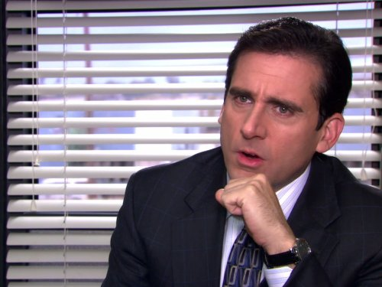
Structuring win-win-win Scenarios
100% sale (to third party, or to employee group)
Sale of Control (51-99%).
Sale with an earn-out.
Sale with limited consulting role.
    This is almost an imperative these days.
Non-compete and other restrictive covenants.
Holdback/basket for possible indemnification, reduced over time.

Slide 15
Post-sale Roles for the Seller
Retire-in-Place via smart hiring
Minority Owner
Consultant/Goodwill Ambassador
or.....

Slide 16
How David Wants to Spend his Silver Tsunami Years….

Slide 17


Slide 18
www.foodbevlaw.com

