Slide 1
Workplace Law in 2025 – What to Expect
Andria L. Ryan

Slide 2

Andria L. Ryan
Partner, Fisher Phillips LLP
Atlanta, GA
Co-chairs the firm’s Hospitality Industry Practice Group
A frequent speaker to hospitality associations and organizations
Volunteer of the Year – Atlanta Pro Bono Partnership Association – 2023

Slide 3
Buckle Your Seatbelts
President Trump will have significant impact on workplace law.
Trump presidency has a history of policy reversals – less oversight but bumpier ride
Look for a rollback in regulations.
Possible reduction in employee headcount at DOL, EEOC, NLRB

Slide 4
Chevron Doctrine - Overruled
What is it?
A 1984 SCOTUS decision on admin law (40 years old)
The Chevron doctrine provides a two-step framework for courts/agencies to interpret statutes.
  If the text spoke to a precise issue, then the agency was bound by the unambiguous expressed language.
  If it was silent or ambiguous, then the court should defer to the agency’s interpretation.
Deference has provided stability throughout the years but has given agencies outsized power to set regulations that govern the workplace.

Slide 5
The Chevron Doctrine
What happened?
June 28, 2024: SCOTUS overturned the decades-old Chevron doctrine in Loper Bright Enterprises v. Raimondo and Relentless Inc. v. Department of Commerce.
If agency action is challenged in court, courts will continue to respect the agency’s authority if it has been properly delegated by statute.
However, if a law is ambiguous, courts will now get to decide whether an agency has acted within its statutory authority – rather than yielding to the agency.

Slide 6
What does this mean for employers?
A federal agency’s regulatory interpretation and opinions letters are now subject to court review.
Agencies and positions that might come under attack:
  Wage and Hour (FLSA)
  Labor Law (NLRB)
  EEOC and Discrimination Law (ADA/ADEA)
  Workplace Safety (OSHA)
  Non-competition (FTC)
  Pay Equity
  Immigration
The Court’s decision gives employers new tools for pushing back when agency rulemakings are overly aggressive.

Slide 7
Anticipated Changes at the EEOC

Slide 8
Change but at a Slower Pace
Democratic majority will remain until 2026 with strategic plan set
Republican Andrea Lucas appointed Acting Chair
Could impact EEOC’s interpretation of existing laws
Focus on conciliation and mediation

Slide 9
EEOC: LGBTQ+ Workplace Harassment
EEOC updated guidance in April 2024 on harassment in the workplace, specifically providing clarity on issues affecting LGBTQ+ employees and pregnancy.
  First time in 25 years EEOC has updated harassment guidance
Key Updates
  Broad protections for LGBTQ+ employees
  Workplace anti-bias laws cover pregnancy-related decisions
  Clarification on protection for religious expression
  Harassment can occur virtually or through technology
  Guidance for employers to update their harassment policies

Slide 10
EEOC: LGBTQ+ Workplace Harassment
Unlawful to deny employment based on gender identity, gender expression, and sexual orientation
Names and pronouns
  If an employee requests to be identified by a preferred gender, name, and/or pronoun, it must be honored.
Restrooms and Other Facilities
  Employees must be permitted to use restrooms and other facilities that correspond with their gender identity or expression.
  Transgender employees not to be required to use single-user restrooms
Notes:
https://www.vitallaw.com/news/expert-insights-the-3-biggest-wage-and-hour-steps-employers-can-take-in-a-post-chevron-world/eld01516dfd65aa7b4d74af3c9be511351076

Slide 11
EEOC: LGBTQ+ Workplace Harassment
  Will this guidance stick?
  Currently being challenged by multiple states
  Whether the EEOC can enforce this kind of guidance is a complicated analysis.
  For now, it is most certainly best to assume this guidance is binding and proceed accordingly.
    Employers should recognize preferred names and genders to the greatest extent possible, including internal and external personnel directories, email addresses, etc.
    Employers should avoid gender stereotypes in dress codes.

Slide 12
Pregnant Workers Fairness Act
  PWFA Refresher
  Effective June 2023 – requires covered employers with 15+ employees to accommodate the known limitations that relate to pregnancy, birth, or related medical conditions, up to the point of an undue burden.
  Prohibits employers from placing a qualified employee on a leave of absence when a different reasonable accommodation option is available.

Slide 13
Pregnant Workers Fairness Act
  2024 Updates to PWFA
  Effective June 2024
  Key Points
    Broad coverage includes abortion-related accommodations and infertility treatments.
    “Qualified” covers more employees than the ADA.
    “Limitations” don’t have to be very limiting.
    Employers can check documentation in some cases.
    Employers can only deny accommodation request if it imposes “undue hardship” on business operations.
Notes:
https://www.vitallaw.com/news/expert-insights-the-3-biggest-wage-and-hour-steps-employers-can-take-in-a-post-chevron-world/eld01516dfd65aa7b4d74af3c9be511351076

Slide 14
PUMP Act also Expanded
  Requires organizations to provide time and private space for breastfeeding parents
  Includes salaried workers for the first year of the baby’s life
  For hourly workers, time spent breastfeeding must be considered hours worked if the employee is still working during this time.
  Expanded to include nearly 9 million more workers, including teachers, nurses, farmworkers, etc.
  Requires a clean, sanitary, functional, and private space for pumping

Slide 15
EEOC Enforcement Priorities per Acting Chair Lucas:
Lucas has outlined several key priorities for her tenure, including, in her words:
“rooting out unlawful DEI motivated race and sex discrimination;
protecting American workers from anti-American national origin discrimination;
defending the biological and binary reality of sex and related rights, including women’s rights to single-sex spaces at work;
protecting workers from religious bias and harassment, including antisemitism; and
remedying other areas of recent under-enforcement.”

Slide 16
New Joint EEOC and DOJ Guidance on DEI (released March 19, 2025)
DEI practices may be unlawful if an employment action is motivated, even in part, by an employee’s protected categories. For instance, if an employer seeks to maintain a diverse workforce in terms of age, race, national origin, or sex and advances those factors by recruiting to these groups (for instance by recruiting from associations that further the interests of women or people of color), that employer, under the Guidance, may be advancing unlawful DEI.
  The new guidance significantly restricts how employers may implement DEI programs under federal anti-discrimination law.
Notes:
https://www.fisherphillips.com/en/news-insights/trump-shocks-employers-by-tapping-chavez-deremer-for-secretary-of-labor-the-10-things-employers-can-expect.htmlhttps://www.fisherphillips.com/en/news-insights/trump-shocks-employers-by-tapping-chavez-deremer-for-secretary-of-labor-the-10-things-employers-can-expect.html

Slide 17
New Joint EEOC and DOJ Guidance on DEI
Clarifies that Title VII prohibits disparate treatment in the terms, conditions, and privileges of employment including:
  Hiring
  Promotion
  Compensation
  Exclusion from training
  Exclusions from fellowships
  Firing
  Demotion
  Fringe benefits
  Exclusion from mentoring or sponsorship programs
  Selection for interviews, including placement on candidate slates.

Slide 18
DOL Updates

Slide 19
New Secretary of Labor
Lori Chavez-DeRemer
Expect her to largely carry out many of the employer-friendly initiatives you’d expect from a Republican appointment
Has co-sponsored the PRO Act and has positioned herself as a supporter of unions and labor rights
  However, still don’t expect her nomination to move the needle much when it comes to actual labor policy
Will have enormous influence on workplace safety and who is selected as the new OSHA leader
Will likely support Trump’s crackdown on foreign workers, possibly implementing a higher wage requirement for all H-1B wages or selecting a higher wage level for PERM/green card filings.
Notes:
https://www.vitallaw.com/news/expert-insights-the-3-biggest-wage-and-hour-steps-employers-can-take-in-a-post-chevron-world/eld01516dfd65aa7b4d74af3c9be511351076

Slide 20
FLSA Salary Threshold
Biden Overtime Rule 3.0
The minimum salary threshold increased from $684/week ($35,568 annual) to $844/week ($43,888 annual), effective July 1, 2024.
Then, to $1,128/week ($58,656 annual), effective January 1, 2025
Every three years – “automatic” updates based on wage survey

Slide 21
FLSA Salary Threshold
Biden Overtime Rule 3.0 Challenged
On November 15, 2024, a Texas federal judge issued an order blocking the Overtime Rule.
Court said the DOL exceeded its authority by setting the salary threshold too high and by setting up automatic increases every three years.
Court relied on recent SCOTUS decision overruling Chevron.
The old rule is back in effect - $684/week ($35,568 annual)

Slide 22
FLSA Salary Threshold
What Happens Next?
DOL has filed an appeal.
Unlikely that Trump administration will pick up the legal battles over the Overtime Rule
Prediction –
  Threshold will remain $35,568 annualized for now.
  DOL may take steps to modestly increase the salary threshold, as it did during the first Trump administration.
  New salary threshold may be somewhere in the $44,000 annual range (around the same level set by Phase One of the Biden Overtime Rule).
Notes:
https://www.vitallaw.com/news/expert-insights-the-3-biggest-wage-and-hour-steps-employers-can-take-in-a-post-chevron-world/eld01516dfd65aa7b4d74af3c9be511351076

Slide 23
Joint Employer Test
Under Trump’s first administration, his DOL issued a final joint employer rule that captured the realities of modern business arrangements.
  Struck down by a NY federal judge
  Then, the Biden DOL rescinded it altogether in 2021.
Still likely that the DOL pushes for a new rule that will reflect the evolving nature of flexible work arrangements, but it might be up to the courts to decide whether such a rule ever takes effect.

Slide 24
The Tip Credit Rule
FLSA permits tipped employees to receive $2.13/hr. in direct wages if their direct wages + tips equals at least the $7.25 minimum wage
  Historic 80/20 rule
    exemption applies if at least 80% of work in a week tip producing or related to tip producing work
  Biden DOL 80/20/30 rule
    Created distinction between “tip-producing” and “directly supporting” work
      lose exemption if > 20% of work is either “directly supporting” or non-tipped work
      lose exemption if > 30 minutes of continuous work is either “directly supporting” or non-tipped work
      5th Cir. vacated the 80/20/30 rule on August 23, 2024
Notes:
https://www.vitallaw.com/news/expert-insights-the-3-biggest-wage-and-hour-steps-employers-can-take-in-a-post-chevron-world/eld01516dfd65aa7b4d74af3c9be511351076

Slide 25
ICE/Business Immigration Issues

Slide 26
Immigration
What to Expect in 2025
President Trump’s continued emphasis on reducing foreign worker reliance
  Expansion of penalties for employers with undocumented workers
Increased and targeted deportations
Increased I-9 Audits
  Strongly recommend internal audits!
  E-Verify potentially becoming mandatory
H-1B visa program scaled back

Slide 27
Current Executive Orders and Recent Actions
Mass Deportation Initiatives:
  Commencing with plans for large-scale deportations, aiming to remove millions of undocumented individuals from the country. ICE has begun conducting raids and arrests on a wide scale.
Revocation of Parole:
  On January 22, the Trump administration terminated the CHNV (Cuba, Haiti, Nicaragua, and Venezuela) parole programs and revoked the parole status of anyone who entered under this program. Any beneficiaries who do not have another status are no longer eligible to work or remain in the U.S. (preliminary injunction in place – covers certain individuals)

Slide 28
Current Executive Orders and Recent Actions
Revocation of Temporary Protected Status (TPS):
  DHS revoked TPS for approximately 600,000 Venezuelans residing in the United States, render them no longer allowed to live and work legally in the U.S. (some extensions available per court order)
Previous Safe Zones
  Churches and schools were deemed no longer safe zones from ICE activity, thereby making them locations that ICE can target during enforcement activity.

Slide 29
Why Would ICE Be At The Worksite? Raids vs. Audits
ICE may come to the worksite to:
  Start an I-9 audit (Document will be called “Notice of Inspection”);
  Workplace raid – must have a judicial warrant;
  Detain a specific person – must have a judicial warrant.

Slide 30
What protections are available?
Employers and employees have rights under law, regardless of status
  4th Amendment – protects against unreasonable search and seizure of their home, person and belongings
  5th Amendment – right to remain silent
Worksite Raids must be accompanied by a Judicial Warrant signed by a judge and
give a specific scope of search and seizure.
Home Searches must also be accompanied by a Judicial Warrant
Warrants
  An administrative warrant authorizes an ICE agent to make an arrest or seizure, but not to search
  An ICE warrant does not authorize an ICE agent to enter a private space or home without consent
  An ICE warrant does not provide probable cause of a crime or meet Fourth Amendment requirements for arrest

Slide 31
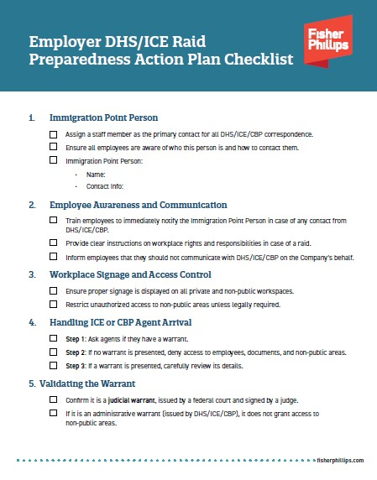
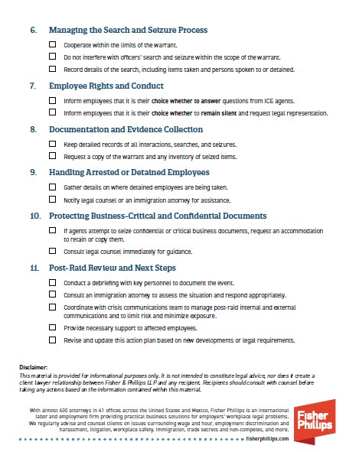
Employers’ Rapid Response Website
Complimentary checklist available on the Employers’ Rapid Response webpage

Slide 32
Fisher Phillips Rapid Response Team
Comprehensive Services
Immediate Legal Counsel
Employee Representation
Documentation and Compliance Review
Post-Raid Support and Strategy
24/7 Emergency Hotline – (877) 483-7781
DHSRaid@fisherphillips.com

Slide 33

Andria L. Ryan
alureryan@fisherphillips.com
404.240.4219
678.662.4678

