Slide 1
How to Prepare For and Manage an OSHA Inspection
Eric J. Conn
Chair of the OSHA Practice at Conn Maciel Carey LLP
SEPTEMBER 16 - 17, 2025

Slide 2
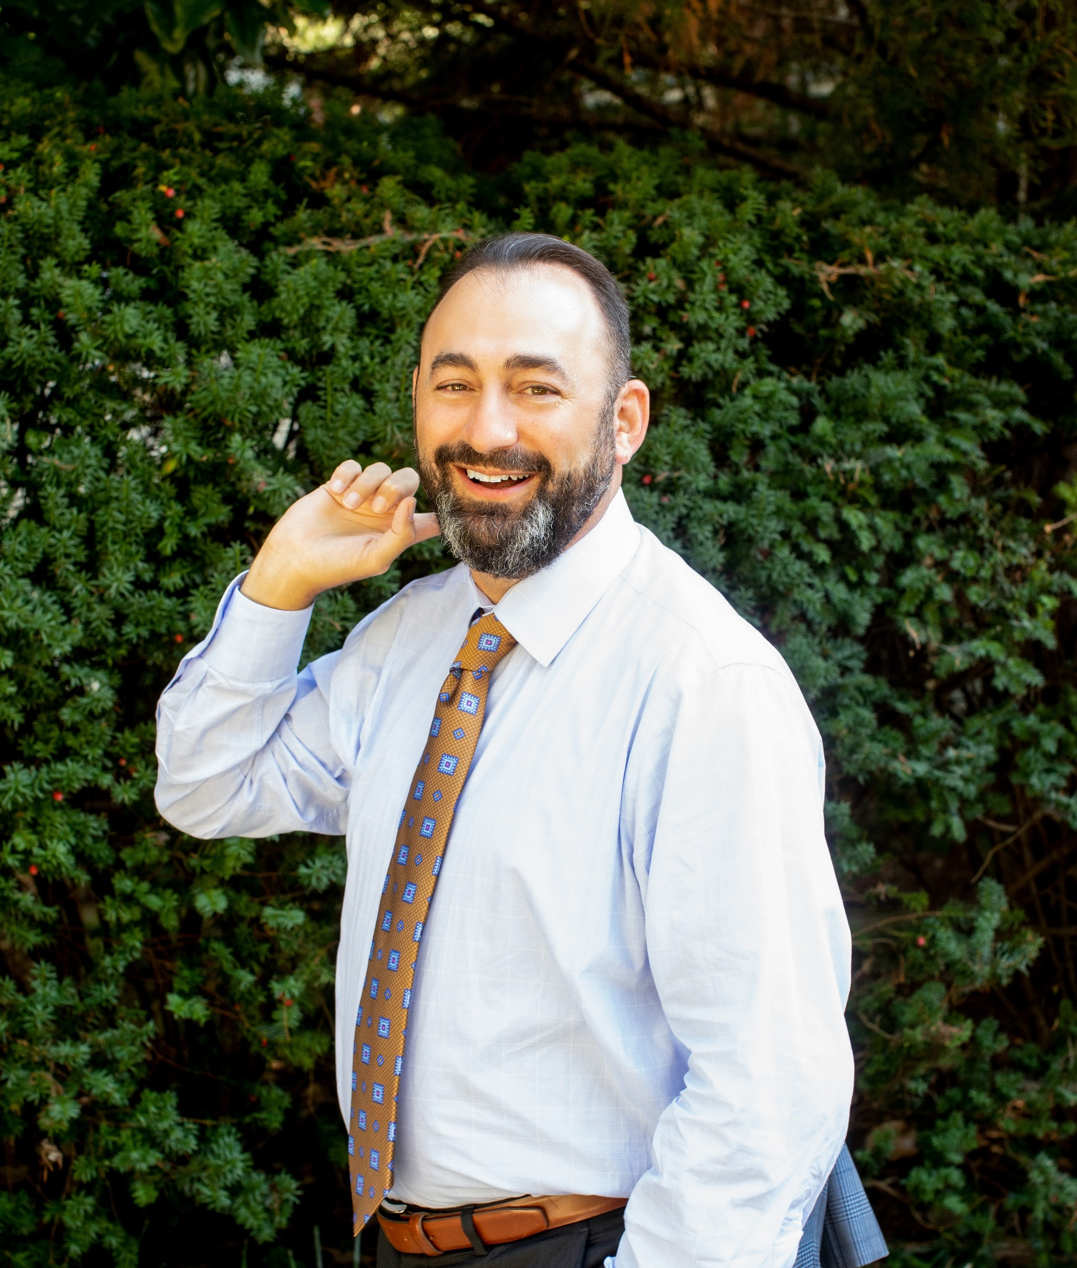
Eric J. Conn
OSHA Practice Chair, CONN MACIEL CAREY LLP
Washington, DC
Practiced 11 years alongside the 1st General Counsel of OSHRC
Manages investigations of serious workplace accidents and represents employers in inspections and enforcement actions involving OSHA and State OSH agencies
1 of only 9 OSHA-specialist attorneys rated “Band 1” nationwide by Chambers USA.

Slide 3
Goals of Managing an OSHA Inspection
Control Flow of Information
Cast Workplace in Best Light
Identify Potential Problems Early
Minimize Business Disruption

Slide 4
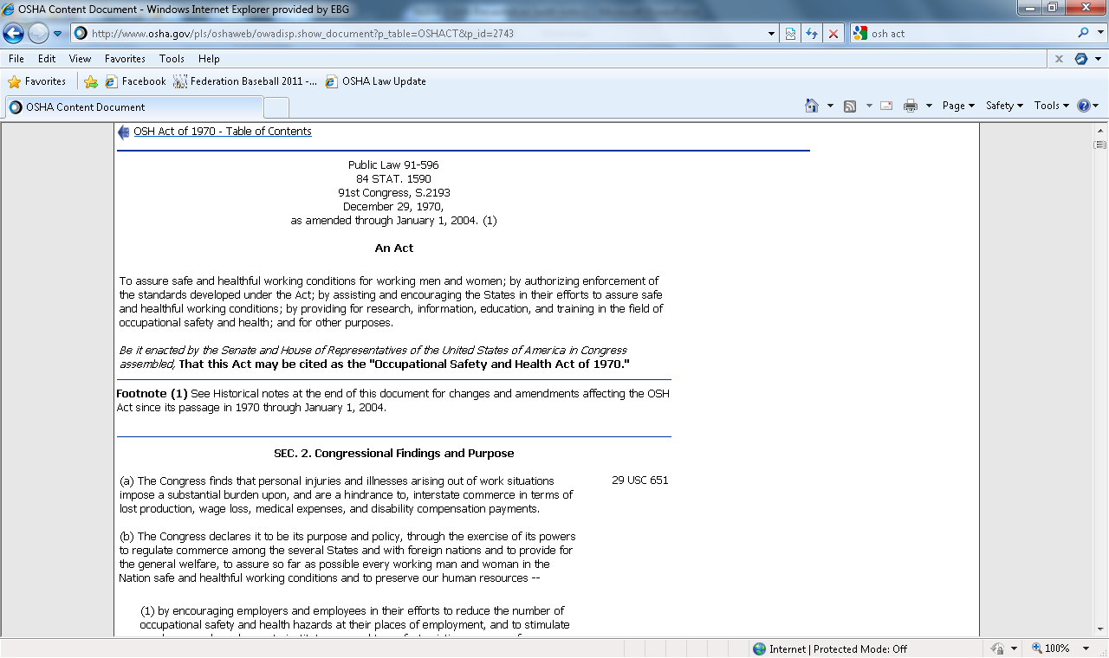
OSHA Inspections
Sec. 8(a) of the OSH Act:
“OSHA may inspect at reasonable times any workplace during regular working hours and at other reasonable times within such reasonable limits and in a reasonable manner.”

Slide 5
OSHA’s Inspection Rights
Right to inspect workplaces (w/ probable cause / hazards in plain view)
No Advance Notice
Right to inspect records
Right to collect physical evidence
Right to conduct interviews

Slide 6
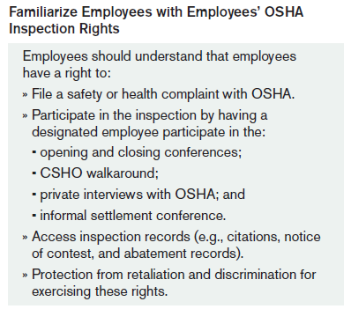
Employees’ Inspection Rights
Right to file a Complaint
Right not to be discriminated or retaliated against
Participation Rights:
Opening Conference
Walkaround
Private interviews
Closing Conferences
Informal Settlement Conferences
Access to inspection records

Slide 7

Employer’s Inspection Rights
“Reasonable Inspection” at “Reasonable Times”
Demand Inspection Warrants
Hold Opening Conference
Access a copy of Complaints
Protect Trade Secrets/CBI
Accompany CSHO at all times
Participate in Supervisory Interviews
A Closing Conference
Challenge Citations

Slide 8
Stages of an OSHA Inspection
Opening Conference
Closing Conference
Citations Issued/Contested
Employee Interviews
Walkaround Inspection
Document Production
Attorney-Client Privileged Communication

Slide 9
Key Questions
Who will be notified internally of the inspection?
What type of access will be granted?
Who will interact with the compliance officer?
Who will accompany inspector on the walkaround?
How will ongoing work be handled?
Where will opening conference and interviews be conducted?

Slide 10
What To Do When OSHA Arrives
In most instances, arrival will be unannounced.
CSHO will ask for the person in charge and present credentials
Immediate steps to take:
Follow written plan
Notify other company personnel
Get contact info from CSHO; ask to see credentials if not volunteered
Escort CSHO into an area ksite where work is generally not visible
Note: CSHO can expand scope of inspection to issues in plain view!

Slide 11
Opening Conference
CSHO arrives and displays credentials
Opening Conference begins:
Employee reps. may participate
CSHO explain purpose of inspection
CSHO discuss scope and duration:
● Wall-to-Wall ● Complaint / Referral
● NEP / LEP ● Accident
CSHO requests documents/information
Resolve warrant issue
OSHA

Slide 12
Opening Conference
Insist on an Opening Conference
Ask OSHA to wait for selected inspection representative(s)
Select location and participants in advance
Ask for purpose/scope of inspection
Introduce Inspection Team
Explain Document Production Protocol
Establish Interview Protocol
Arrange for daily close-out meetings
Arrange to screen photos for proprietary info

Slide 13
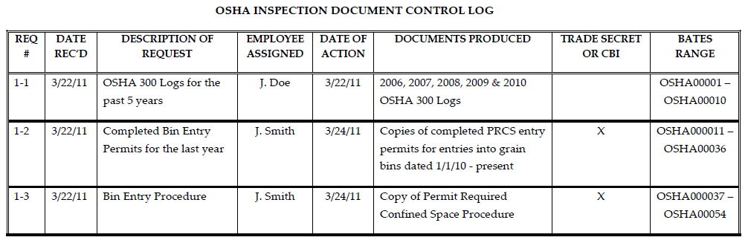
Document Production
Insist on written requests for documents (except: OSHA Recordkeeping Forms)
Voluntary vs. Subpoena
Do not create new documents
Do not leave docs in plain sight
Do not volunteer information
Review for responsiveness, privilege and Confidential Business Info
Keep a copy of all docs produced
Consider a Document Control Log
Attorney-Client Privileged Communication

Slide 14
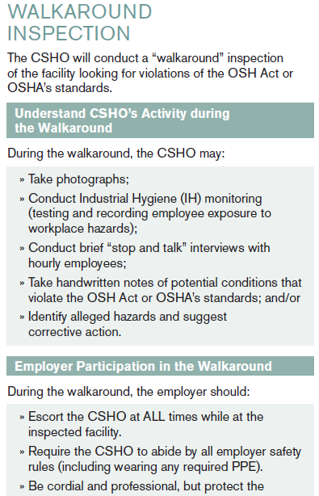
Walkaround Inspection
Scope depends on nature/purpose of inspection
Always accompany the CSHO
Employee representative may accompany
Take side-by-side images
Act professionally but protect your rights
Fix hazards identified by CSHO but do not admit violations
Require CSHO to follow safety rules

Slide 15
Walkaround Inspection
Practitioner’s Tips:
Escort OSHA at all times
Ask for notice of sampling
Take detailed notes
If CSHO takes an instrument reading, note the type of instrument used and ask to see and record the reading
Do not perform demonstrations/re-enact incidents

Slide 16
Final Worker Walkaround Representative Rule
Final New Reg Text of 1903.8(c):
Representative(s) authorized by employees may be an employee of the employer or a 3rd party. When the representative(s) authorized by employees is not an employee of the employer, they may accompany the CSHO during the inspection if, in the judgment of the CSHO, good cause has been shown why accompaniment by a 3rd party is reasonably necessary to the conduct of an effective and thorough physical inspection of the workplace (including but not limited to b/c of their relevant knowledge, skills, or experience w/ hazards or conditions in the workplace or similar workplaces, or language or communication skills).

Slide 17
Who May Get To “Walkaround”?
Union Representatives at non-union workplaces accessing workplaces and employees for organizing, influencing bargaining, etc.
Plaintiffs’ Attorneys (or their “experts”) piggyback on OSHA’s broad investigative authority (access, records and evidence, and participate in private employee interviews)
Disgruntled Former employees
Media
Worker advocacy or other activist organizations (PETA, environmental activists, etc.)
Attorneys and consultants “experienced in interacting w/ gov’t officials,” or “w/ relevant cultural competencies”
Technical experts with more expertise than OSHA has in-house
Competitors accessing proprietary information
Customers

Slide 18
OSHA Inspection Interviews
Arrange through interview procedure
Pre-select office or conference room
Stop and Talk vs. Interview
5 Minute Rule
OSHA must be reasonable
Voluntary vs. Subpoena

Slide 19
Preparing Employees for Interviews
Explain Witness’ Rights
Give Interview Tips
Review Substantive Issues
Voluntary interview
Right to reasonable schedule
Right to be represented
Right to not be recorded
Right to not sign/write/draw
Right to examine documents
Right to take a break any time
Always tell the truth
Listen carefully
Short, concise answers
Stick to the facts
Do not guess or speculate
No silence is awkward
Don’t let CSHO answer for you

Slide 20
Closing Conference
Held at close of inspection
May occur weeks after on-site inspection
CSHO explains post-citation rights
CSHO communicates findings:
Standards allegedly violated
Bases for alleged violations
Possible abatement and abatement dates
Usually will not share classification or penalty

Slide 21
Closing Conference
Correct obvious errors/misimpressions
ID alleged violations you already corrected
Request time to offer additional info
Ask about citation classification and penalty
Offer no commitments about abatement
Take detailed notes

Slide 22

Questions?

Slide 23


Eric J. Conn econn@connmaciel.com
202.909.2737

