Slide 1
More than a bad review: The New Legal Risk of Hotel Ownership.
Joe Viglietta and Jeff Shockley
Dimension Hospitality
SEPTEMBER 16 - 17, 2025

Slide 2

Joe Viglietta
Chief Operating Officer, Dimension Hospitality
Fort Lauderdale, Florida
30 + years leading hospitality organizations
Graduate of Notre Dame
Proud Father of 3 Girls

Slide 3

Jeff Shockley
Exec Vice President – Development, Dimension Hospitality
Atlanta, Georgia
35 Years of Hospitality Experience
Development and Acquisitions Expert
Brand and Franchise Veteran

Slide 4
The New Legal Risks of Hotel Ownership
Owning a hotel has always meant managing guests, staff, and service standards. Today, it also means navigating new minefields of escalating legal threats that didn’t exist a decade ago.
Social Media and the Challenge of Controlling the Message
Cyber Attacks and the Cost of protecting owner and guest data
EPLI and the Cost of Following Brand Standards
Human Trafficking Prevention and the New “Look Back” changes

Slide 5
The New Legal Risks of Hotel Ownership
Social Media and the Challenge of Controlling the Message
Social media is a go to for most consumers planning a trip and the first impression for most hotels. Franchise companies prioritize the engagement on social media by tracking the speed hotel associates respond to guest inquiries. This speed is essential in helping the guest make booking decisions and also setting a great first impression of engagement. When done properly, the hotel image on social media is very positive. However, the are many potential dangers to poorly trained responders that can occur and some could lead to serious legal consequences.

Slide 6
The New Legal Risks of Hotel Ownership
Social Media and the Challenge of Controlling the Message
8 months ago on Google
It was just your basic room. 2 stove burners (electric), bed and chair with end table w/ NO BIBLE in room which really SUCKED! Microwave and T.V., no Big deal. Don't be fooled by the pictures they show for advertisement.
Rooms 3.0 Service 2.0 Location 4.0
Hotel highlights: Quiet
Rooms: Basic
Safety: Good
Response from the owner 8 months ago
William,
Thank you for the review of your stay.
Due to the state law that went into effect last year, we are no longer allowed to keep bibles in the guest rooms. We do keep them at the front desk but I do not show that you ever requested one with the desk staff.
I agree that people should not be fooled by the photos on the website- we’ve made many modern updates since posting those photos!
Our rooms are basic but come equipped with kitchens for long term guests. Perhaps one of our sister properties would have been better suited for your short term stay. Although, they still wouldn’t have had bibles in their rooms due to the law.
Management
In fact, there is no such law which prohibit hotels providing Bibles in guest rooms.

Slide 7
The New Legal Risks of Hotel Ownership
Social Media and the Challenge of Controlling the Message
Why Responding to Hotel Reviews is Important
4 out of 5 travelers agree that hotels that respond to reviews care more about their guests.
85% agree that thoughtful review responses improve their impression of the hotel.
91% of customers trust online reviews as much as personal recommendations. Online reviews are the new “word of mouth.”
97% of people that read online reviews also read the responses given.
-(Positive Sentiment, 2023)

Slide 8
The New Legal Risks of Hotel Ownership
Social Media and the Challenge of Controlling the Message
Understand the legal landscape
Defamation: The primary concern is libel, which involves publishing false and harmful statements that damage a business's reputation.
Consumer Review Fairness Act (CRFA): The CRFA protects consumers' right to leave honest reviews and prohibits businesses from including non-disparagement clauses in their contracts that penalize negative reviews. Violating the CRFA can lead to financial penalties and court orders.
Anti-SLAPP Laws: Many states have anti-SLAPP (Strategic Lawsuit Against Public Participation) laws that protect individuals from frivolous lawsuits intended to silence criticism. These laws can lead to quick dismissals and even recovery of legal expenses for the reviewer.
Section 230: Websites hosting reviews are generally protected from lawsuits over negative reviews by Section 230 of the Communications Decency Act.

Slide 9
The New Legal Risks of Hotel Ownership
Cyber attacks and the cost of exposed guest data
The hospitality industry has long been known for tracking guest preferences and using that data to enhance the guest experience through thoughtful touches and consistent delivery of services. Handling this type of information also comes with a significant responsibility to ensure the data is secure. Franchise partners shoulder the majority of the security for protecting the guests payment methods and personal information, but management companies also share in the liability of such data.

Slide 10
The New legal Risks of Hotel Ownership
Cyber attacks and the cost of exposed guest data
Key features of hotel cyber insurance
First-Party Coverage: Protects the hotel itself from losses, including forensic investigations, public relations expenses, regulatory compliance costs, notification expenses to affected individuals, and potentially fines and penalties.
Third-Party Coverage: Provides protection against lawsuits from individuals whose data was compromised due to a breach.
Business Interruption Coverage: Can help cover lost income if the hotel's operations are disrupted due to a cyber event.
Cyber Extortion Coverage: May cover ransom demands in cases of ransomware attacks, according to Travelers.

Slide 11
The new legal risks of Hotel Ownership
Cyber attacks and the cost of exposed guest data
In addition to cyber insurance coverage, hotels must ensure the following.
Invest in Robust Security: Implement strong cybersecurity measures to protect guest data.
Regularly Update Security Systems: Ensure all systems are up-to-date with the latest security patches.
Train Staff: Educate employees on cybersecurity best practices.
Incident Response Plan: Have a plan in place to quickly and effectively respond to a breach.
Transparency: Be transparent with guests about the breach and the steps being taken to address it.

Slide 12
The new legal risks of Hotel Ownership
Cyber attacks and the cost of exposed guest data
A major franchise company experienced 3 large data breaches over a 4-year period (2018 to 2022), with the first of those resulting in $52 million in settlement costs stemming from a class-action lawsuit.
A major hotel accounting software company fell victim to ransomware costing the company and over 4000 customers 2 months of productivity and significant loss of subscribers.

Slide 13
The New Legal Risks of Hotel Ownership
EPLI and the cost of following brand standards
Employment practices liability insurance is essential in the hospitality industry. Brand standards and written operating procedures are consistent methods to provide associates the framework to be successful, but what happens when enforcement of these standards can lead to alleged discrimination.
Enforcement of no smoking in the hotel can lead to racial profiling if documentation and consistent enforcement is not adhered to.

Slide 14
The New Legal Risks of Hotel Ownership
EPLI and the cost of following brand standards
What EPLI Covers:
Discrimination: Claims based on race, gender, age, religion, disability, etc.
Harassment: Including sexual harassment, both between employees and from customers.
Wrongful Termination: Claims alleging termination for illegal reasons.
Retaliation: Claims of retaliation against employees who report workplace violations.
Defamation: Claims of libel or slander.

Slide 15
The New legal Risks of Hotel Ownership
Human trafficking prevention and the new “look back”changes
Human trafficking is an ongoing challenge in the hospitality industry and franchise partners all have mandatory training all associates are required to complete upon hire. Despite the training and implementation of best practices, human traffickers find their way into hotels often and operators must respond swiftly to ensure the threat is addressed. Recent updates to TVPRA (trafficking victim protection reauthorization act) doubled the time period of 5 years to 10 years for cases to be brought forward. This recent change increased the number of “Jane Doe” claims and adds additional burden to the operators to ensure files and security footage are maintained for the 10 year period.

Slide 16
The new legal risks of Hotel Ownership
Human trafficking prevention and the new “look back”changes
Helpful links to best practices:
https://www.dhs.gov/blue-campaign
https://www.state.gov/20-ways-you-can-help-fight-human-trafficking/

Slide 17
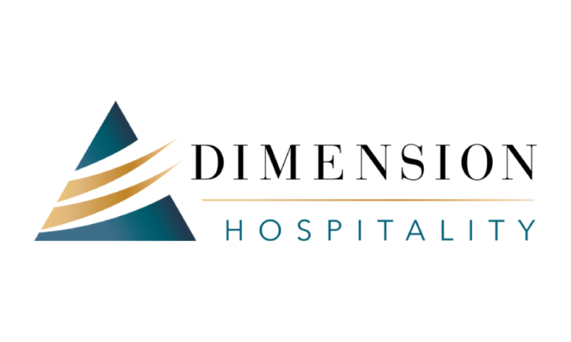
Joe Viglietta – joe.viglietta@dimensionhospitality.com
Jeff Shockley – jeff.shockley@dimensionhospitality.com
www.dimensionhospitality.com

