Slide 1
The Importance of Conducting Effective Workplace Investigations
Andria L. Ryan
SEPTEMBER 16 - 17, 2025

Slide 2
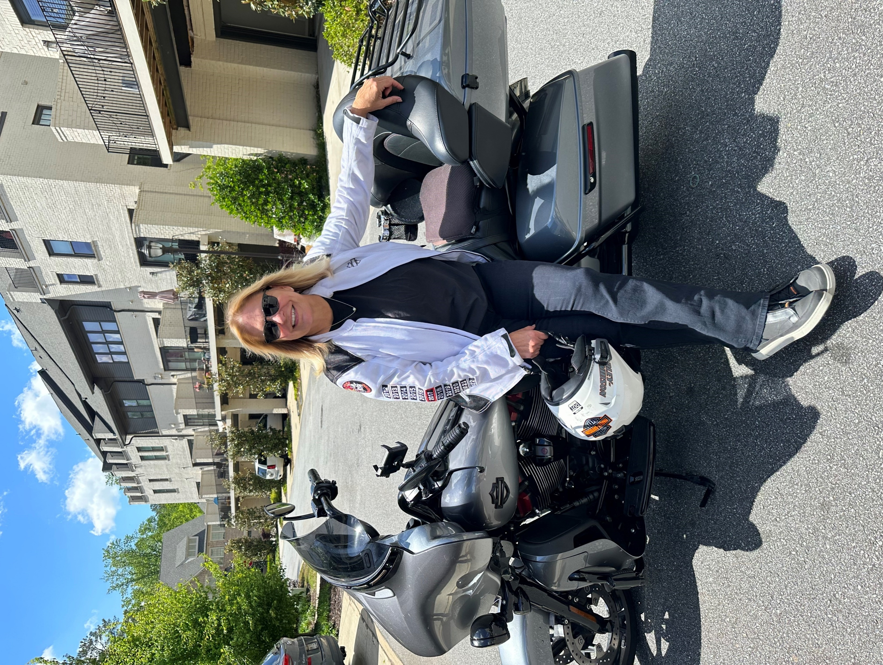
Andria L. Ryan
Partner, Fisher Phillips LLP
Atlanta and Beyond
Co-Chair – Hospitality Business Practice Group
Member “Hotel Hogs” motorcycle “gang”
Employment lawyer representing management in the hospitality industry

Slide 3
Why Investigate?
Proper investigations help to maintain a safe workplace where employees are treated with dignity and respect
Fosters diverse and inclusive workplace
Creates “speak up” culture without fear of retaliation
Prevents and deters improper and unsafe conduct
Shows commitment to policies & code of conduct
Limits legal exposure

Slide 4
What Triggers the Need to Investigate?
Obligation to investigate arises whenever and however the Company learns of potential wrongdoing
Wrongdoing/Improper Conduct = unsafe conduct or conduct that could violate the law, company policies or the Code of Conduct
Duty to act even if Complainant requests no action
Knowledge obtained and duty triggered many ways
Formal complaint (written/verbal complaint, ethics hotline complaint, attorney letter, EEOC charge, etc.)
Anonymous complaint
Informal communication to HR or a supervisor (even away from work)
ANY supervisor knowledge of potentially improper conduct

Slide 5
Who Should Investigate?
Trained on conducting workplace investigations
Familiar with company policies
Credible, trustworthy and organized
No actual or perceived conflict of interest
Non-witness
Same person(s) should conduct all interviews
Supervisors and managers should generally not conduct investigations
Sometimes appropriate to use a neutral, third-party investigator

Slide 6
Who Should be Notified?
Investigations should ONLY be discussed with those who have a legitimate need to know of the investigation
Legal
HR Leaders
Business Leaders
Risk/Safety
Third-Parties
Law Enforcement

Slide 7
Attorney Client Privilege
Investigations conducted at the request of counsel are generally privileged
Cannot apply retroactively
Must remain confidential or will be waived
Assume investigation file will be seen by others
Privilege is fragile / court may find it does not apply
Company may eventually waive the privilege to show steps taken

Slide 8
Interim Action
Consider if alleged wrongdoer should be placed on a leave of absence pending the completion of the investigation
If allegation involves serious safety risk or threats of harm to the Company, its employees or others (e.g., threats of violence, harassment, intoxication, etc.)
Can eliminate the risk of further misconduct or retaliation
“Administrative leave of absence” vs. “Suspended pending investigation”
Paid or unpaid ?
Temporarily relocate the alleged wrongdoer?
Complainant should never involuntarily be placed on leave of absence
Could deter others from complaining

Slide 9
Investigations Involving Third Parties
Obligation to investigate is not limited to complaints by or against the Company’s employees
Company has a duty to protect its employees against improper conduct by third-parties
Company also has a duty to protect third-parties against improper conduct by its employees
Usually requires notice to and/or coordination with third-party employer
Sometimes it is appropriate to allow third-party to investigate alleged wrongdoing by its employees
Company should expect its vendors and contractors to cooperate with its workplace investigations

Slide 10
Documenting and Concluding the Investigation
Assessing credibility
Making factual findings
Deciding on corrective action
Drafting investigation report
Closing investigation
Post-investigation considerations

Slide 11
Appropriate Corrective Action
Must be reasonably calculated to be effective and should be proportionate to the seriousness of the conduct
Should consider wrongdoer’s employment history and response
Corrective actions include:
Training
Counseling
Verbal warning
Written warning
Transfer/reassignment
Demotion
Termination
Sometimes appropriate even without a finding of improper conduct

Slide 12
Investigation Report
Goal is to have a clear and complete documentary record that shows:
Fair and impartial effort to find out what happened
Appropriate action taken based on findings
Draft with expectation it will be seen by others
Key parts of report:
Issues investigated
Response of alleged wrongdoer(s)
Documents reviewed
Witnesses interviewed
Factual findings
Actions taken

Slide 13
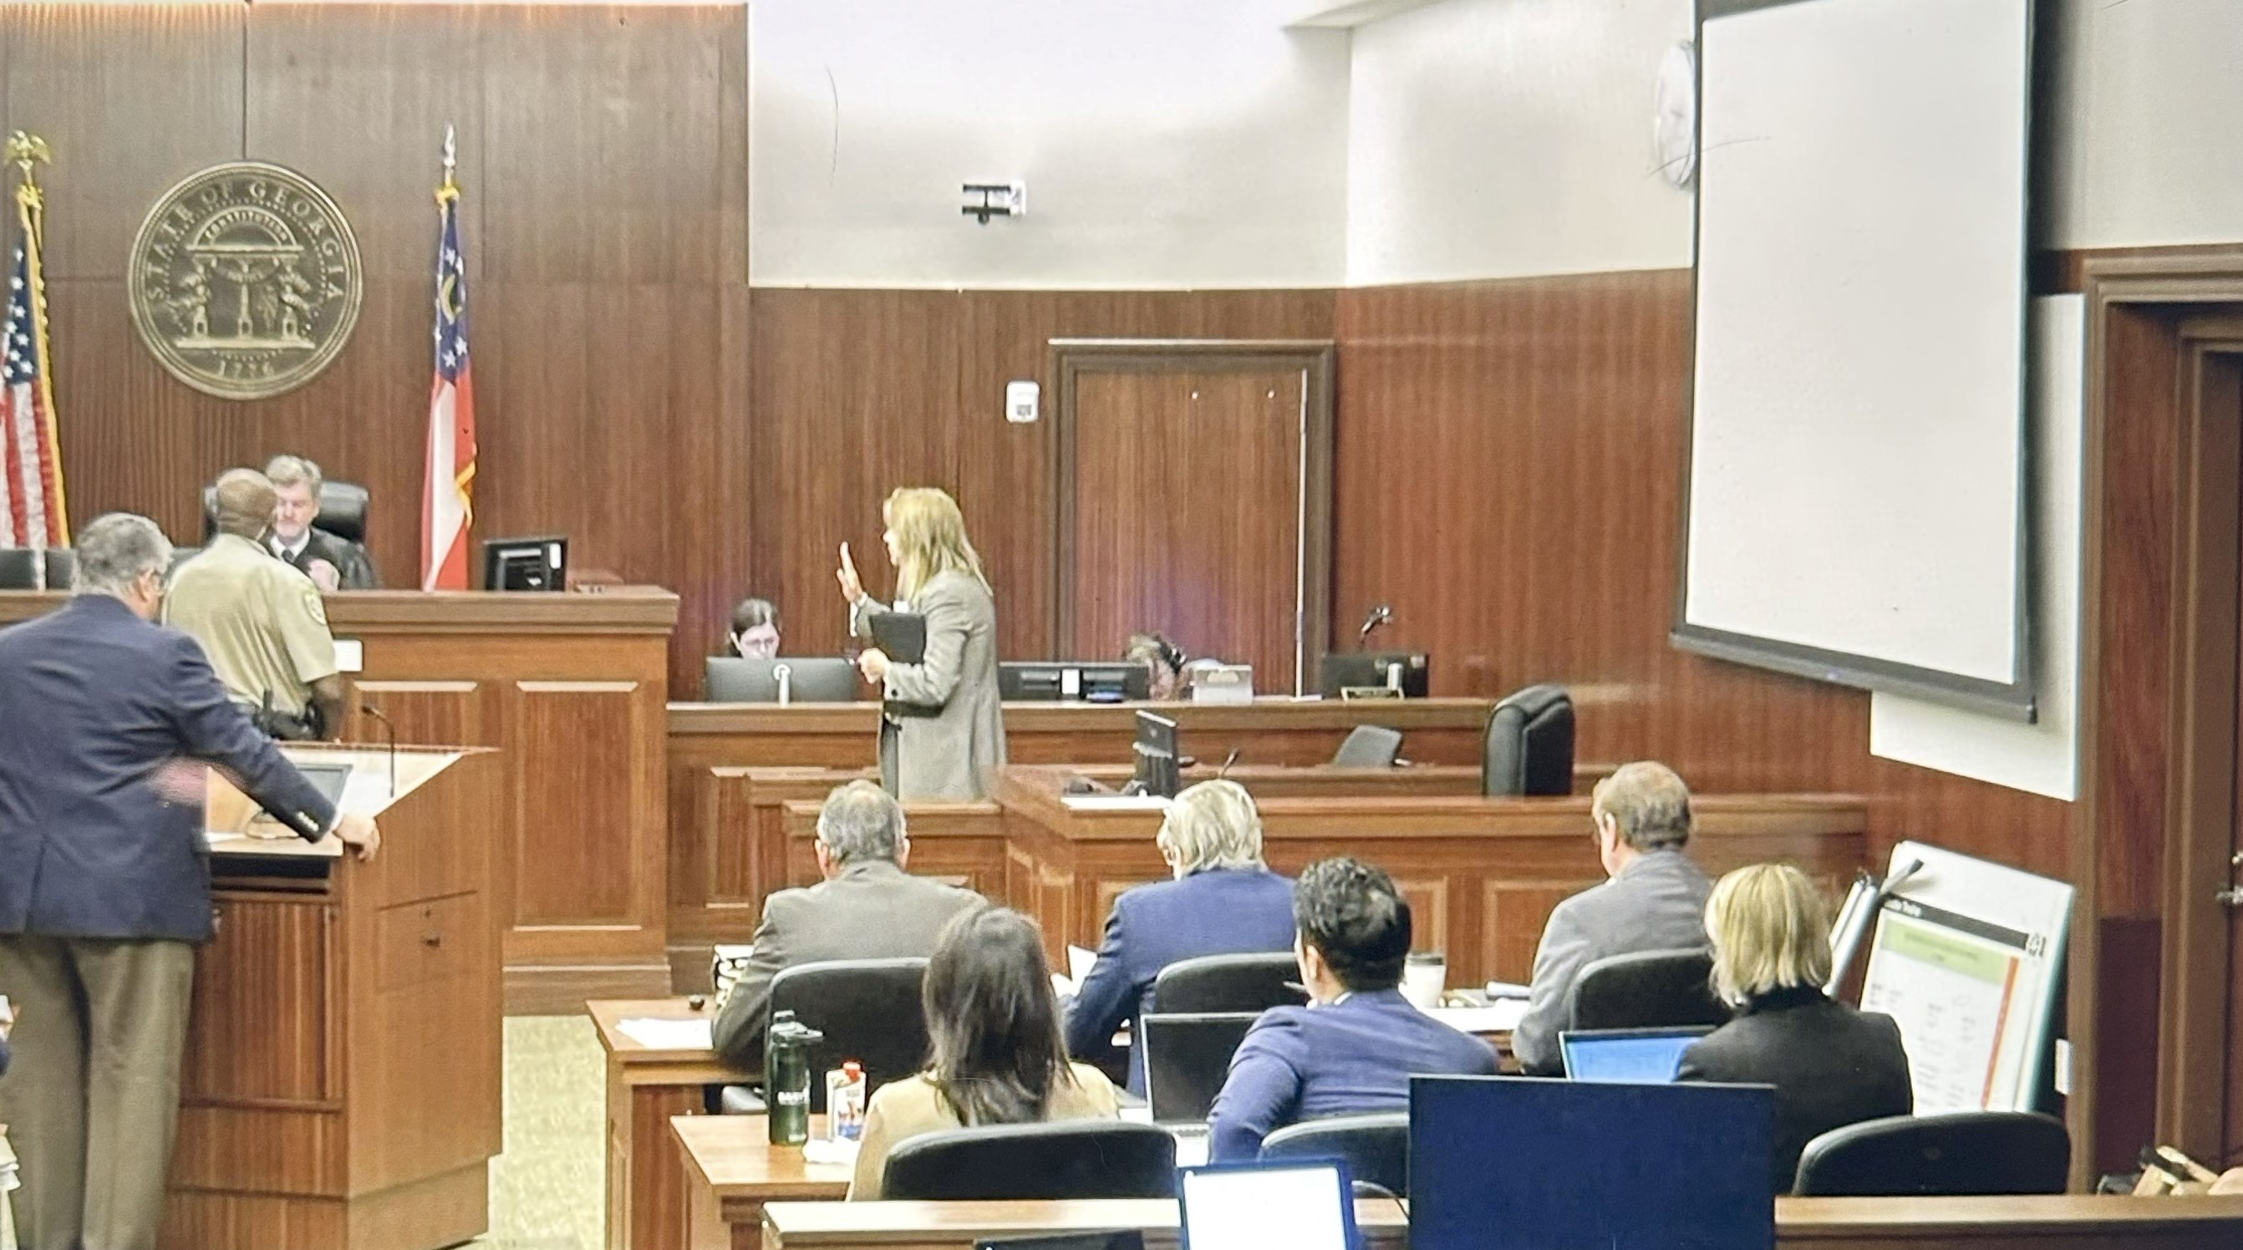
Four Hours . . .

Slide 14
Cast of Characters
Vic – employee
Pablo – site supervisor
Chris – regional supervisor
Margie – General Counsel
Henry - VP

Slide 15

Andria L. Ryan
alureryan@fisherphillips.com
404.240.4219
678.662.4678

