Slide 1
MEDIATING HOSPITALITY DISPUTES
David Samuels
SEPTEMBER 16 - 17, 2025

Slide 2
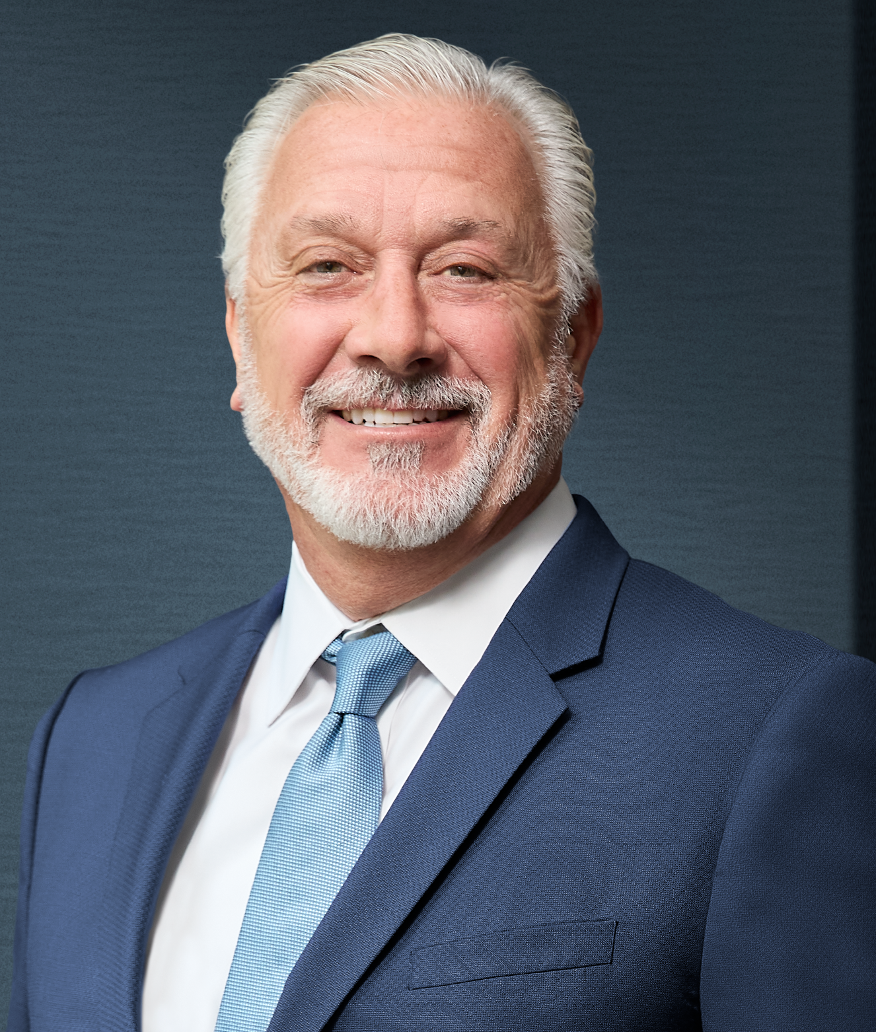
David Samuels
NEUTRAL, SIGNATURE RESOLUTION
LOS ANGELES, CALIFORNIA
Immediate past president of the Academy of Hospitality Industry Attorneys.
Former co-chair of Lewis Brisbois’ national hospitality practice.
Nearly 35 years of litigation and mediation experience.

Slide 3
Benefits of mediation vs. litigation
Preserving Relationships
Speed & Efficiency
Cost
Control Over the Outcome
Confidentiality
Compliance & Future Dispute Prevention

Slide 4
Types of hospitality disputes best suited to mediation
Guest-Related Disputes
Vendor & Supplier Disputes
Franchise & Brand Conflicts
Employment & Workplace Disputes

Slide 5
Types of hospitality disputes best suited to mediation (continued)
Event & Catering Disputes
Shared-Use & Property Management Issues
Online Reputation & Public Relations Conflicts

Slide 6
Alternative (mandatory) dispute resolution provisions in hospitality contracts
Tiered Dispute Resolution Clauses
Mandatory Mediation Before Litigation
Arbitration Clauses
Med-Arb & Arb-Med Clauses
Hospitality-Specific ADR Considerations

Slide 7
Role of mediation in protecting brand value
Keeps Disputes Out of the Public Eye
Preserves Key Relationships
Enables Brand-Consistent Solutions
Minimize Disruption to Operations
Supports a Culture of Responsiveness

Slide 8

David Samuels
E: dsamuels@signatureresolution.com
Sarah Osborne, Case Administrator
P: (310) 810-0012
E: sosborne@signatureresolution.com

