Slide 1


Slide 2
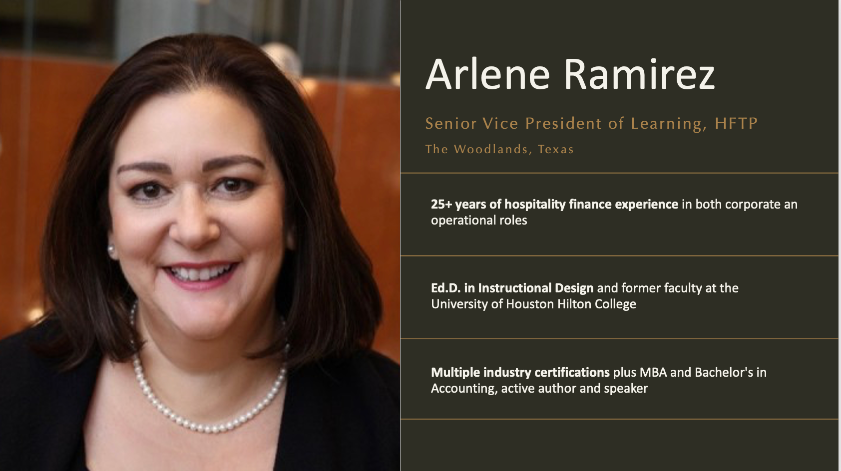

Slide 3

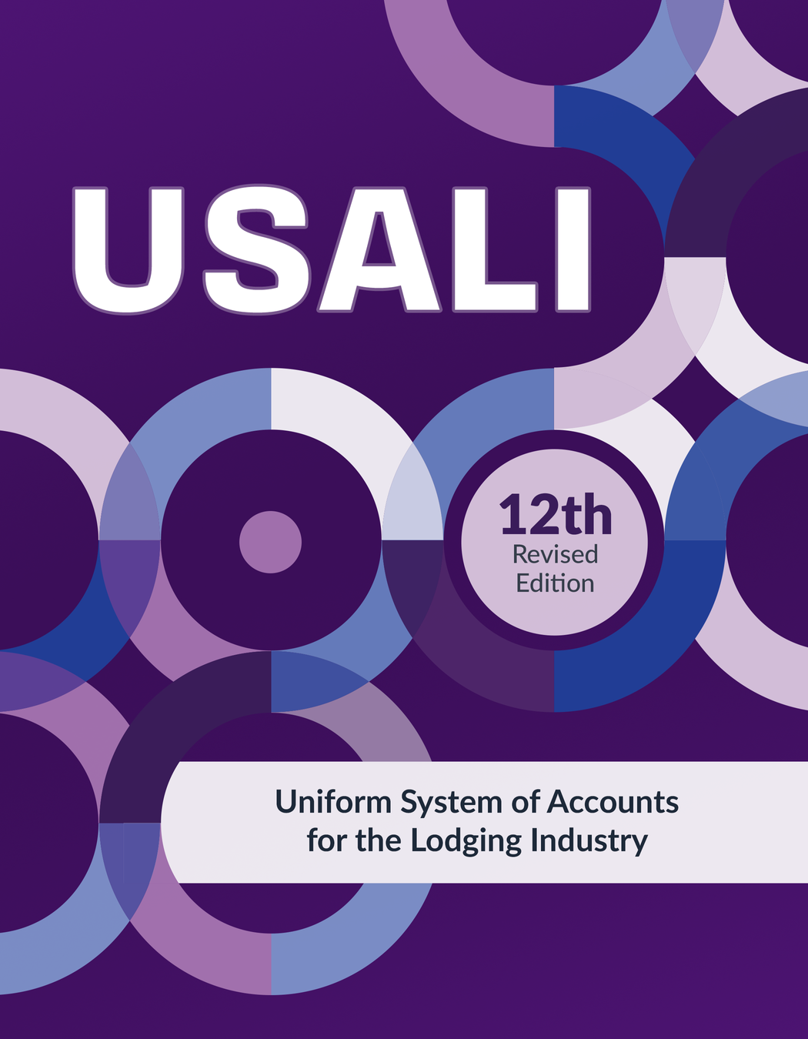

DO YOU KNOW ABOUT THE USALI?

Slide 4
UNIFORM
SYSTEM OF
ACCOUNTS FOR THE
LODGING
INDUSTRY

Slide 5
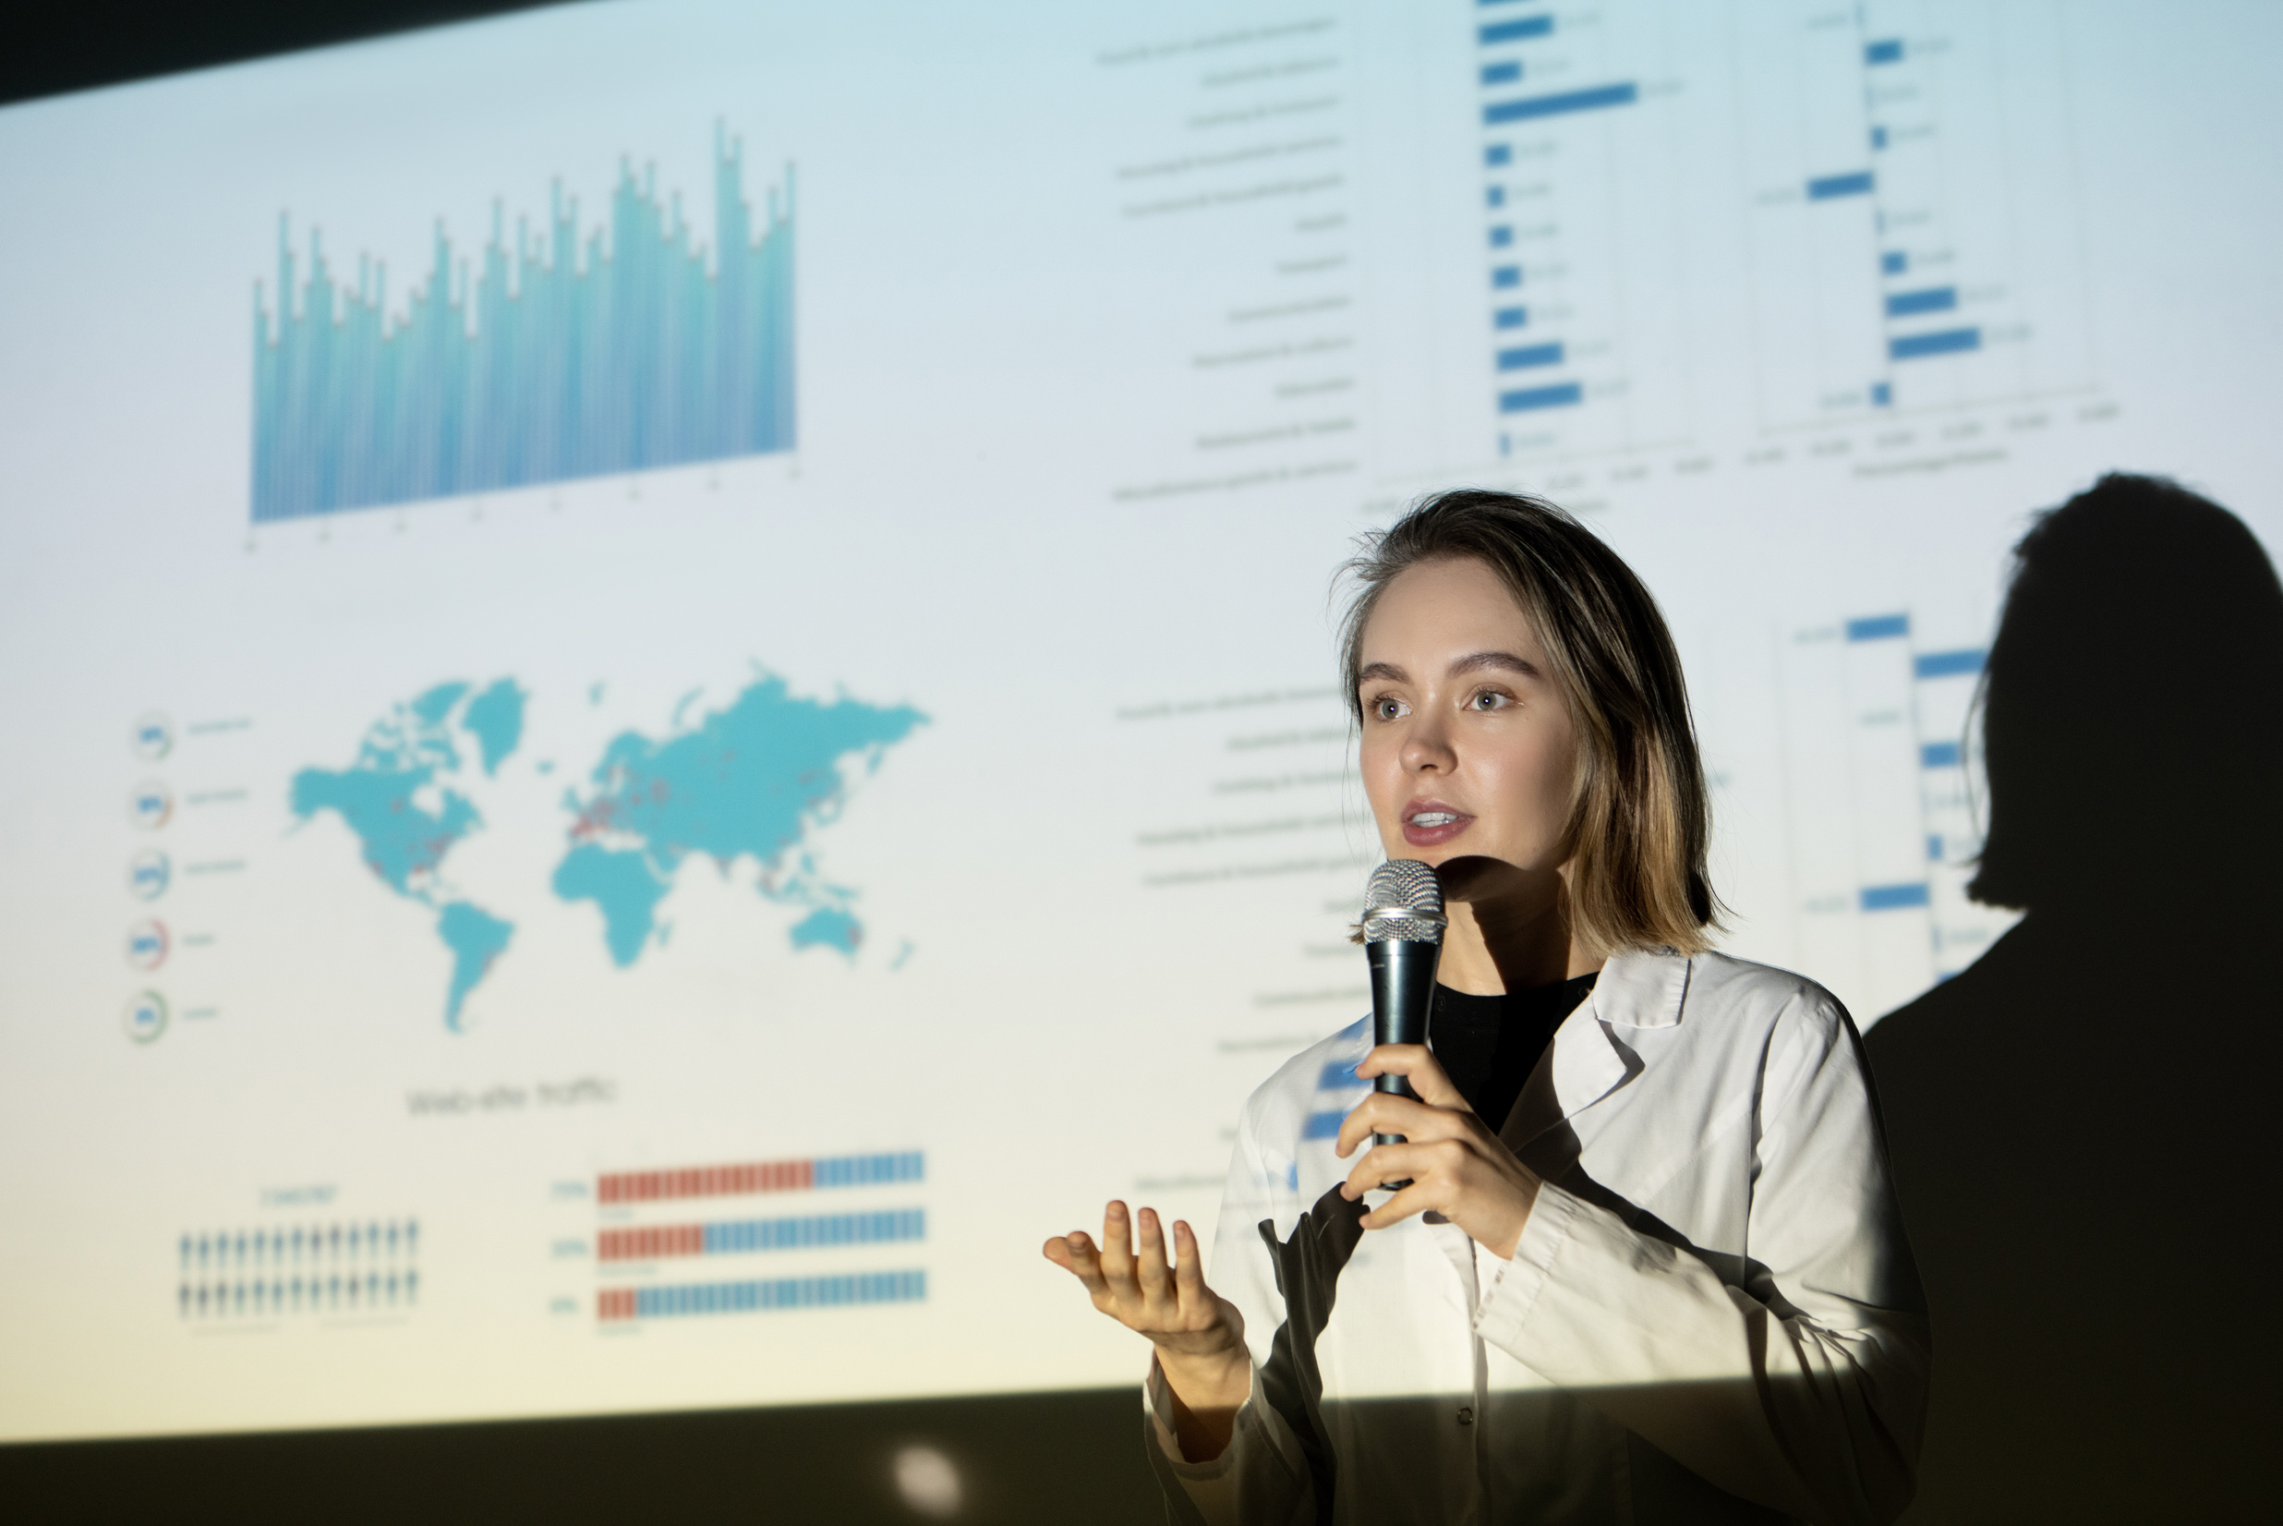

WHAT IS IT?
USALI is hotel accounting’s global standard.
Has GAAP & IFRS as foundations—but hospitality specific
“All financial reporting shall comply with the latest edition of USALI.”

Slide 6
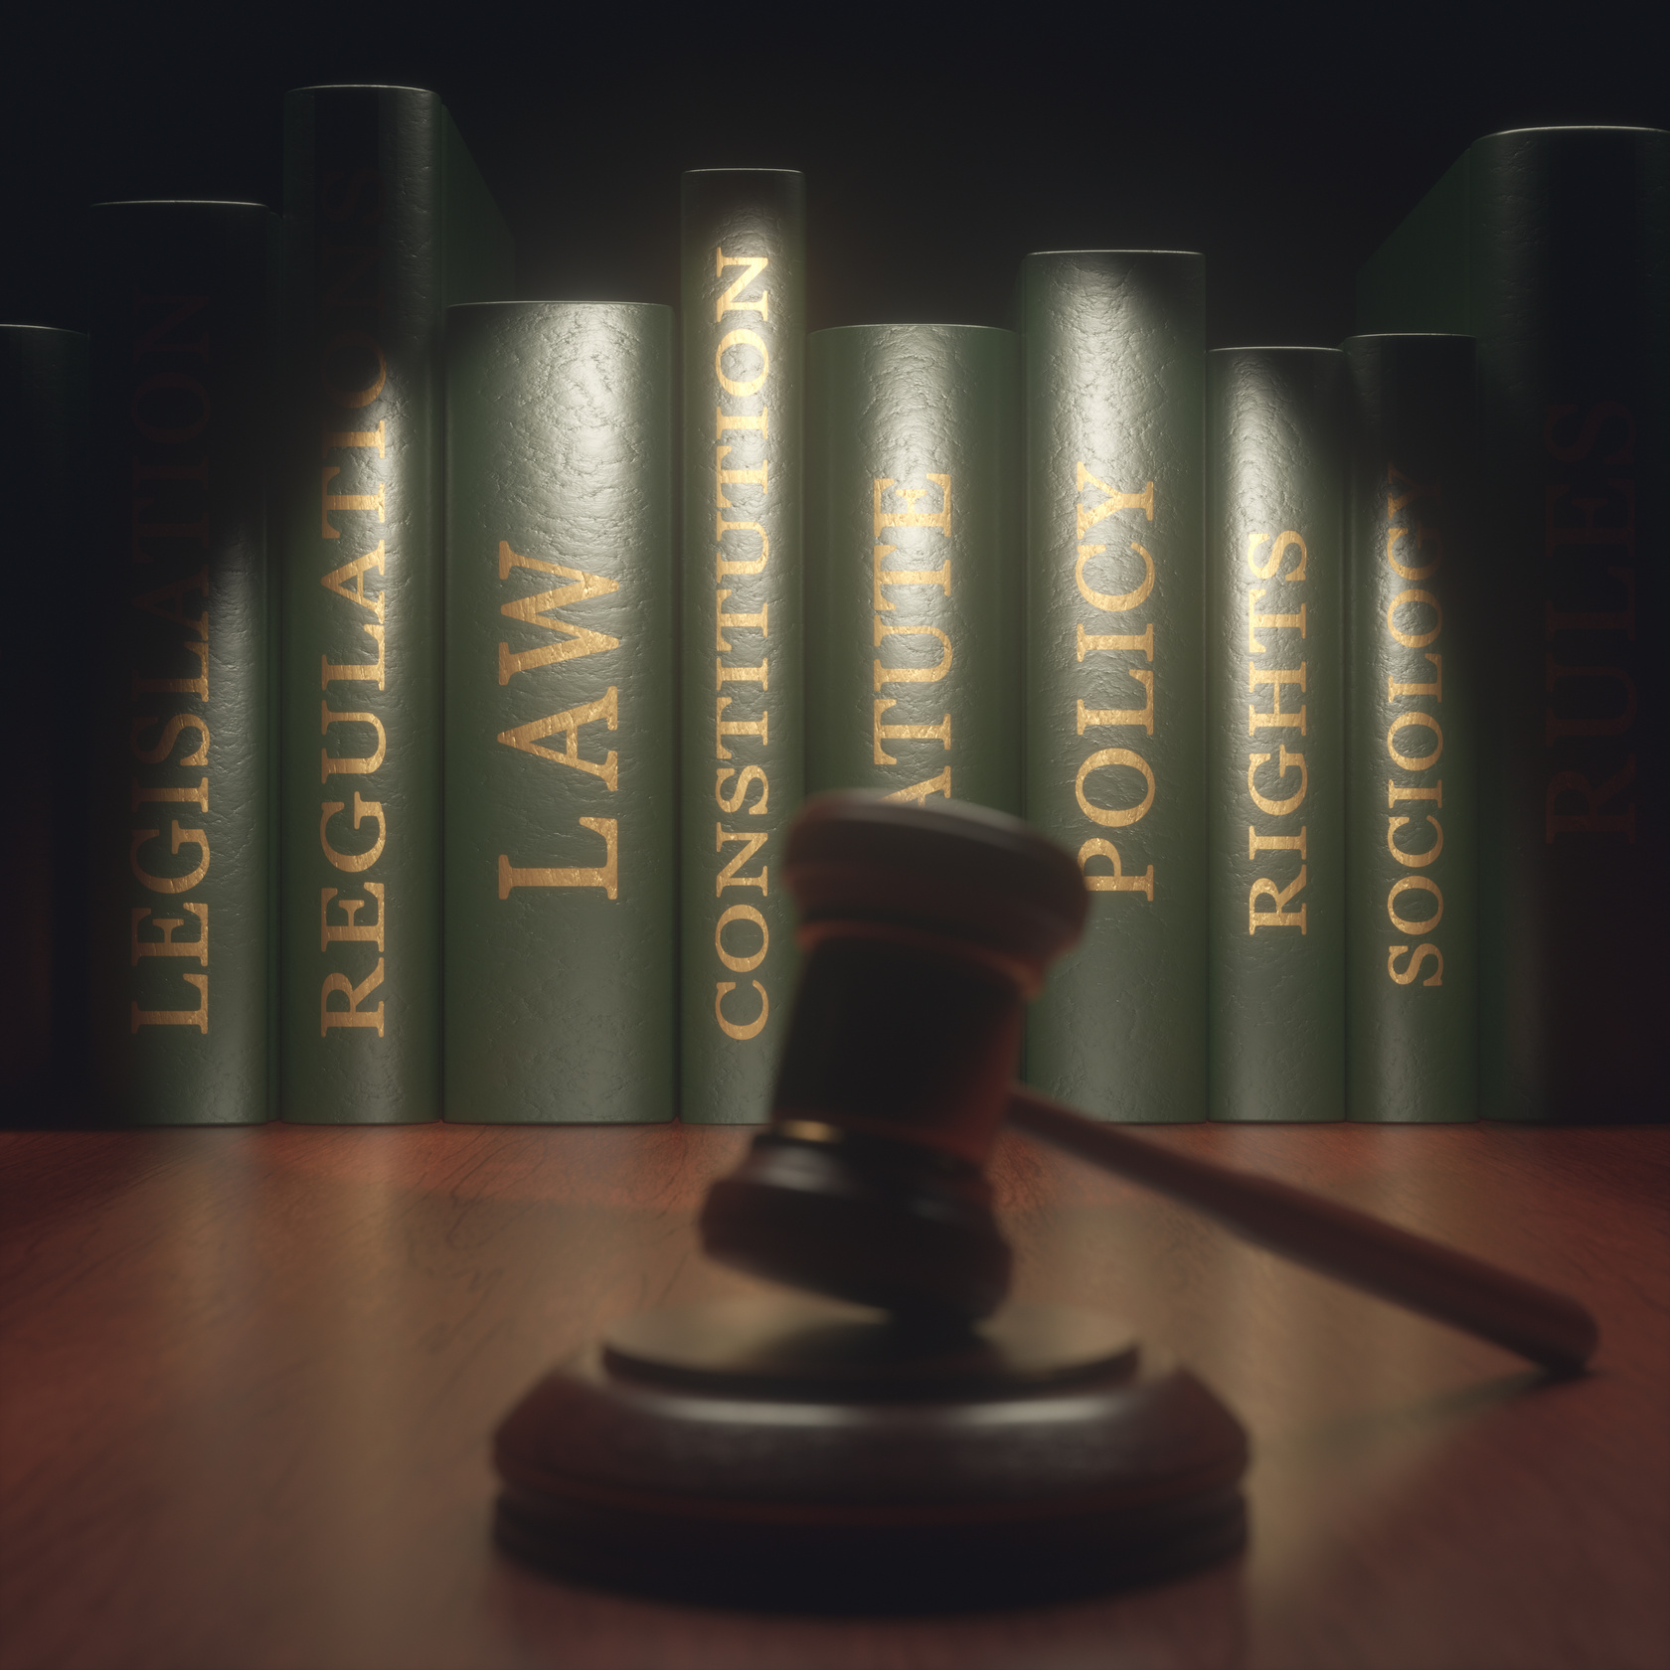
LEGAL SIDE
USALI shows up in hotel management agreements, franchise contracts, leases, and even loan covenants

Slide 7

HFTP NEWS
In October 2018, the Hospitality Financial and Technology Professionals (HFTP) purchased the copyright to the USALI.

Slide 8
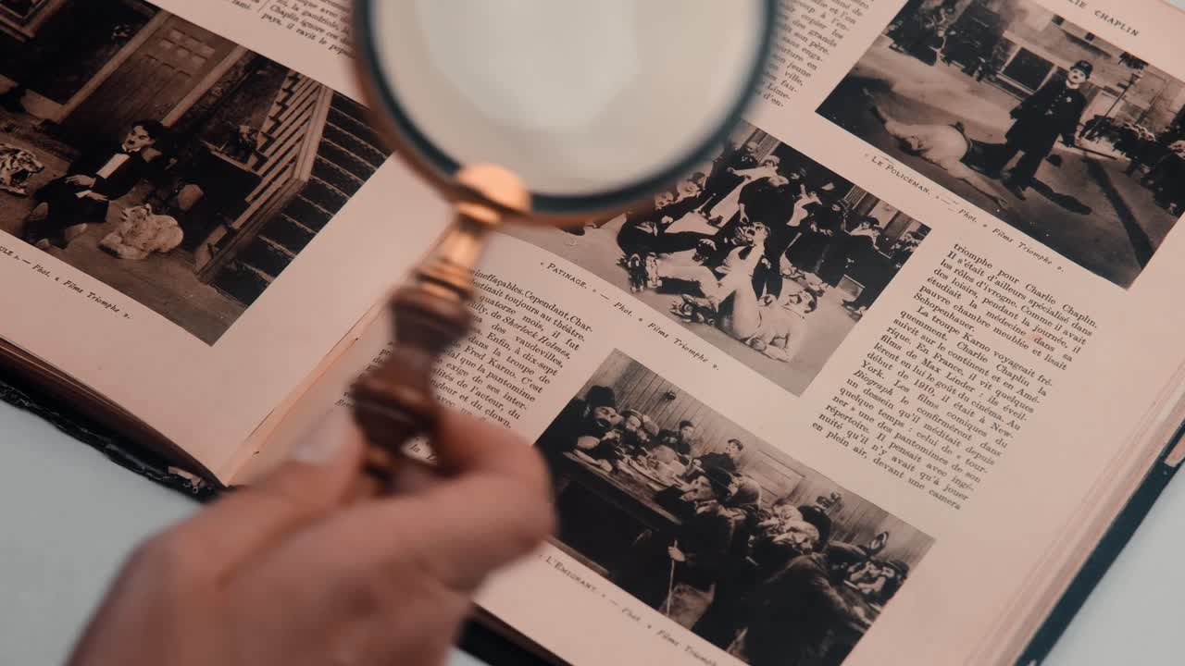
HISTORY
First published in 1926, the publication aimed to provide hotel stakeholders with operational data relevant to the lodging industry.

Slide 9
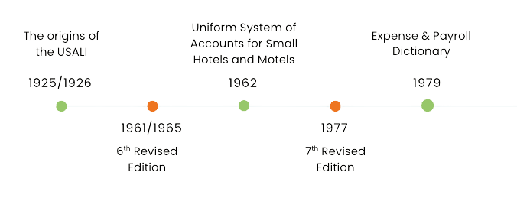
TIMELINE

Slide 10
TIMELINE
8th Revised Edition
10th Revised Edition
12th Revised Edition
1986
2006
2025
1996
2014
9th Revised Edition
11th Revised Edition

Slide 11

12TH REVISED
EDITION EFFECTIVE JANUARY 1, 2026!

Slide 12



COLLABORATION
Global Finance Committee

Slide 13
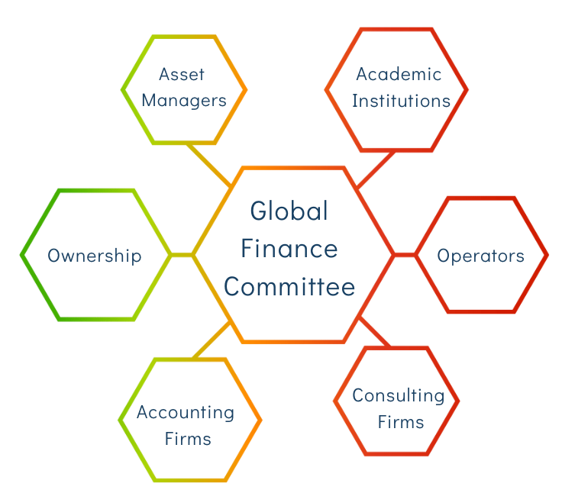

THE COMMITTEE
The GFC was a collaboration of multiple industry stakeholders to ensure all perspectives were considered.

Slide 14

USALI 12TH GENERAL CHANGES
TM
Brand and Operator Costs Schedule

Slide 15
USALI 12TH GENERAL CHANGES
TM
Energy, Water, and Waste Schedule (EWW) replacing the Utilities Schedule

Slide 16
USALI 12TH GENERAL CHANGES
TM
Environmental Impact Metrics
Sustainability and ESG Reporting

Slide 17
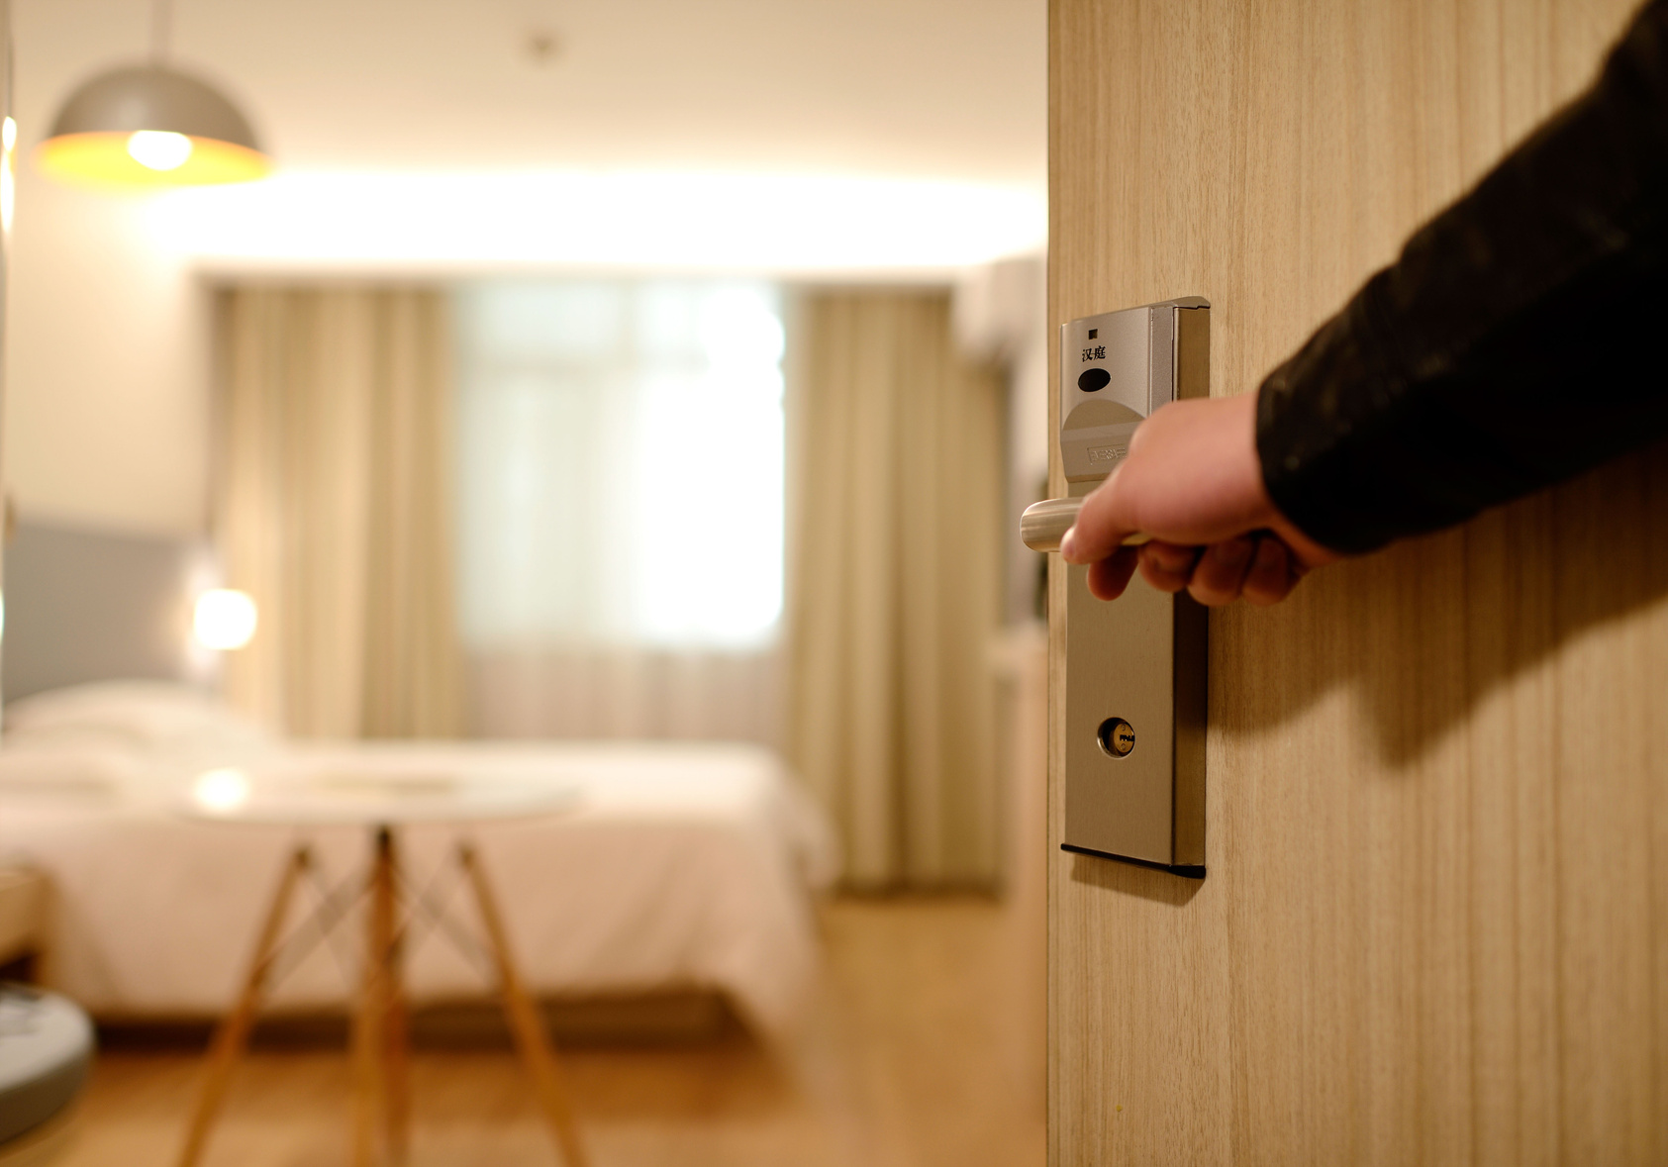

USALI 12TH
CHANGES
TM
Rooms
Executive Lounge Schedule
Channel Mix
Loyalty Programs

Slide 18


USALI 12TH CHANGES
TM
Food & Beverage
Outlet determination
Venue versus Operated Department

Slide 19

USALI 12TH
CHANGES
TM
Sales & Marketing
Digital related accounts
Marketing Agency Fee

Slide 20

USALI 12TH CHANGES
TM
Full-Time Equivalent Schedule

Slide 21

USALI 12TH
CHANGES
TM
Other Notable Items
Gross vs Net Reporting
Leases
Subsidies & Grants

Slide 22
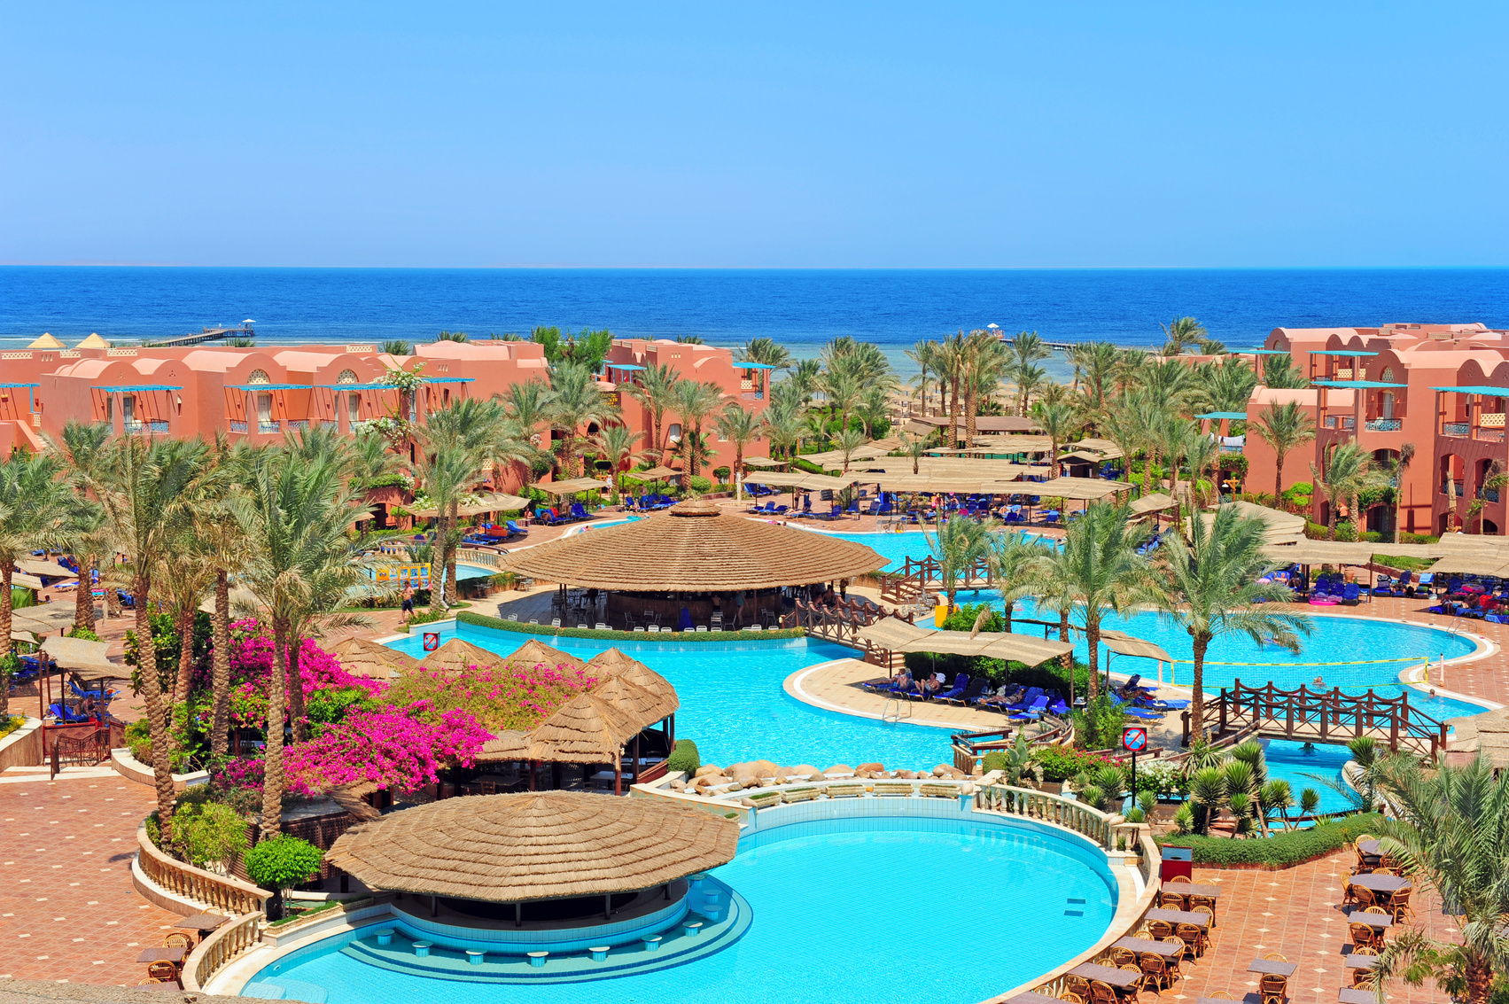
USALI 12TH CHANGES
TM
All Inclusive Reporting

Slide 23

USALI 12TH CHANGES
TM
.....and there is much more to review such as guidance, metrics, and enhanced definitions.

Slide 24



