Slide 1
Top Employment Issues in the Hotel and Hospitality Sector
Andria L. Ryan and Justin Braigel
May 13 - 14, 2026

Slide 2

Justin Braigel
General Counsel, Legislative Director, Texas Hotel & Lodging Association
Austin
Represents over 6,000 hotel business.
Focus on all aspects of hotel operations.
Provides governmental affairs advocacy for the Texas hotel industry.

Slide 3

Andria L. Ryan
Fisher Phillips LLP
Atlanta
Co-chair Firm’s Hospitality Business Practice Group
Firm’s Assistant General Counsel for Employment
Member – “Hotel Hogs” Motorcycle “Gang”

Slide 4
Accommodations

Slide 5
Accommodation Obligations
Employers must “reasonably” accommodate :
  An employee’s religious beliefs
  An employee’s disability
  An employee’s pregnancy-related limitations
  . . . unless an undue hardship exists

Slide 6
Religious Accommodation
Title VII’s definition of religion: "all aspects of religious observance and practice, as well as belief."
  Employers must accommodate sincerely held religious beliefs
  That conflict with an employment requirement
  Unless "undue hardship"
  Cultural, social and political beliefs do not qualify

Slide 7
Disability Discrimination – the Definition
The Americans with Disabilities Act (ADA) prohibits discrimination against a “qualified individual with a disability”
Under Title I of the ADA, Employers are required to provide reasonable accommodation for those individuals who, because of their disability, are unable to perform essential functions of their job – unless undue hardship exists
A “disability” is a physical or mental impairment that interferes with a
major life activity

Slide 8

ADA and Guests with Disabilities
Under Title III of the ADA, as a “public accommodation” hospitality establishments are required to provide reasonable accommodation to guests
Must provide equal access so that people with disabilities can use services through:
physical accessibility (new construction/alterations)
policy modifications
effective communication
barrier removal where readily achievable

Slide 9
Pregnancy Accommodation
Pregnant Workers Fairness Act – effective June 27, 2023
Requires covered employers to provide reasonable accommodations for employees with medical conditions related to pregnancy and childbirth.
  Similar to ADA disability requests
Employers can check documentation in some cases.
Can only deny accommodation request if it imposes “undue hardship” on business operations

Slide 10
Wage and Hour Compliance

Slide 11
The Basics
Must pay all non-exempt employees the minimum wage ($7.25/hr.).
Must pay overtime (1.5 x the regular rate) for all hours over 40 in a workweek.
Must keep an accurate record of all “hours worked.”
Cannot employ “minors” in certain positions or work certain hours.

Slide 12

Top Five Mistakes
Tip Credit/Tip Pooling
Child Labor
Meal and Rest Breaks
Off-The-Clock Work
Overtime Exemptions

Slide 13

Tip Credit
Under federal law – may take tip credit of $2.13/hour
Check state law
Must have notice proper tip credit in writing.

Slide 14

Tip Pooling
Ensure managers/supervisors stay out of the tip pool
Implement a clear tip pool policy
Train management and staff on tip pooling policy

Slide 15

Child Labor
Keep records on employee ages
Audit time records and duties of minor workers
Implement strict policies
Train everyone on the policies
Set up fail safes to ensure no one is working outside of hours permitted and performing hazardous duties

Slide 16

Meal and Rest Periods
Federal law does not require (except for lactation)
Check state law
Develop a Policy
Do not use auto-deductions
Implement policy putting the burden on the employee to acknowledge missed breaks

Slide 17

Off the Clock Work
Develop a policy prohibiting off-the-clock work and manner to report time.
Be mindful of after-hours message and communication (WhatsApp, Slack, etc.)
Audit regularly and train managers.

Slide 18

Overtime Exemptions
Salary basis test = $684 per week
Duties Tests
  Administrative
  Executive
  Professional

Slide 19
ICE/Business Immigration Issues

Slide 20
OBBB Act =Boosted ICE Budget = Increased Immigration Enforcement
ICE’s annual budget has tripled to nearly $30 billion for enforcement and deportation operations, with a total of about $170 billion allocated over the next decade for immigration enforcement and border security.
Impact on Employers
  ICE continues to ramp up workplace activities, including audits, I-9 inspections, and worksite raids

Slide 21
Why Would ICE Be At The Worksite?
Raids vs. Audits
ICE may come to the worksite to:
  Start an I-9 audit (Document will be called “Notice of Inspection”);
  Workplace raid – must have a judicial warrant;
  Detain a specific person – must have a judicial warrant.

Slide 22
What Protections Are Available
Employers and employees have rights under law, regardless of status
  4th Amendment – protects against unreasonable searches and seizures
  5th Amendment – right to remain silent
Worksite Raids must be accompanied by a Judicial Warrant signed by a judge and give a specific scope of search and seizure.
Warrants
  An administrative warrant authorizes an ICE agent to make an arrest or seizure, but not to search
  An ICE warrant does not authorize an ICE agent to enter a private space or home without consent

Slide 23
Preparation
Immigration Point Person
  Assign a manager as the primary contact for all DHS/ICE/CBP correspondence.
  Ensure all employees are aware of who this person is and how to contact them.
Employee Awareness and Communication
  Train employees to immediately notify the Immigration Point Person in case of any contact from DHS/ICE/CBP.
Workplace Signage and Access Control
  Ensure proper signage is displayed on all private and non-public workspaces.
  Restrict unauthorized access to non-public areas unless legally required.

Slide 24
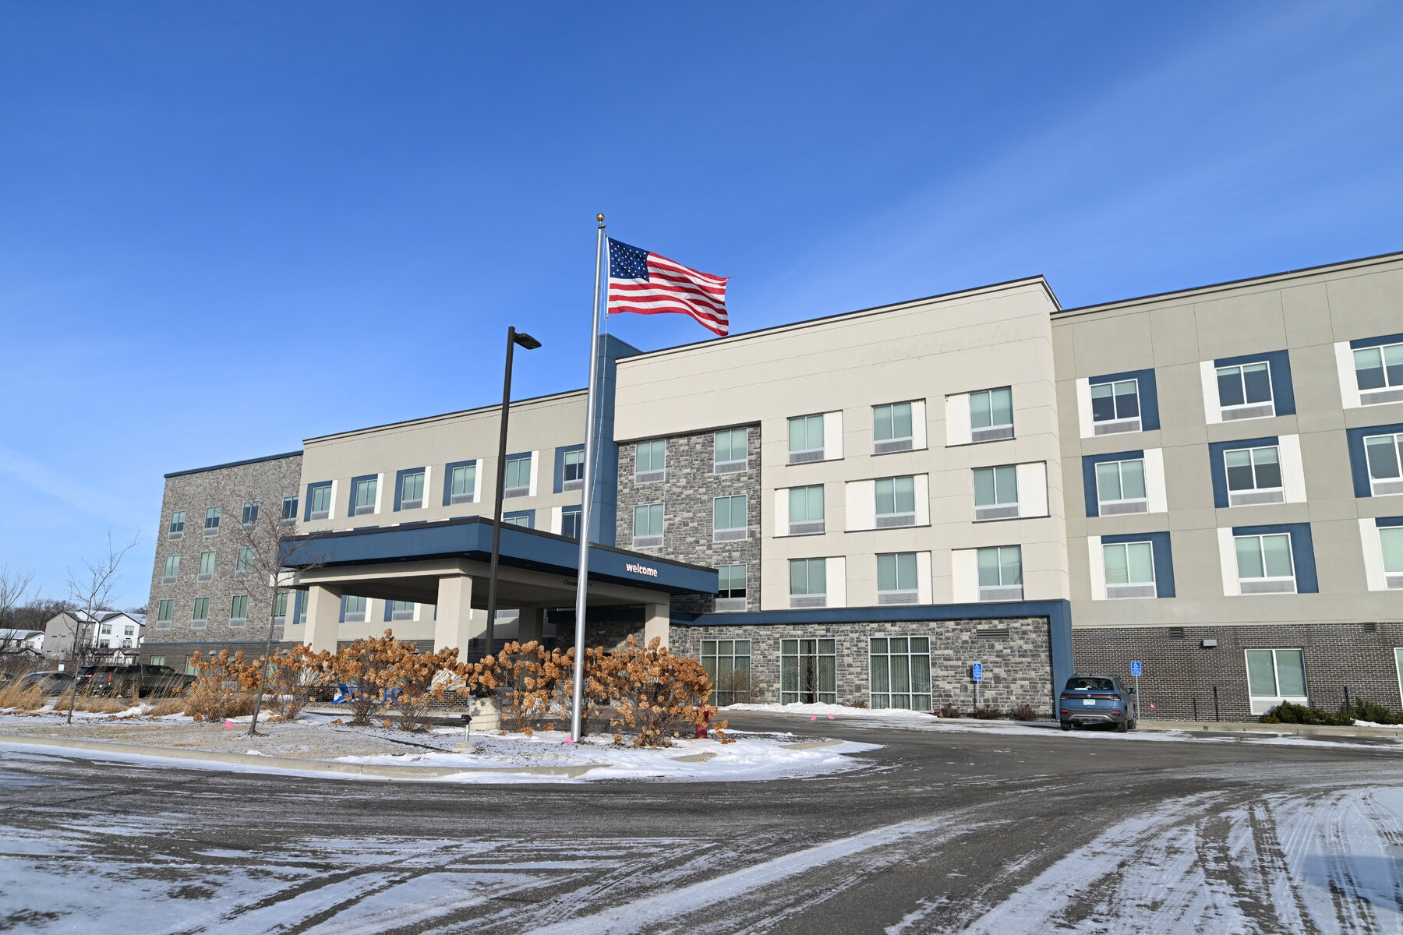
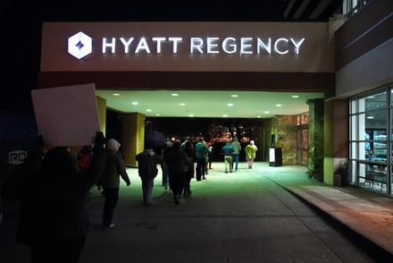
ICE and PR
Reputation management is critical:
  Governmental relations
  Employee relations
  Customer perception
  Retaliation concerns
  Contract issues

Slide 25
Firearms

Slide 26

Firearms Policies: Employees
Have a workplace weapons policy.
Know state law: Some states limit where employees can store firearms or require employers to provide storage solutions for employees.
Be consistent.
Special exceptions for licensed private security personnel and contractors (maybe).
Be sensitive to employees dealing with domestic violence.

Slide 27
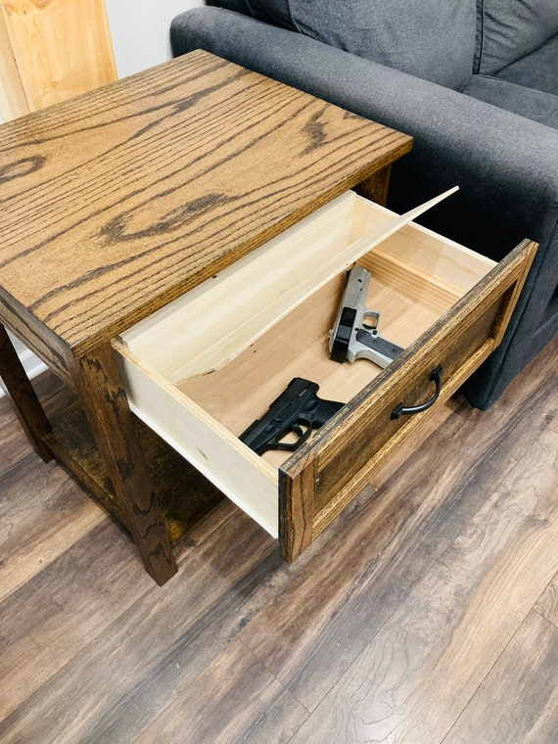
Firearms Policies: Guests
Know state law:
  Some states limit what polices establishments can implement regarding restricting firearms.
  May also include LEOs.
Know signage requirements, disclosure requirements, etc.
Alcoholic beverage service areas may control the issue.
Have an internal policy with how to deal with mislaid and found firearms.
Consider having a designated employee or employees trained to handle, secure, and safeguard firearms.
Train, train, train employees.

Slide 28


Andria L. Ryan
Fisher Phillips LLP
Justin Braigel
Texas Hotel and Lodging Association

