Slide 1
Legal & Operational Issues Associated with Hemp-Based Beverages
Elizabeth A. DeConti
May 13 - 14, 2026

Slide 2

Elizabeth DeConti
REGULATED PRODUCTS SECTION CHAIR, GRAYROBINSON
TAMPA, FL
ELIZABETH.DECONTI@GRAY-ROBINSON.COM
813.273.5159
Chairs GrayRobinson’s Regulated Products Section with experience advising on alcohol, hemp-derived, and emerging THC beverage regulations.
Helps clients navigate the rapidly changing legal landscape surrounding THC-infused beverages, including federal/state regulations, marketing, and distribution risks.
Combines litigation and regulatory experience to guide alcohol and alternative beverage companies through innovation, compliance, and market entry strategies.

Slide 3

Change and Disruption are Upon Us
The environment we’re living in
Alcohol consumption is down as a result of financial belt-tightening and a desire for alternatives, leading to public interest in THC and Alternative Beverages.
Ripple effects of decreased consumption include numerous spirits supplier bankruptcies.
The federal government changes its tune on the safety of alcoholic beverages for human health.

Slide 4
Change and Disruption are Upon Us
The Legal Landscape
Federal and state laws were inconsistent before the ban arose as part of the 2025 Continuing Budget Resolution.
A ban on hemp-based beverages is set to take effect in November of this year.
Federal and state laws remain inconsistent, and no one knows what to do about it.
The result is industry chaos.

Slide 5
Navigating the Chaos
Understanding the Federal Hemp Ban
Public Law No. 119-37 (November 12, 2025): Ended the federal government shutdown and changed cannabis definitions previously contained in the 2018 Farm Bill.
The law amends the earlier definition of federally legal hemp to now exclude products with more than 0.4 milligrams of total THC.
Hemp does NOT include certain seeds, intermediate/final products, or synthetic cannabinoids or cannabinoids with 0.4 milligrams or more total combined THC per container.
The ban is due to take effect on November 12, 2026.

Slide 6
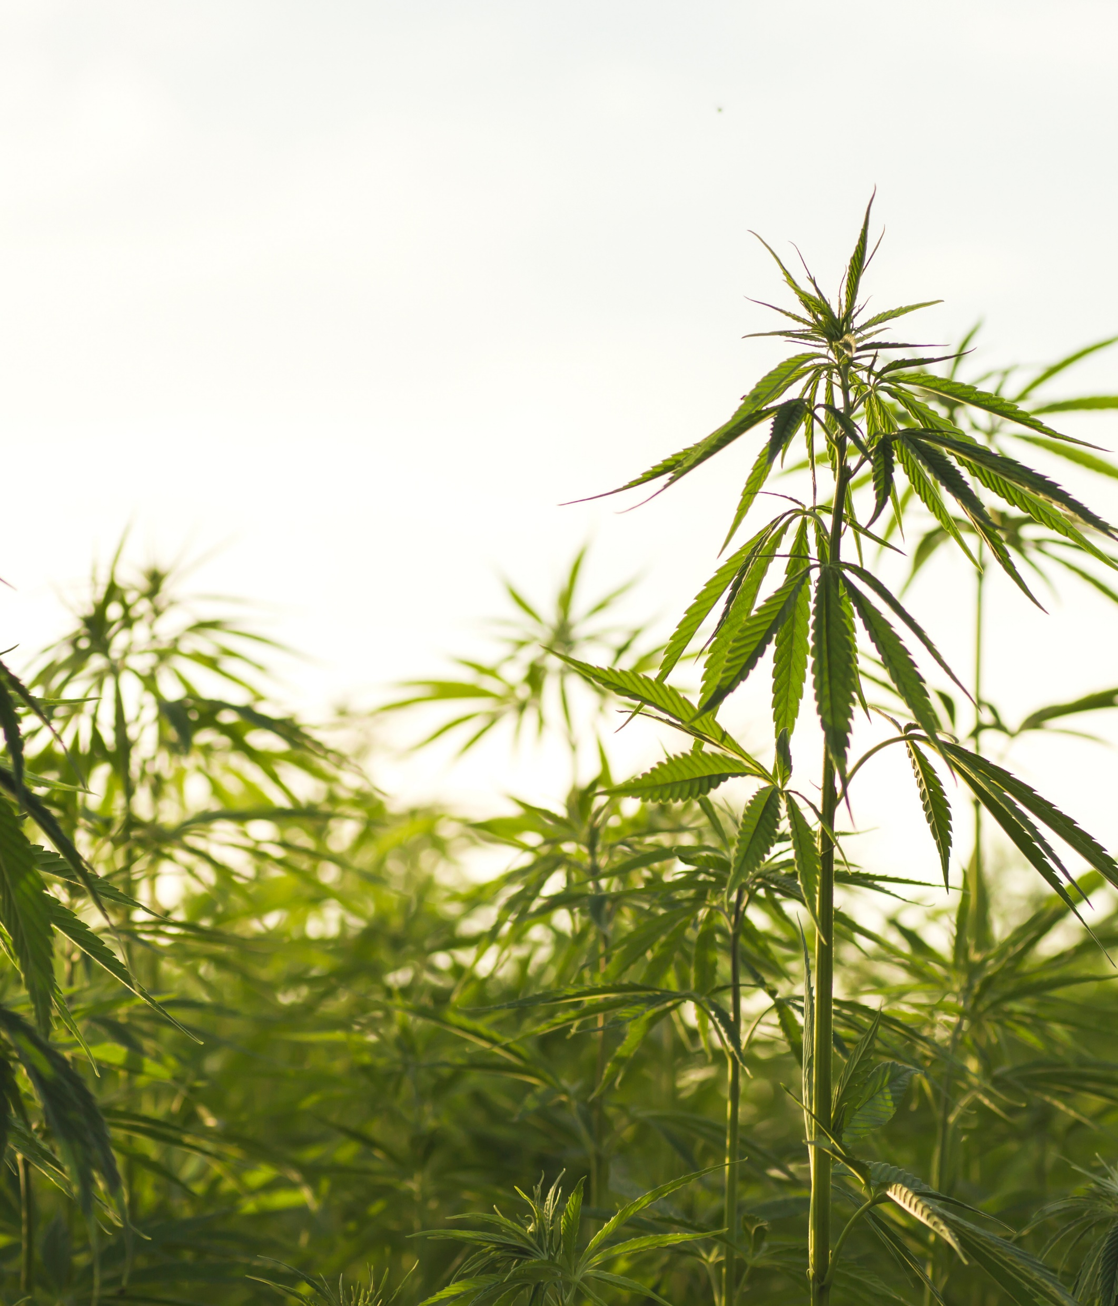
Practical Effects of the Federal Hemp Ban, Assuming it Moves Forward
Products that were legal before, with low levels of delta-9 THC but high levels of other cannabinoids, will be illegal.
Synthetic products will be illegal.
Products with more than 0.4 milligrams of THC will be treated as marijuana.
Enforcement mechanisms are as yet unclear.

Slide 7
Issues for Hotels and Restaurants
If the ban moves forward, some products being sold now will be illegal.
A patchwork of state-level regulations is difficult to track between now and November.
May on-premises retailers holding liquor licenses sell these products?

Slide 8
Now What?
Alternatives to the federal ban to create a more balanced and clear regulatory structure without loopholes. These may change the timeline/deadline.
The ban rolls forward. States deal with regulatory purgatory in an interim period, when what we knew as the universe of hemp-derived beverages is still allowed.
The ban rolls forward, and the states adopt it sooner rather than later.

Slide 9
Efforts to Push Back the Implementation of the Federal Hemp Ban
Hemp proponents believe that a deadline of November 2026 does not provide enough time to regroup and propose alternatives and could mean the end of the hemp industry. Proposed federal legislative fixes include:
Cannabinoid Safety and Regulation Act, 2025 Cong. U.S. S 3474 (December 15, 2025) would amend the FDA Act to provide a structure to legalize certain intoxicating hemp products, with guardrails for packaging, labeling, testing, and over-21 age gating.
Representative James Baird (R-IN) introduced a bipartisan bill on January 12, 2026, which would delay the implementation of the hemp ban for three years; see 2025 Cong. U.S. HR 7010 (January 12, 2026).

Slide 10
STATE APPROACHES: NEW JERSEY
New Jersey tightens rules to achieve alignment with the federal ban and to close the gap between traditional hemp products and higher THC-based beverages.
Delta 8, Delta 9, and Delta 10 products over the limit are treated as cannabis.
Two sales channels:
Traditional cannabis licensees may sell under Cannabis Regulatory Commission Oversight.
Wholesalers and retailers of alcoholic beverages sell in accordance with NJ ABC laws, with agency approval.
Cannabis Regulatory Commission, in consultation with the NJ ABC, must promulgate regulations within 12 months.

Slide 11

STATE APPROACHES: TEXAS
Permitting is required from both TABC and the Texas Department of State Health Services.
Over 21 only, and ID checks are mandatory.
A TABC licensee who does not check ID on the sale of a THC beverage will have their TABC license suspended or revoked.

Slide 12

STATE APPROACHES: OHIO
Products that do not meet federal guidelines may only be sold in licensed marijuana dispensaries.
No grace period following Governor Mike DeWine’s line-item veto on the bill, which would have allowed a temporary grace period until the end of 2026.
Changes must be made within 90 days of the passage of the new law.

Slide 13
An Uncertain Future in 2026
Will the pendulum swing back to alcohol?
Will the impending THC ban pave the way to success for beverage categories containing neither alcohol nor THC?
Will we have a legislative solution?

Slide 14
Elizabeth DeConti
Regulated Products Section Chair, GrayRobinson
Tampa, FL
elizabeth.deconti@gray-robinson.com
813.273.5159

