Slide 1
Trade Secrets and Restrictive Covenants:
Best Practices to Safeguard Your Company’s Critical Assets
Jordan B. Schwartz
Conn Maciel Carey LLP
May 13 - 14, 2026

Slide 2

Jordan B. Schwartz
Partner, Conn Maciel Carey LLP
Washington, DC
As a Partner at Conn Maciel Carey LLP, Jordan B. Schwartz represents employers across all aspects of the employment relationship within the Labor and Employment Practice.
He defends employers in federal and state litigation involving complex matters such as the ADA, FLSA, FMLA, Title VII, and restrictive covenants or trade secrets.
He provides expert guidance to hotels, restaurants, and retail stores on ADA accessibility (both physical and digital), as well as general compliance regarding hiring, discipline, and internal investigations.

Slide 3
The Current Legal Landscape of Non-Compete Agreements

Slide 4
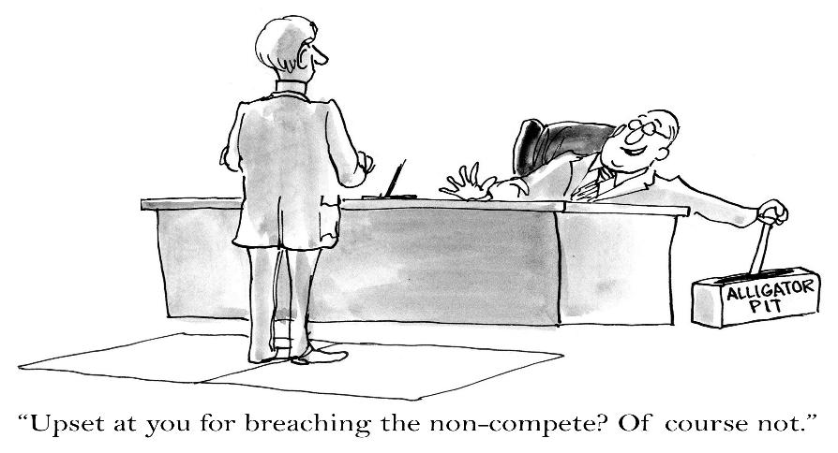
Brief Primer on Non-Compete Agreements

Slide 5
Non-Compete Agreements
A restrictive covenant designed to prevent workers from competing with a prior employer, directly or indirectly, for a specific period while employed and/or after the employment has ended
  Typically requires the employee to enter into a non-competition agreement before beginning work
Common prohibitions:
  Working for a competitor
  Starting a company that competes with the former employer
  Developing competing products

Slide 6

Non-Compete Agreements
Generally, in order to be considered valid, a non-competition agreement must:
  Be supported by consideration at the time it is signed
  Protect a legitimate business interest of the employer
  Be reasonable in scope, geography, and duration

Slide 7
Legitimate Business Interest
Regardless of how well a non-compete agreement is written; courts will not enforce it unless the employer can identify a legitimate business interest that the restrictive covenant seeks to protect.
Case law has expanded upon the meaning of legitimate business interest, but this also varies by jurisdiction.
Typically, courts will apply a totality of the circumstances review to determine whether the employer has identified a protected business interest.

Slide 8
Protected, Legitimate Business Interest
Courts have identified the following as potential legitimate business interests:
  Trade secrets
  Intellectual property
  Customer lists
  Goodwill with customers
  Knowledge of business practices
  Methods
  Profit margins
  Costs
  Other information (that is confidential, proprietary, and increases in value from not being known by a competitor)
  Training and education

Slide 9
Reasonable in Scope, Geography, and Duration
Key consideration: Are the non-compete provisions “overbroad?”
Inquiry is generally based on the totality of the circumstances.
  Non-compete agreements must be limited with respect to duration and scope in a manner that is not greater/broader than necessary to defend the protectable business interest of the employer.
    Time: 1 to 2 years is presumptively reasonable in many jurisdictions; potentially 5 years if it involves the sale of a business.
    Geography: Is it feasible?
    Scope/Unduly Harsh: Is it unreasonably necessary to protect the employer’s legitimate business interest?

Slide 10
Federal Status of Non-Compete Agreements in 2026
Non-competes remain valid under federal law
🛑 FTC’s 2024 Ban Blocked
  Attempted to ban all non-competes
  Blocked by federal courts (TX & FL)
  Appeals unlikely to proceed under Trump administration
📄 NLRB Opposition Reversed
  Former GC Abruzzo (Biden appointee) opposed non-competes
  Pushed for damages for affected employees
  Abruzzo terminated Jan 2025
  Position rescinded under new Trump-appointed GC
🔒 Bottom Line: Federal efforts to invalidate non-competes have failed—for now

Slide 11
Validity and Enforceability of Non-Compete Agreements Vary By State Law
Restrictions continue to expand at the state level:
  Over the past 3 years, more than 150 bills have been introduced in more than 35 states restricting non-competes to at least some degree.
  6 states (CA, OK, MN, ND, MT & WY) ban non-competes outright. In June 2027, Washington State will become the seventh.
  33 states and D.C. have laws limiting their use, often with salary thresholds (e.g., DC: $154,200; IL: $75,000; MD: $46,800).
  Virginia is expanding prohibitions to require that new covenants are only enforceable if the employee is terminated for "cause" or receives severance. VA also now bans noncompetes for employees entitled to overtime under the FLSA regardless of their weekly income.

Slide 12
Validity and Enforceability of Non-Compete Agreements Vary By State Law
  Pending legislation in New York aims to ban non-competes for most workers earning less than $500,000 annually.
  Healthcare professionals face increasing protections—20 states, including PA and MD, now limit or ban non-competes for these workers.
  Contrary to the national trend, Florida enacted the "CHOICE Act," which strengthens the enforceability of non-competes up to 4 years for higher income employees.
    It presumes agreements are valid, removes strict geographic limitations, and mandates that courts issue injunctions against departing employees.

Slide 13
Hiring Employees
With Non-Compete Agreements

Slide 14
Hiring Employees with Restrictive Covenants
KEY → Take reasonable steps to protect your business from interfering with competitors’ restrictive covenants.
Interview Stage
  When considering a new hire, ask during the interview whether the individual is subject to any employment agreement
  Obtain copies of the employment agreement pre-hire
  Inform the applicant that Company insists on full compliance with employment agreements
  Company does not want applicant to disclose or use any of the competitor’s confidential or proprietary data
Hire Stage
  In an offer letter, confirm that Company expects employees to comply with former employer’s agreements

Slide 15
Hiring Employees with Restrictive Covenants
Post-Hire Stage
  Review restrictive covenants with employees to ensure everyone understands how to comply
  Have new employees create a comprehensive customer list that the employee serviced while at former employer or about whom the employee has information
    Update list regularly
  Create ethical wall between business that employee serviced at former employer
  Avoid allegations of flipping

Slide 16
What Are Trade Secrets?
Notes:
So in this part of the presentation, we’re going to dive into trade secrets :
First, what trade secrets are and how they’re legally defined;
Then, we’ll shift to the real-world risks—from insider threats to cybersecurity lapses;
And finally, we’ll talk about how to protect those secrets proactively and what legal tools are available if something goes wrong.

Slide 17
What Are “Trade Secrets”?
Information not generally known to others that gives an employer a competitive advantage
  Confidential information
  Information has economic value
Subject of reasonable efforts to maintain its secrecy
Generally defined by state law – a large majority of states have adopted the Uniform Trade Secret Act

Slide 18
What Are “Trade Secrets”?
Fact-specific inquiry
Factors courts consider include:
  Whether the information is known outside of the owner’s business
  Measures taken by the owner to guard the secrecy of the information
  The value of the information to the owner and to the competitor
  The amount of effort or money expended by the owner in developing the information
  The ease or difficulty with which the information could properly be acquired or duplicated by others

Slide 19

Examples of Trade Secrets
Customer lists
Formulas
Manufacturing processes
Marketing plans
Pricing information
Research studies
Strategic business plans
Testing data
Training manuals

Slide 20
Threats to Trade Secrets and Proprietary Information

Slide 21
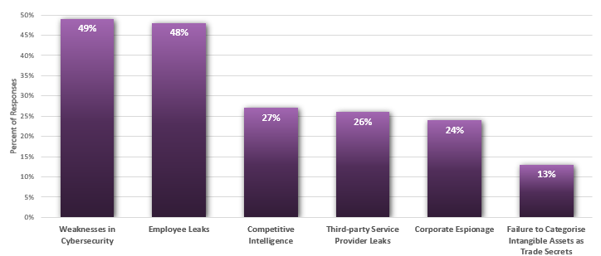
Poll: Top Threats to Trade Secrets
“What do you regard to be the most significant threats to your organization’s trade secrets?”

Slide 22
Resource-Based Threats
Reduced Headcount = Increased Risk
  Downsizing can strain organizational resources, creating vulnerabilities to external cyber threats and internal risks.
Loss of Checks & Balances
  Eliminating roles in IT, HR, and management may lead to fewer safeguards and oversight in critical systems.
Gaps in Supervision
  Fewer IT staff may mean less coverage and weaker monitoring, increasing exposure to breaches.
Access Management Concerns
  Terminating employees with oversight responsibilities can result in poorly managed access to sensitive databases and confidential materials.

Slide 23
Risks of BYOD and Remote Work:
Trade Secrets at Risk
🔓 Data Breaches and Cyber Threats
  Nearly 50% of employers with BYOD report data breaches
  Unsecured home networks & personal devices increase risk
  Trade secrets and proprietary info are vulnerable outside company firewall
🕵️ Privacy and Monitoring Challenges
  Blurred lines between personal and work use
  Legal complications with device searches and data access
  Difficult to track misuse or mishandling of confidential data
📱 Device Misuse and Vicarious Liability
  Employees could engage in harmful or unauthorized actions
  Trade secrets may be shared—accidentally or intentionally—via unsecure apps
  Departing employee

Slide 24
Protecting Trade Secrets and Proprietary Information
Notes:
Proactive Steps

Slide 25

How to Protect Trade Secrets
Internal Steps
  Identify and value TSI
  Catalog and audit of TSI
  Implement of classification, tracking and security protocols
  Disseminate company policies
  Dispose of documents completely

Slide 26
Utilize Confidentiality: Non-Disclosure Agreements
Whether a non-disclosure agreement (NDA) is enforceable rests on the somewhat vague notion of “reasonableness.”
Should describe in detail the categories of confidential information. Avoid boilerplate and tailor description to nature of business so employees understand obligation and are on notice.
Require Signed Agreements
  Duty to Maintain Confidentiality
  Restrictions on Solicitations of Customers
  Restrictions on Solicitations of Employees
  Duty to Return Confidential and Proprietary Information
  Interests of the public

Slide 27

Provide Training On Handling
Confidential Information / Trade Secrets
Periodic training, review and acceptance of:
  terms of use for: devices, systems, data, access
  non-disclosure agreements
  non-compete agreements
  assignment agreements
  security awareness training

Slide 28
Specific Employees:
Insider Threat Indicators – “Personal”
Disgruntled.
Poor performance ratings.
Exhibits “above the rules attitude”.
Routinely goes to executives and by-passes supervisor.
Undisclosed foreign travel.
Excessive or unusual foreign travel.
Unjustified work pattern (nights, weekends).
Numerous security infractions.
Excessive use of copier, scanners or faxes.
Chronic expression of being under recognized at work.
Unexplained affluence

Slide 29
Insider Threat Indicators – “Technology”
Increased non-business-related activities on internet (web surfing, job hunting, social media).
Increased foreign IP traffic.
Increased e-mail and USB storage/transfers.
Repeated responder to phishing attacks.
Purging or wiping system prior to termination.
Posting sensitive information on social media.
Speaks out against company leadership or company on social media.
Conducting unexplained network or company database searches.
Attempting remote access after being laid off or terminated.
Encrypting e-mails to private or personal accounts.

Slide 30
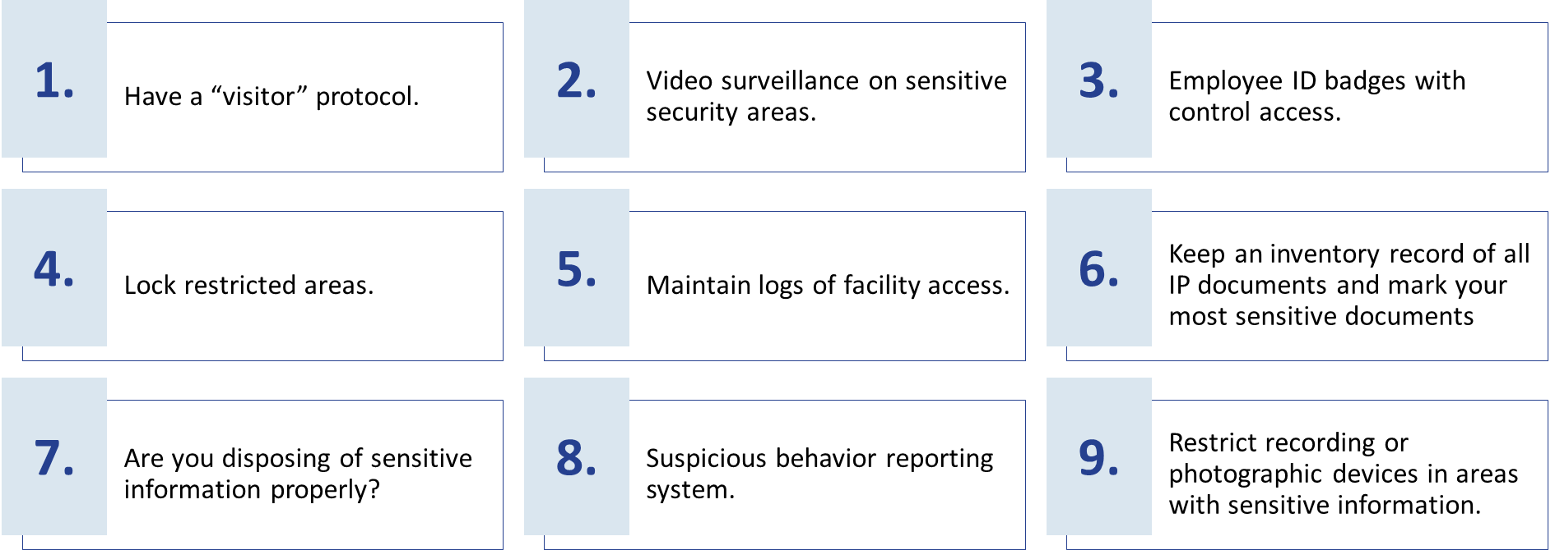
Maintain Physical Security

Slide 31
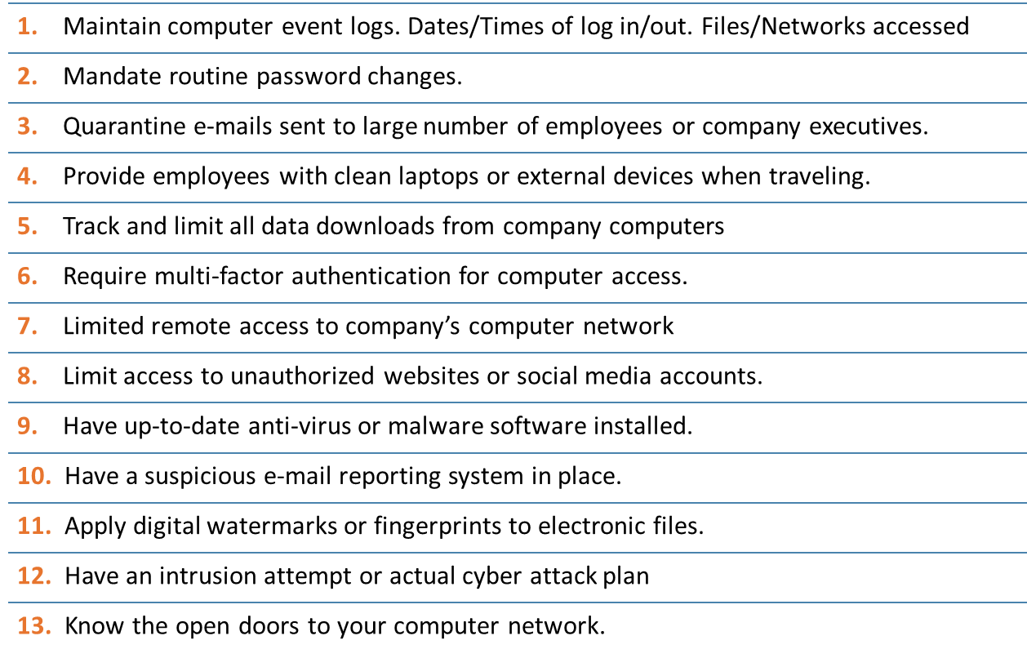
Maintain Cyber Security

Slide 32
TSI Policies and Plans
Plan and roadmap for onboarding and offboarding, responding to a potential insider threat incident, and periodic review:
  Granting and cutting access
  Preservation of data, equipment and logs
  When to call counsel and the importance of privilege
  When to call law enforcement
  Entry and exit interviews
  Employee termination procedures

Slide 33
Legal Recourse and Response Options
Notes:
🔒 Slide 1: Legal Recourse and Response Options
✅ Intro:
“Even with the best internal controls and preventative measures, things can still go wrong. That’s why it’s critical to have a legal response framework ready.”
💬 Talking Point:
“This next section walks through what to do when you suspect a theft or breach of confidential information—from internal investigation to potential legal action.”
🔁 Transition to Next Slide:
“We’ll start by looking at how you can launch an internal investigation the right way—without compromising evidence or crossing legal lines.”

Slide 34

Play Detective: Investigating
Potential Theft of Confidential Information
Key Steps to investigate potential theft of confidential information include:
  Securing back up tapes / drives of emails and network servers
  Developing internal forensic protocol for searching back up tapes and drives
  Treating theft allegations as confidential – i.e. share on a “need to know” basis
  Avoiding invasion of privacy

Slide 35
Investigating Theft of Confidential Information: Technology-Based
Every internal investigation should include a survey of the following potential sources of information:
Office personal computer
E-mail
Voicemail
Company Smart Phone
Cellular phone records
Telephone dial-out/dial-in records
Card access records
Video surveillance cameras

Slide 36
Incident Response Plan
Outline steps to be executed in the event of an intrusion or theft of IP.
Identify the information that has been stolen.
Determine how much of the network needs to be shutdown, quarantined or isolated.
Secure or archive all relevant security activity.
Document who discovered the theft or intrusion.
Have a reporting system.
Determine when the theft occurred and is it ongoing.
Have an employee termination procedure in place.

Slide 37
Initial Response
Conduct Investigation
  Ideally Under Direction of Counsel
  Use internal or external cybersecurity professionals to gather facts around what data was taken / exfiltrated
Preserve Trade Secrets
  Seek Injunctive relief using the Defend Trade Secrets Act or a state version of the Uniform Trade Secrets Act

Slide 38

Civil Lawsuit Remedies
Tort: Conversion, Trespass
Breach of Contract
  Violation of Non-Disclosure Agreement
  Confidentiality Agreement
  Employment Agreement
Computer Fraud and Abuse Act
Trade Secret Claim
  UTSA/ State Law
  DTSA

Slide 39

Jordan B. Schwartz
Conn Maciel Carey LLP
202.909.2731
jschwartz@connmaciel.com

