Slide 1

U.S. Hotel Industry Report
Hospitality Law Conference: Houston
Luigi Major, Managing Director
May 2026

Slide 2
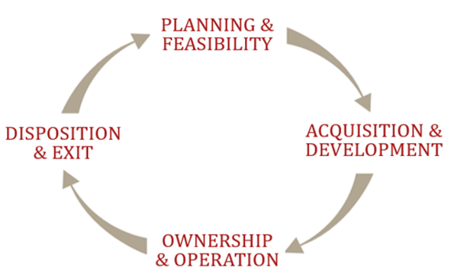
HVS Provides Expertise Through Every Phase of Ownership Across a Wide Range of Hospitality Assets
End‑to‑End Advisory Services for Owners & Investors
Hotel owners
Developers
Investors
Lenders
Management Companies
Public Agencies
Hotels
Mixed Use Development
Shared Ownership Lodging
Golf Clubs & Wellness
Casinos
Convention, Sports & Entertainment Facilities
Resort Residential Properties
HVS.com
Market Research and Industry Publications:
Broker Survey, Franchise Fee Guide, Development Cost Survey, and more!
Notes:
global consulting firm specifically focus on the hospitality industry
we provide help hospitality investors, developers, and lenders to make informed business decisions through the entire lifecycle of a hotel
Consulting & Valuations side of business: appraisals, market studies, feasibility studies, provide facility recommendations
Other: brokerage & capital markets, hotel & asset management, design, spa and wellness, executive search
Publish interesting market data for industry – development cost, broker’s survey, franchise fee guide

Slide 3







A Seven‑Step, Approach to Hotel Feasibility Analysis
That Translates Market Insight into Actionable Results
01
07
02
06
03
04
05
Assignment Conditions and Scope of Work
Narrative Report
Property Inspection and Market Fieldwork
Market Area Supply & Demand
Facility Overview and/or
Guidance
Market & Subject Property Forecasts
IRR and Feasibility Analysis
Notes:
Interesting to note that this is the first year with supply at pace with demand causing occupancy to flatten and rate to drop to inflationary levels.

Slide 4

National Performance Trends

Slide 5
After an Occupancy Decline, a Modest Increase Is Likely
Forecast
Source: STR/CoStar (Historical), HVS (Forecast as of January 2026)
Notes:
Updated, LC

Slide 6

Demand Uncertainty Is Driving Occupancy Volatility
The international traveler shifts away from the U.S.
Tougher immigration policies creates caution
Heightened new alternative supply (Airbnb, VRBO, new brands)
Iran War, Oil Price Uncertainty, Inflation Uncertainty, Stock Market Uncertainty
Unemployment rising; historical jobs creation revised down.
Employment uncertainty creates caution
(New term: Job hugging)
AI and robotics improving business productivity
Notes:
The International Traveler Shifts Away from the U.S. Brand (for now)
Federal Government Employment Centers Thrown into Disarray
Heightened New Supply Drags Down Overall Average (Lower Start-Up Occupancies)
Impacts of Tariffs on All Industries, Big and Small, on the Horizon; Uncertainty Leads to Less Hiring & Travel
University Towns Brace for Impact: Government Spending Changes Emerge
Decline Not Widespread: National averages are down, but half of the top 25 U.S. markets registered positive change in the four-week period ending April 19.

Slide 7
ADR Growth On Steady Momentum
Forecast
⬆ 3.5%
⬆ 3.0%
⬆ 1.5%
Source: STR/CoStar (Historical), HVS (Forecast as of January 2026)
Notes:
Please make sure the headline still jives with the forecast
Rod covers this slide in opening.

Slide 8
Luxury Overperformed in 2025
RevPAR change in 2025 vs 2024
Source: STR/CoStar

Slide 9
Likely due to the return of business and group travel
Urban Locations Overperformed in 2025
Source: STR/CoStar

Slide 10


RevPAR Performance: Best & Worst Markets, YTD 2026
Best Performing Markets
Worse Performing Markets
SF/Bay Area +31.2%
Minneapolis +12.7%
Miami +12.1%
St. Louis +11.4%
San Diego +10.9%
New Orleans -20.4%
Tampa Bay -9.4%
DC -6.3%
Boston -4.9%
Atlanta -2.8%
Source: STR/CoStar, HVS
Notes:
(This slide will be updated weekly; make sure you have the most current version.)
If you see the 2022 line, Q1 2022 was still off 2019 levels due to Omicron – this impacted groups and corporate transient in particular. By the 4th quarter, occupancy recovery seemed more inline with 2019 levels overall.
This should contribute to our occupancy forecast of nearly 64% in 2023, which will be somewhat tempered by the slowing economy. With the economy expected to strengthen in late 2023 and into 2024, the occupancy recovery should extend in 2024 and 2025.

Slide 11
Nationwide Forecast: RevPAR Growth Stabilizes
RevPAR remains below 2019 RevPAR adjusted for inflation (2025 Deflated RevPAR $79.30 vs. $86.76 in 2019)
Year | Occupancy |  | ADR |  | % Chg |  | RevPAR |  | % Chg
2020 | 43.9 | % | $103 |  | -21.1 | % | $45 |  | -47.4 | %
2021 | 57.5 |  | 125 |  | 21.0 |  | 72 |  | 58.3
2022 | 62.6 |  | 150 |  | 19.1 |  | 94 |  | 30.0
2023 | 63.0 |  | 156 |  | 4.3 |  | 98 |  | 4.9
2024 | 63.1 |  | 159 |  | 2.0 |  | 100 |  | 1.7
2025 | 62.3 |  | 161 |  | 0.9 |  | 100 |  | -0.3
2026 | 62.7 |  | 163 |  | 1.5 |  | 102 |  | 2.2
2027 | 63.1 |  | 167 |  | 3.0 |  | 106 |  | 3.7
2028 | 63.5 |  | 174 |  | 3.5 |  | 110 |  | 4.3
Source: STR/CoStar (Historical through 2023), HVS (Forecast 2026 – 2028, as of January 2026)

Slide 12
Over 20 years, hotel performance remains strongly correlated with changes in GDP
GDP Remains the Strongest Indicator of Hotel Performance
Q4 24 Q4 25
RevPAR $95.53 $94.50
GDP 29,825.2 31,442.5
Source: STR/CoStar, BEA
Notes:
(This slide provides RevPAR insights, after the presentation of the main forecast summary.)
RevPAR moved beyond the prior peak in early 2022, when inflationary-driven movements drove significant moves up in the post-Omircron environment.
Pricing strength remained in place all year, and early indications for 2023 show that gains continue, albeit not as strong.

Slide 13
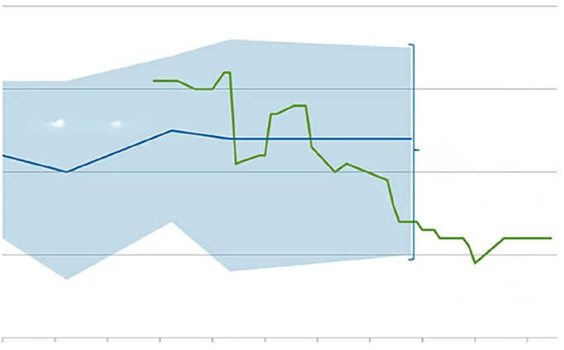
GDP Growth Remains Solid Despite Near‑Term Volatility
Latest GDPNow 2026 Q1 estimate shows steady economic growth at 1.3%
Evolution of Atlanta Fed GDPNow real GDP estimate Q4 2025
Quarterly percent change (SAAR)
4
Source: Blue Chip Economic Indicators and Blue Chip Financial Forecasts
Note: The top (bottom) 10 average forecast is an average of the highest (lowest) 10 forecasts in the Blue Chip survey.
3
Blue Chip consensus
Range of top 10 and
bottom 10 average
forecasts
2
1
Atlanta Fed
GDPNow estimate
0
25-Jan
3-Feb
12-Feb
21-Feb
2-Mar
11-Mar
20-Mar
29-Mar
7-Apr
16-Apr
25-Apr
Notes:
Updated with Q2 2025

Slide 14
Historically, hotel performance remains inversely correlated with unemployment
Unemployment Trends Help Explain RevPAR Performance
YTD thru Feb 2025 2026
RevPAR $86.41 $88.52
Avg Unemployment 4.1% 4.4%
Source: STR/CoStar, Federal Reserve Bank of St. Louis
* Unemployment Rate, Percent, Annual, Seasonally Adjusted
Notes:
(This slide provides RevPAR insights, after the presentation of the main forecast summary.)
RevPAR moved beyond the prior peak in early 2022, when inflationary-driven movements drove significant moves up in the post-Omircron encironment.
Pricing strength remained in place all year, and early indications for 2023 show that gains continue, albeit not as strong.

Slide 15
National Sentiment Shows Signs of Improvement
National Sentiment
Spring 2026
Fall 2025
Cooling
Cooling
Cooled, Starting to Turn
Cooled, Starting to Turn
Steady
Steady
Hot
Hot
Source: HVS Broker Survey Spring 2026 and Fall 2025

Slide 16
Average Cap Rates Remain Between 8.0-8.5%
Weaker performance in the lower-end of the segment spectrum tees up opportunities.
*
*
Source: MSCI Real Capital Analytics
*Q1 2026 Preliminary Data

Slide 17
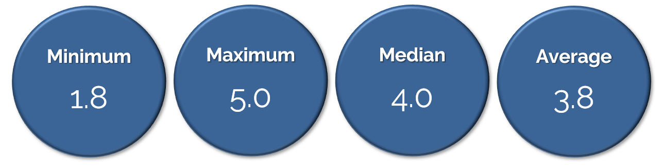
Limited-Service and Extended-Stay Hotels Reported RRMs remain ~ 3.8x to 4.0x
Room Revenue Multiplier Remain At or Above Average
Reflecting Continued Popularity of Assets in This Category
Source: HVS
Notes:
The rooms revenue multiplier (RRM) is a commonly used benchmark for converting an economy or mid-rate hotel’s revenue into an indication of value. RRMs are calculated by dividing the indicated sales price by the property’s rooms revenue. The respondents to this survey were asked to indicate current RRMs for limited-service, select-service, and extended-stay assets. The following graphic illustrates brokers’ responses to the current levels of RRMs.

Slide 18
While higher than 2021/22, discount rates remaining surprisingly stable over the last three years despite higher interest rates.
Discount Rates Remain Stable Over Last 3 Years
Source: HVS Broker Survey

Slide 19
Transaction Activity in 2026 Shows Stagnation
*
Source: MSCI Real Capital Analytics
* Q1 2026 Preliminary Data
Notes:
Lizzette, can we update this for 2025 Q4, even if just with preliminary data that is available thru 1/16?

Slide 20
Interest Rate Stability Is Helping Transactions Stabilize
Source: MSCI Real Capital Analytics, HVS, FRED (Federal Reserve Bank of St. Louis)
Notes:
Will get factors from Emil. Updated with latest

Slide 21
Higher interest rates results in higher discount rates and capitalization rates
Valuations Remain Affected by Cost of Debt
PREVIOUS FINANCING
TERMS
CURRENT FINANCING
TERMS
Interest Rate 5.25% 8.00%
Amortization
25 Years
25 Years
Debt Service Constant
0.07191
0.09262
LVT
RATE
WACC
LVT
RATE
WACC
Debt
65%
0.07191
0.04674
60%
0.09262
0.05557
Equity
35%
0.16000
0.05600
40%
0.01600
0.06400
WACC (Weighted Average Cost of Capital)
10.27%
11.90%
Indicated Value based on $1M EBIDTA
$9,733,000
$8,403,000
Change in Value
-14%
Source: HVS
Notes:
The blended total property yield (discount rate) is calculated based on the actual cash flows forecast for the subject property. Because of the timing of the refinancing and expected increase in EBITDA levels, the blended rate is more aligned with the refinancing rate than the current terms.
This analysis is intended to provide guidance and support for your selected discount rate.
Supported by the lower loan-to-value (LTV) ratio, reflecting investors’ willingness to accept a lower return in the near term, based on the expected refinancing
Current Financing Assumptions:
Higher interest rate, lower LTV ratio and shorter amortization period
The equity yield rate is lower
Refinancing Assumption:
Interest rates returning to the 5.0% to 5.5% level, with higher LTV ratios and longer amortization periods
Higher equity yield rate
The terminal cap rate and transaction costs remain the same in each scenario

Slide 22
Rising debt costs resulting in a 10% decrease in price per key vs. recent peak in 2021
Hotel Price Per Key Still Lower than Historical Peaks
Source: MSCI Real Capital Analytics
* Q1 2026 Preliminary Data
Notes:
Updated

Slide 23
Current Rate Decrease Signals More to Come
Federal Funds Rate Now On Downward Trend
Latest Rate Cut
Source: Board of Governors of the Federal Reserve System (US), March 2026
Shaded areas indicate U.S. recessions.

Slide 24


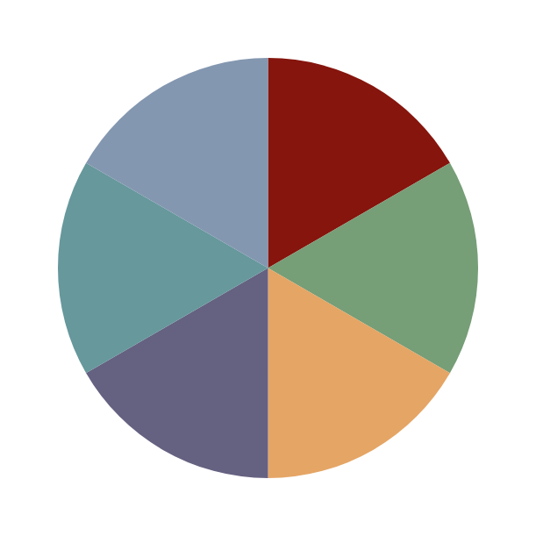





Food and Beverage & Other Revenue Trends
Operators seek to improve F&B revenues and profitability
Resort Pass & Cabana Rentals
Pass purchasing by local residents to use resort pools
Resort Fees
More hotels are adopting percentage‑based resort fees
Room Service Efficiency at
Full –Service Hotels
To‑go boxes are now standard in F&B delivery
Evolution of Menus
Wellness-based, organic farm-to-table & mocktail offerings
Market Pantry and/or Bar Synergy with Front Desk
Select‑service hotels pair front desk with F&B
Activated Lobby & Rooftops
Lobbies and rooftops drive revenue in the right markets
Notes:
Resort Pass & Cabana Rentals: Local residents can purchase passes to use nearby resort pool complexes and pay ++ for cabanas
Parking & EV Charging Fees: More hotels now charging for parking, earning lease income from EV parking
Wellness Memberships: If the facilities are right, offering memberships to use the hotel’s wellness offerings
Resort Fees: More hotels are charging resort fees now, with many charging s a % of the rate vs. a flat fee
Golf Simulator Instead of Pool: A Courtyard in Denver converts pool to 2 sports simulator bays ($40/hour) + offers food service
Activated Lobby & Curated Liquor: Lobbies become reserved lounge seating if the neighborhood is right. Also, in KY: Bourbon vending machines & in market pantries!
Last year the Courtyard in Denver Tech Center installed two Top Golf simulator bays in a conversion of the old pool/whirlpool area. There’s an hourly charge ($40), and the hotel offers to serve food/beverage out of the Bistro into the area. The simulators have golf, bowling, soccer, hockey, and football. First time I had seen that in a non-full-service hotel.
While it isn’t specifically COVID related, the GM mentioned that as a business hotel, the pool/whirlpool was not utilized very often and the conversion allows them to take a non-revenue generating space and convert to revenue, while decreasing POM costs related to the pool/whirlpool.

Slide 25
Key submarkets may support new construction at this time
Higher Construction Costs Limit New Supply
All Hotels
Full-Service
Select-Service
Limited-Service
Average PPK
$408,000
Median Cost to Build
$219,000
Average PPK
$504,000
Median Cost to Build
$410,000
Average PPK
$245,000
Median Cost to Build
$223,000
Average PPK
$163,000
Median Cost to Build
$167,000
Source: HVS U.S. Development Cost Survey, 2025

Slide 26
Construction Cost Inflation Stabilizing
Construction costs inflation significantly increased in 2022, cost increases are now waning
Source: Building Turner Cost Index

Slide 27
Supply Growth Moderating
Openings are picking up, but construction and land costs remain high and obsolete hotels removed from inventory will be a buffer.
Forecast
Source: STR/CoStar (Historical), HVS (Forecast as of January 2026)

Slide 28








A Balanced Outlook
Demand is steady, with occupancy recovering to 64%–65%
ADR growth shows no signs on slowing down
Hotel valuations (price per key) have also been affected by both cost of capital and lower activity
Geopolitical factors, inflation, and employment remain concerns
Supply remains muted due to elevated construction costs
Hotel transaction volume remains muted by capital costs, with interest rate relief expected to help
Hotels remain attractive to investors, with stable cap rates and pricing per key
Notes:
The International Traveler Shifts Away from the U.S. Brand (for now)
Federal Government Employment Centers Thrown into Disarray
Heightened New Supply Drags Down Overall Average (Lower Start-Up Occupancies)
Impacts of Tariffs on All Industries, Big and Small, on the Horizon; Uncertainty Leads to Less Hiring & Travel
University Towns Brace for Impact: Government Spending Changes Emerge
Decline Not Widespread: National averages are down, but half of the top 25 U.S. markets registered positive change in the four-week period ending April 19.

Slide 29

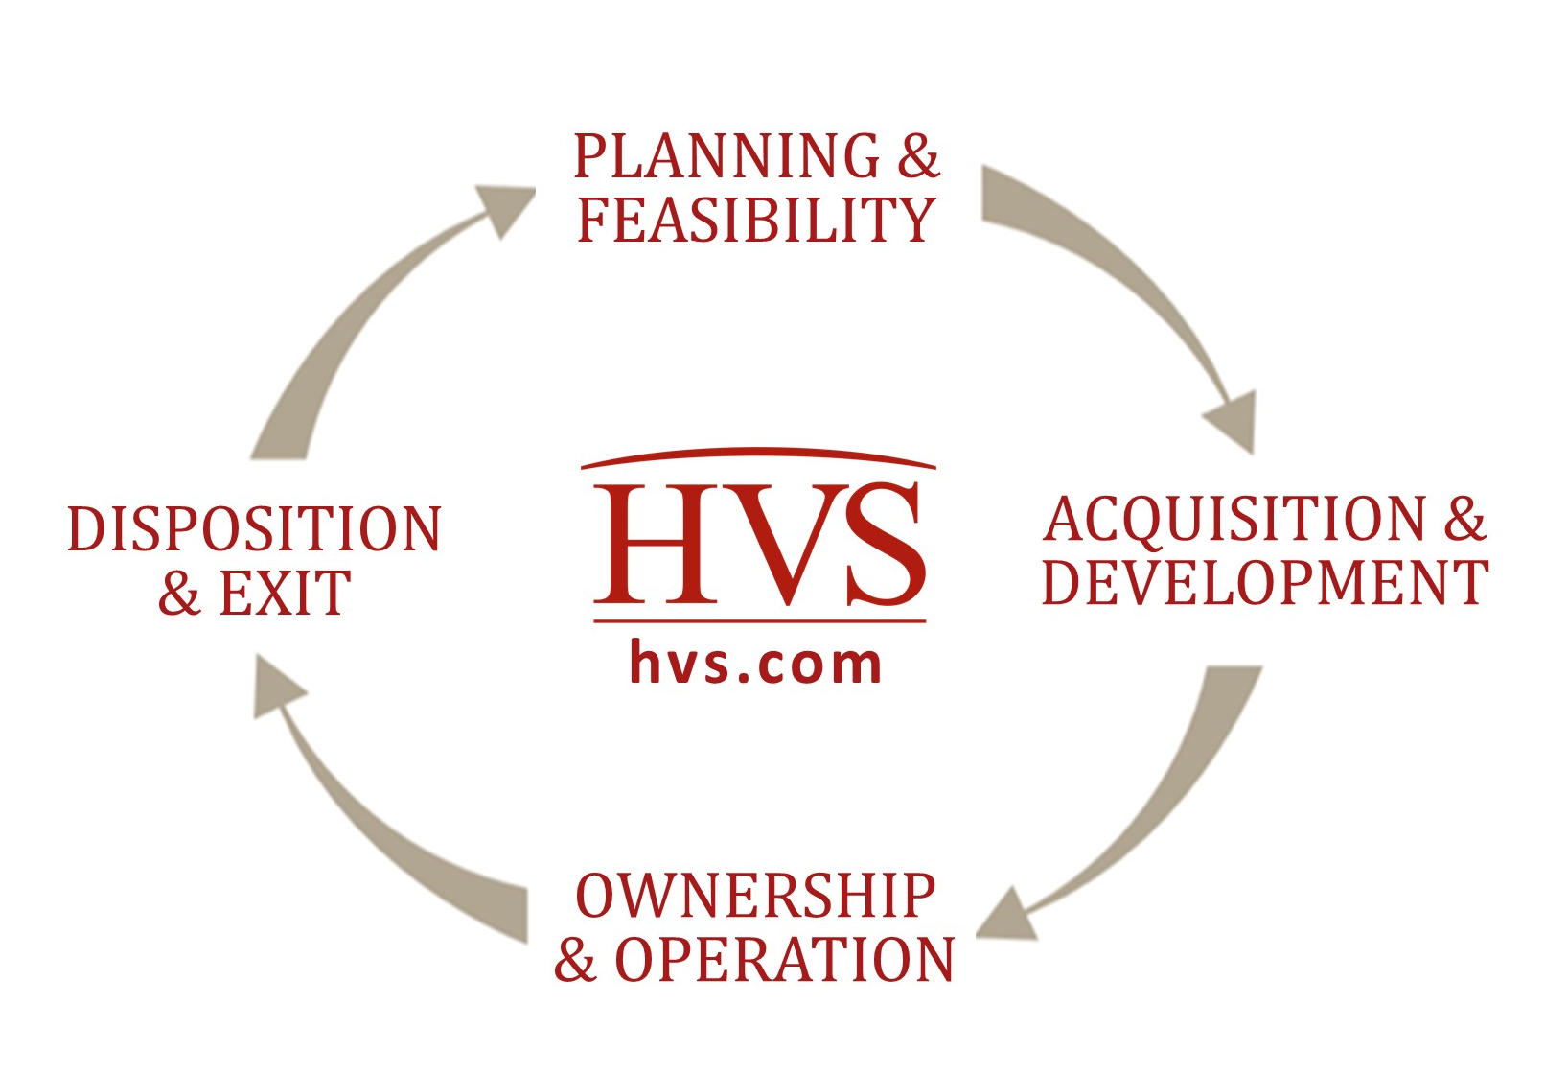
Thank you!
Luigi Major, MAI
LMajor@hvs.com
+1 (310) 270-3240
LinkedIn: linkedin.com/in/luigimajor

