Slide 1
MASTERING LARGE LOSS PROPERTY CLAIMS
The Hidden Factors that Impact Claim Recovery
Marco D. Flores
Stormlex Law Group
May 13 - 14, 2026

Slide 2
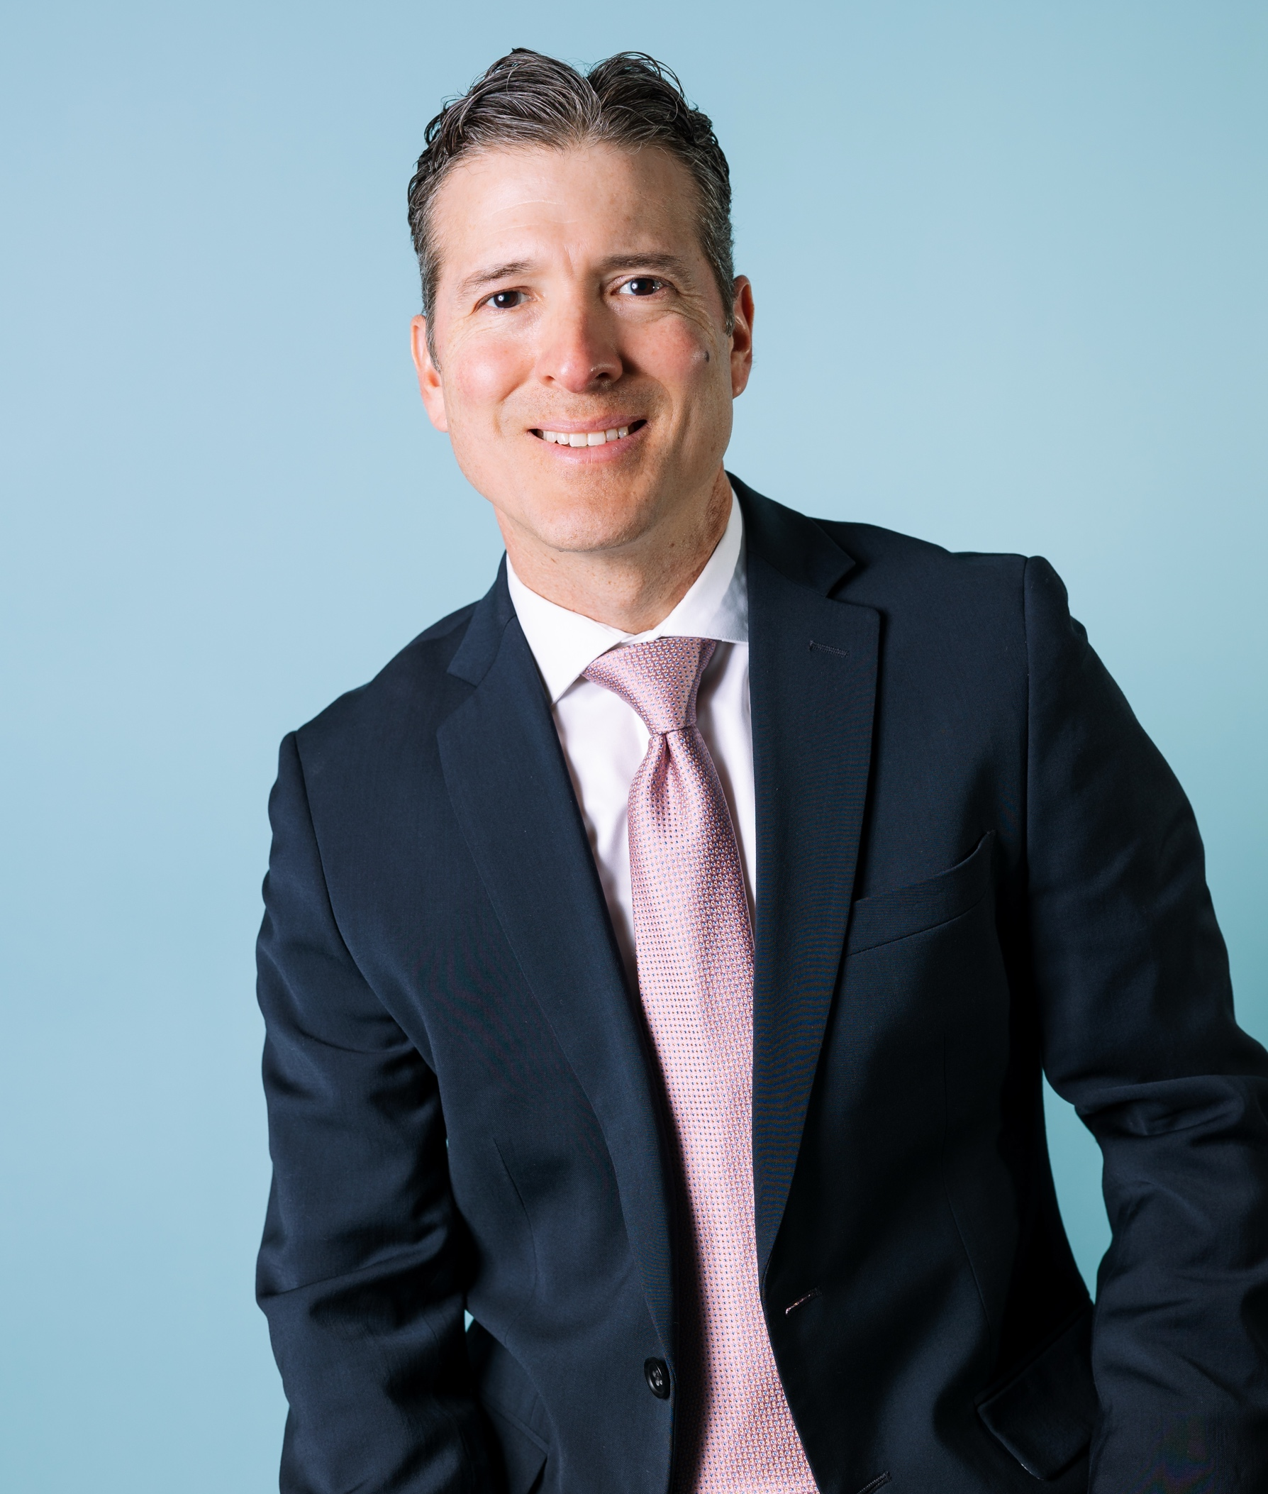
Marco D. Flores
CEO & Attorney, STORMLEX LAW GROUP
SAN ANTONIO, TX
25 Years Legal Experience
Large Loss Insurance Claim Specialist
Pickleball Enthusiast

Slide 3
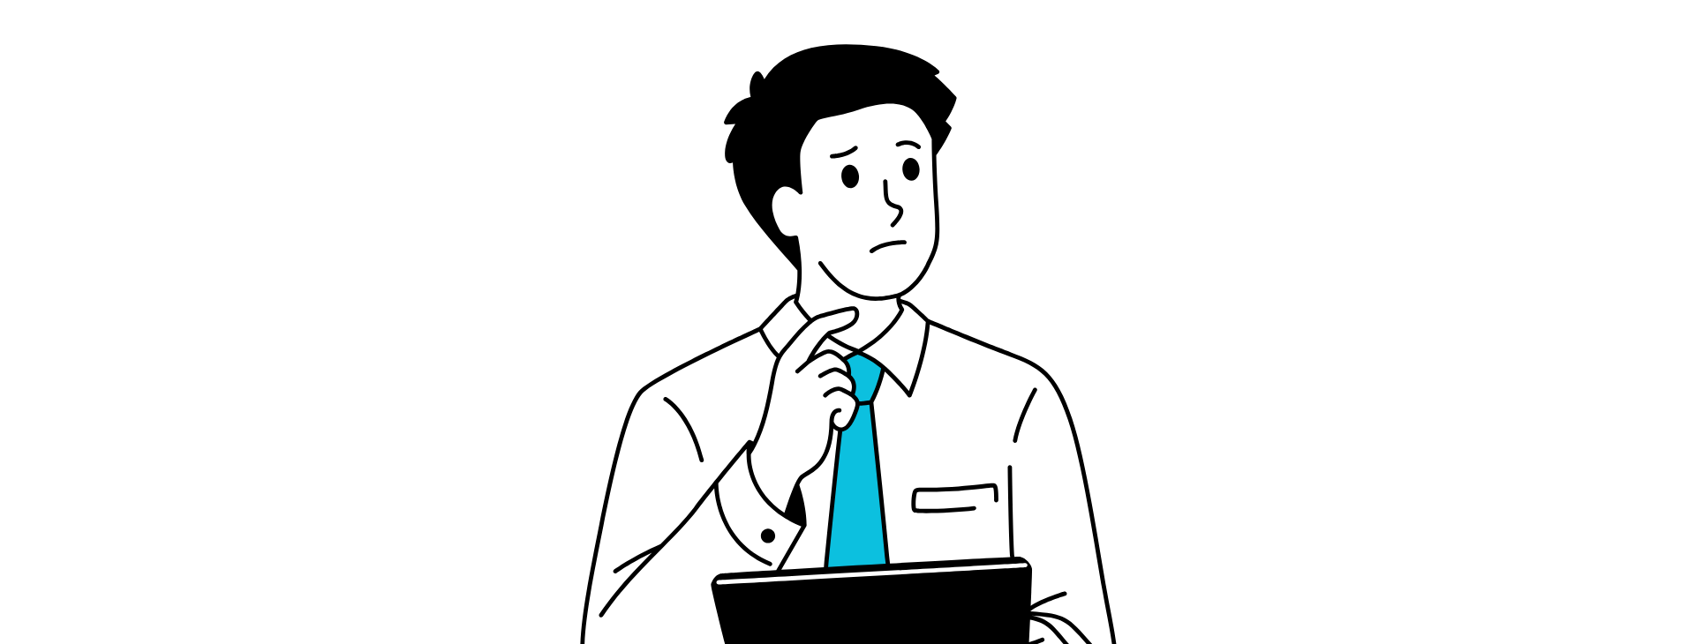
What Does a Lack of Knowledge Cost Commercial Property Owners?

Slide 4
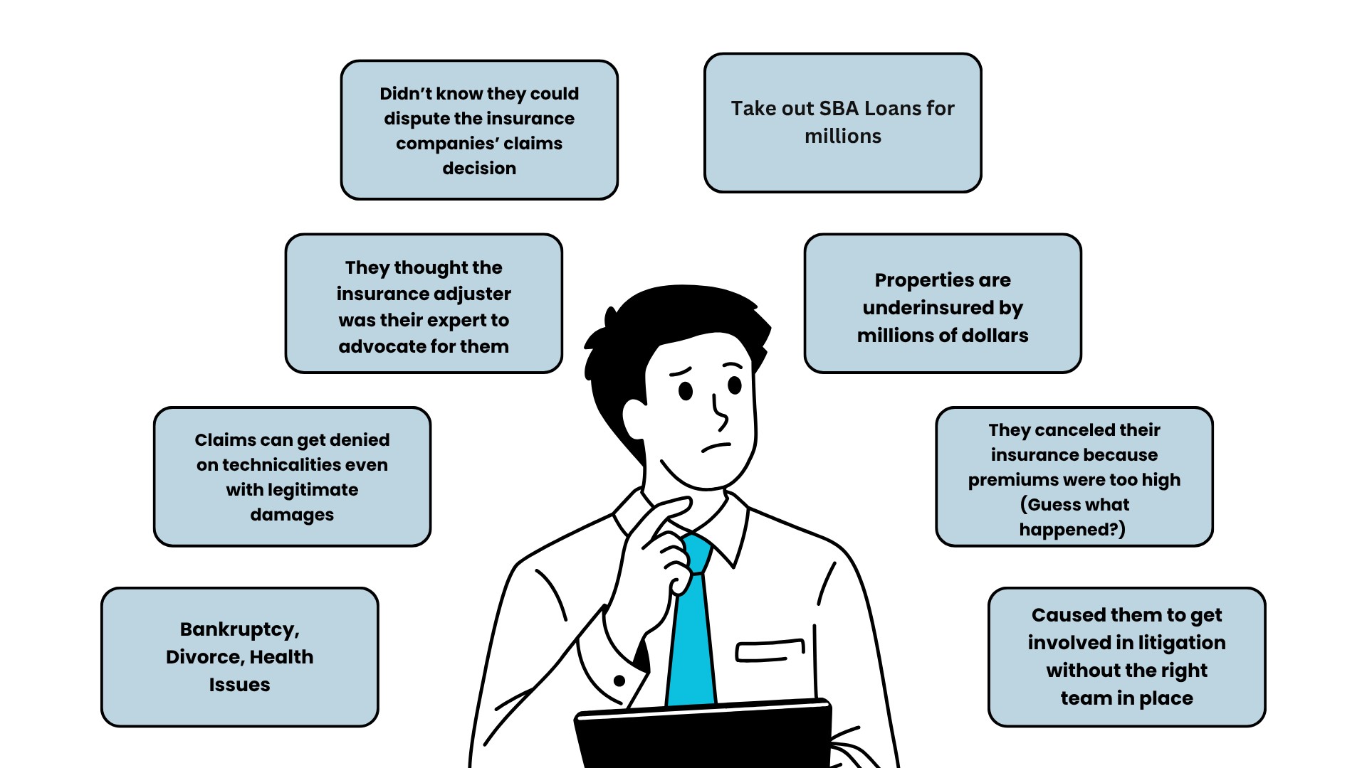
What Does a Lack of Knowledge Cost?

Slide 5

DID YOU KNOW...
Property owners have MANDATORY obligations to follow?

Slide 6

WHAT AM I RESPONSIBLE FOR?
Must pay premiums timely
Must report claim reasonably promptly (absent good cause)
Must cooperate with the insurance company’s investigation
  Communicate and provide requested information
  Don’t ignore their requests
Must make an effort to mitigate damages
May need to produce evidence of damages and cost of repairs

Slide 7

TO DO’s AFTER STORMS/LOSS
DAMAGE DOCUMENTATION & REPAIRS
Document photos of the building after a storm
Keep things from getting worse; temporary repairs
Document all repairs made and expenses incurred
MAKE THESE CALLS
Emergency: Call 9-1-1
Contact the insurance company to inform them of the damaging event

Slide 8
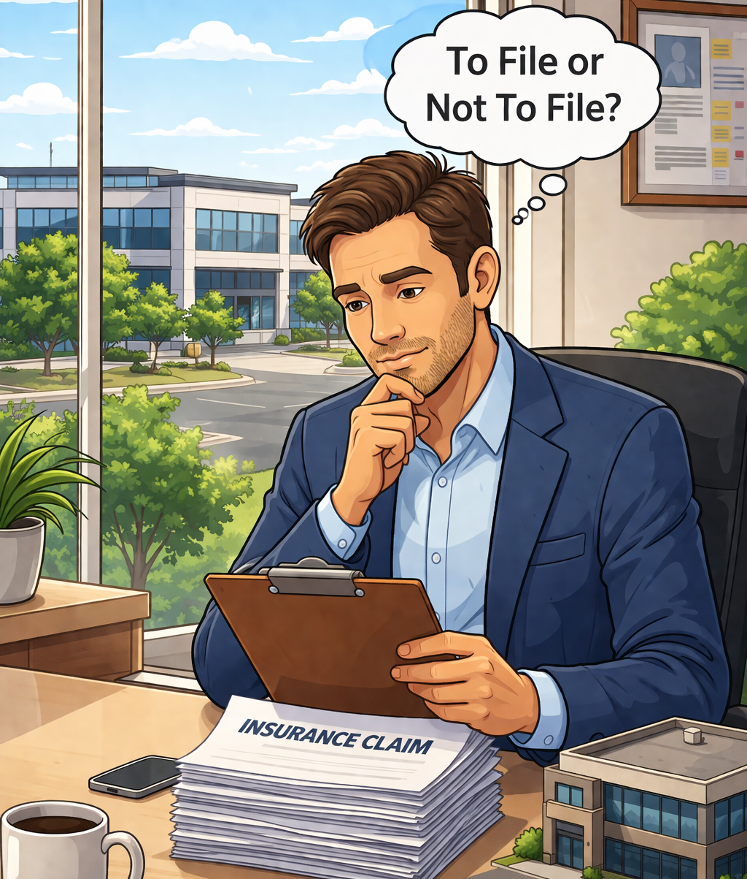
SHOULD I FILE A CLAIM?
“I don’t want to rock the boat. . . “
“I want to stay in the good graces of my carrier/agent...”
“My premiums will go up…”
“They will drop me as a customer...”

Slide 9
WHAT HAPPENS WHEN A CLAIM IS NOT FILED AFTER A STORM OR LOSS?
You could be in Violation of your policy: some require you to report if any damages occur
You lose your right to recover if you wait too long
Your Premiums will continue to rise
Unaddressed/Hidden damages likely to cause premature failure of your roofing system
Damages from a prior storm may cause your next claim to be denied due to “Pre-Existing” classification by carrier

Slide 10
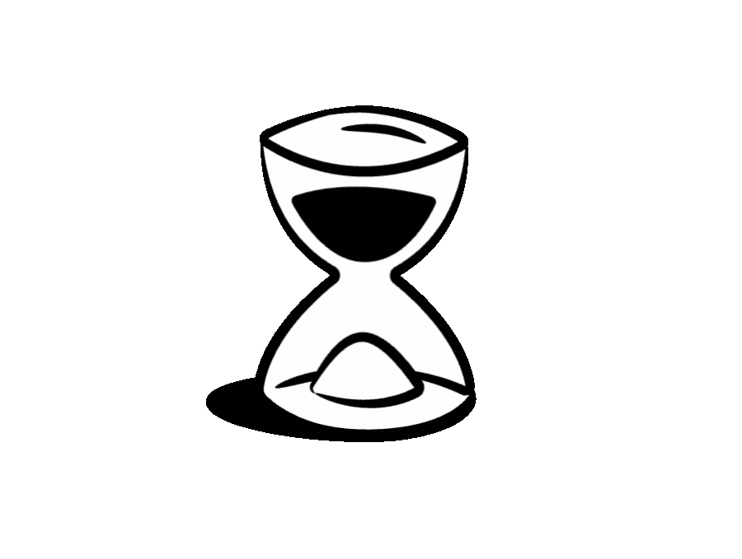
TIME IS MONEY
When is it too late to file a claim?
When is it too late to dispute a claim?

Slide 11

Claim Filed!

Slide 12
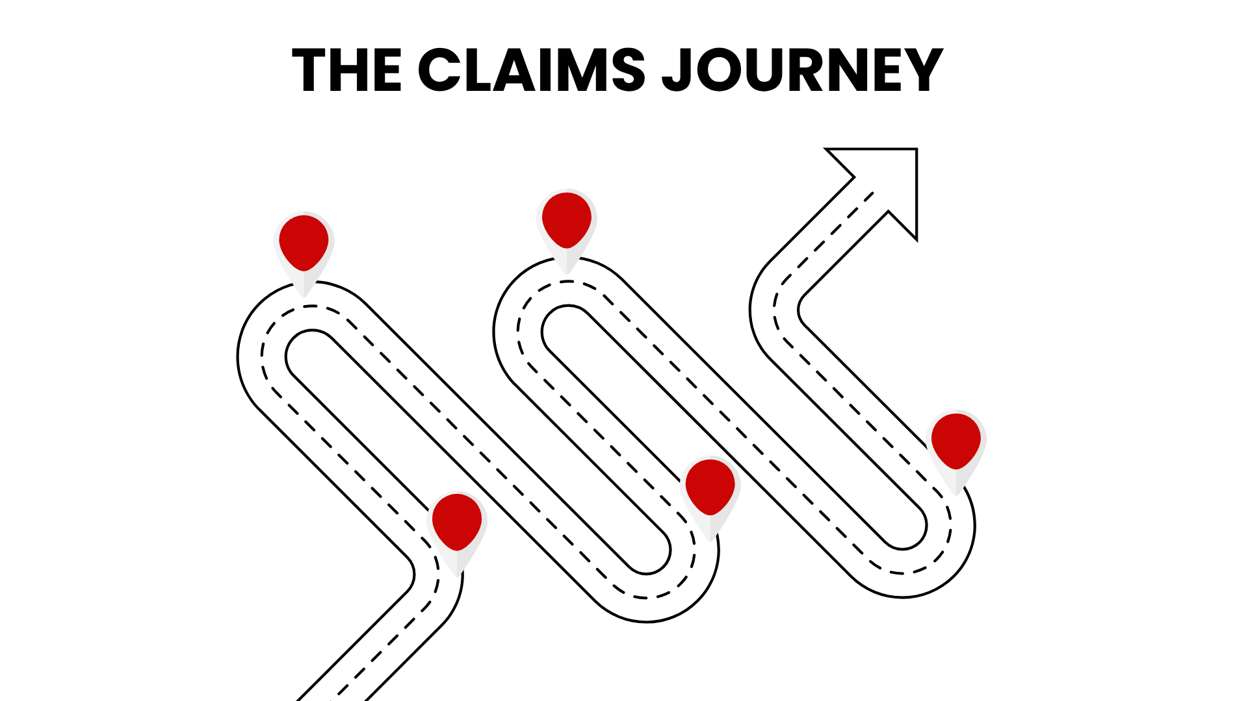
THE CLAIM JOURNEY

Slide 13
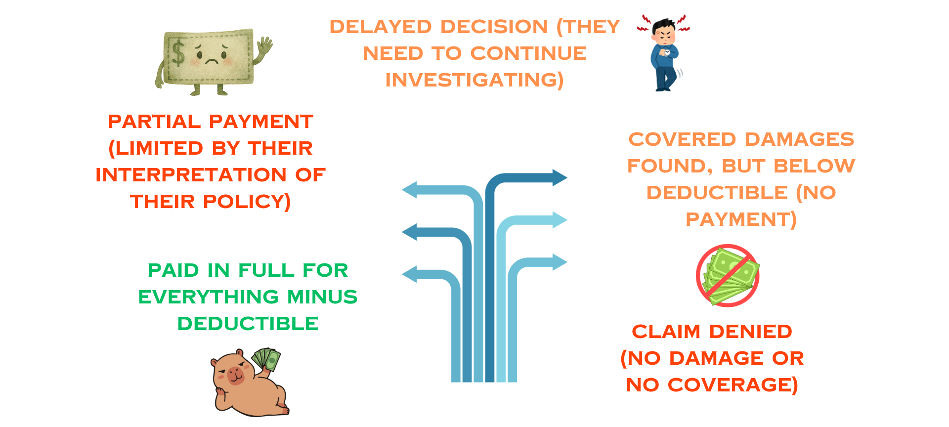
YOUR CLAIM OUTCOMES

Slide 14
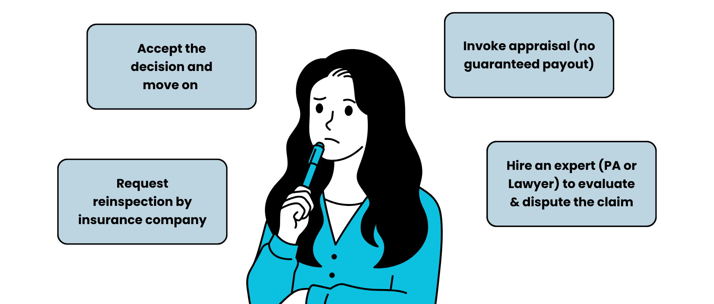
OPTIONS AFTER THE CLAIMS DECISION

Slide 15
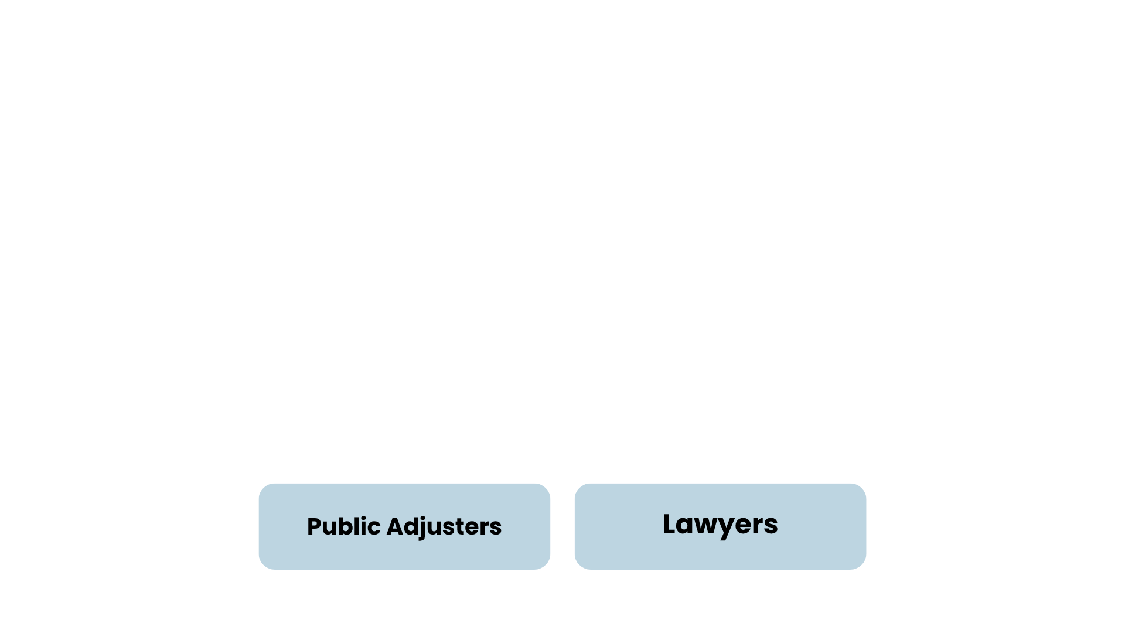
WHO CAN LEGALLY REPRESENT INSUREDS AND NEGOTIATE CLAIMS IN TEXAS?

Slide 16
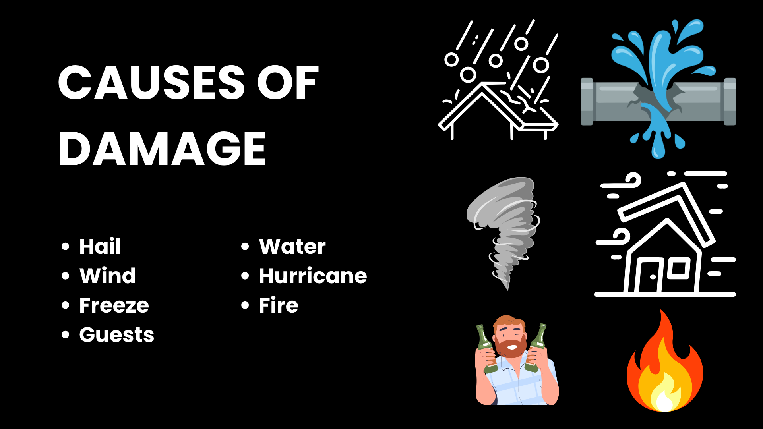
CAUSES OF DAMAGE
Hail
Wind
Freeze
Bad Guests
Water
Hurricane
Fire

Slide 17
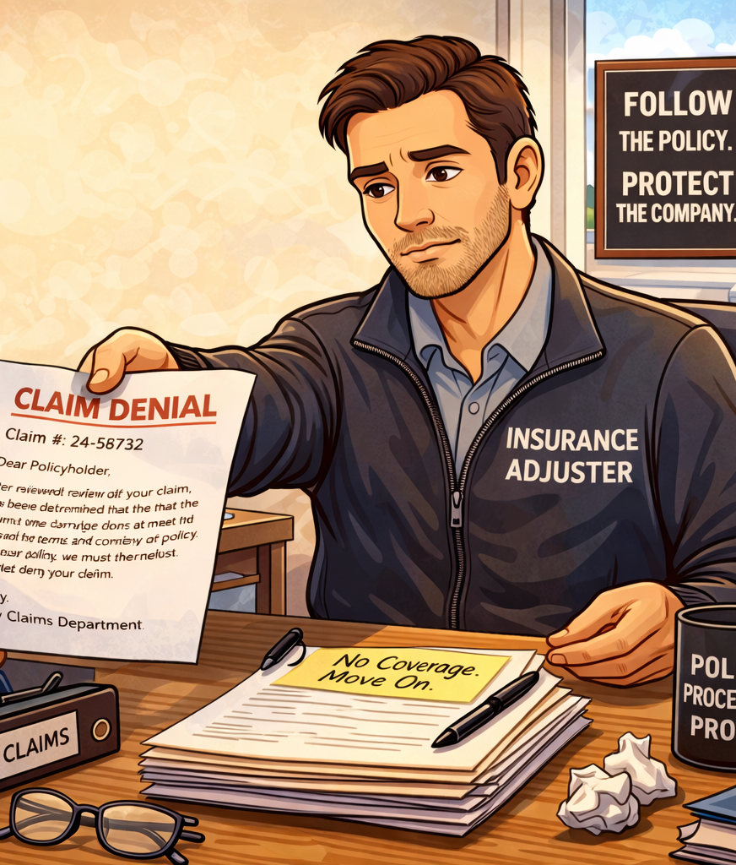
YOUR INSURANCE COMPANY’S BEHAVIOR
UNREASONABLE CLAIMS HANDLING
DENIALS, DELAYS, UNDERPAYMENTS
EXCUSES & POOR COMMUNICATION
UNEXPLAINED OR SURPRISE POLICY LANGUAGE

Slide 18
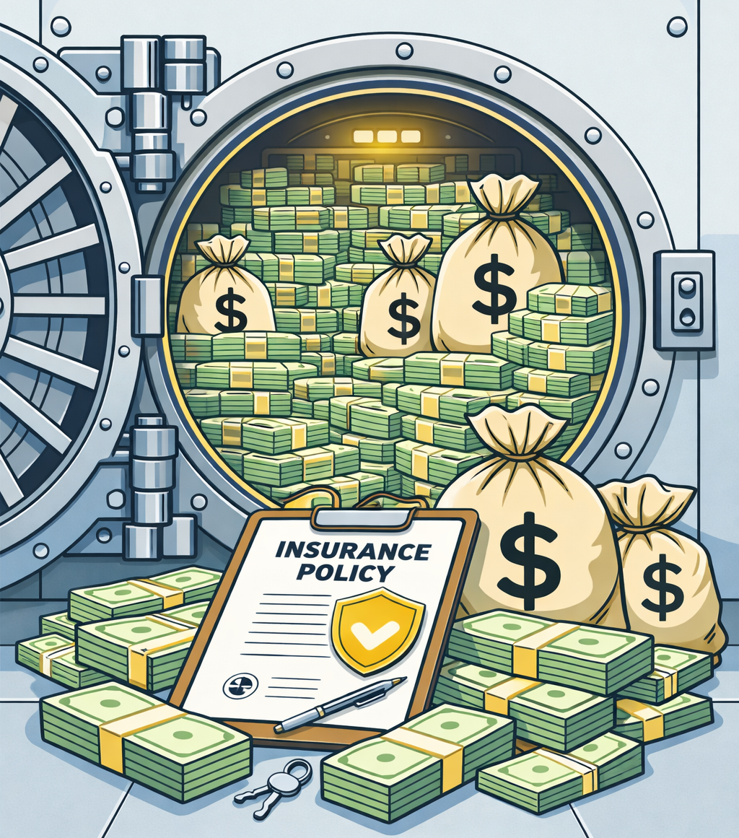
WHY DO INSURANCE COMPANIES DENY OR UNDERPAY CLAIMS?

Slide 19
Things that reduce your payout or lead to denial
BIG DEDUCTIBLES
CLAIM FILED TOO LATE W/O GOOD CAUSE
FAILURE TO IDENTIFY ALL DAMAGED PROPERTY/CONTENTS
AGGRESSIVE DEPRECIATION TAKEN
ACV POLICIES & RCV-ACV CONVERSION ENDORSEMENT
COSMETIC WAIVERS OR PRE-EXISTING DAMAGES
LACK OF MAINTENANCE
POLICY LANGUAGE INTERPRETATION (IN CARRIER’S FAVOR)

Slide 20
Things that reduce your payout or lead to denial
INSUFFICIENT DOCUMENTATION
LACK OF COMMUNICATION
HAIL: BLAME IT ON ANOTHER STORM (OUTSIDE COVERAGE PERIOD)
ENDORSEMENTS (CHANGE THE MAIN POLICY)
REPAIR VS REPLACEMENT ISSUES
NOT INCLUDING MONEY FOR CODE UPGRADES, OVERHEAD AND PROFIT
MANDATORY ARBITRATION & OUT OF STATE LAW/VENUE PROVISIONS
BEING UNDERINSURED

Slide 21
BASIC POLICY PROTECTIONS
1-2% Deductible
ALL RISKS POLICIES (vs Named Risk/Perils)
RCV ONLY Policies (No ACV only)
NO RCV to ACV Conversion Endorsement
NO Cosmetic Waivers
NO Anti-Concurrent Causation Language
NO Mandatory Arbitration Provision
You Want Access to Texas Courts and Texas Law

Slide 22
PRO TIPS
THE ROOF
Have roof inspected annually to avoid pre-existing issues
Document a Maintenance Program
Never sign a proceeds contract with a roofer (Ask for references)
THE POLICY
MAKE SURE you are not underinsured (values)
Have your policy reviewed for the BASICS OF PROTECTION
Shop around for educated brokers
SECRET: Consider buy down deductible policies

Slide 23
YOU RECEIVED MONEY FROM THE INSURANCE CARRIER
Can you still dispute the claims decision?
*Prize Slide

Slide 24
HOW DO YOU WANT YOUR DAMAGES VALUED?
What’s the Difference?
RCV vs ACV
*Prize Slide

Slide 25
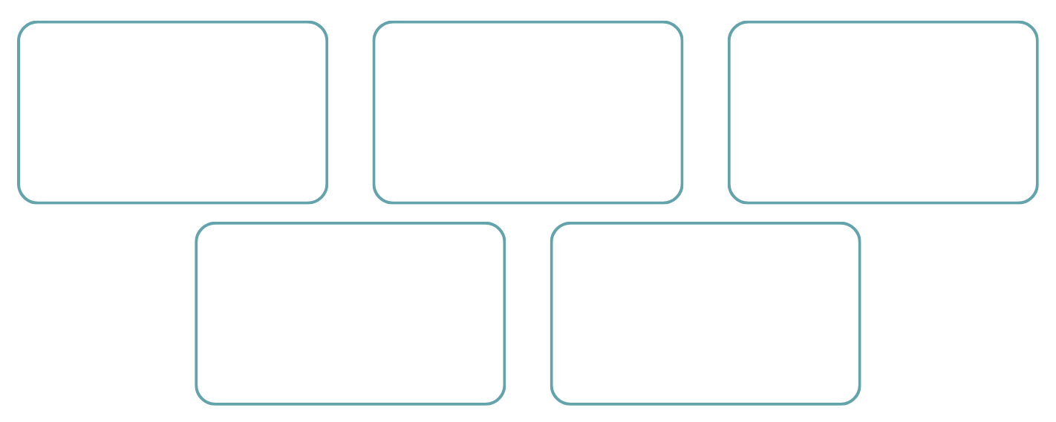
What’s Changed in the Past 20 Minutes?

Slide 26
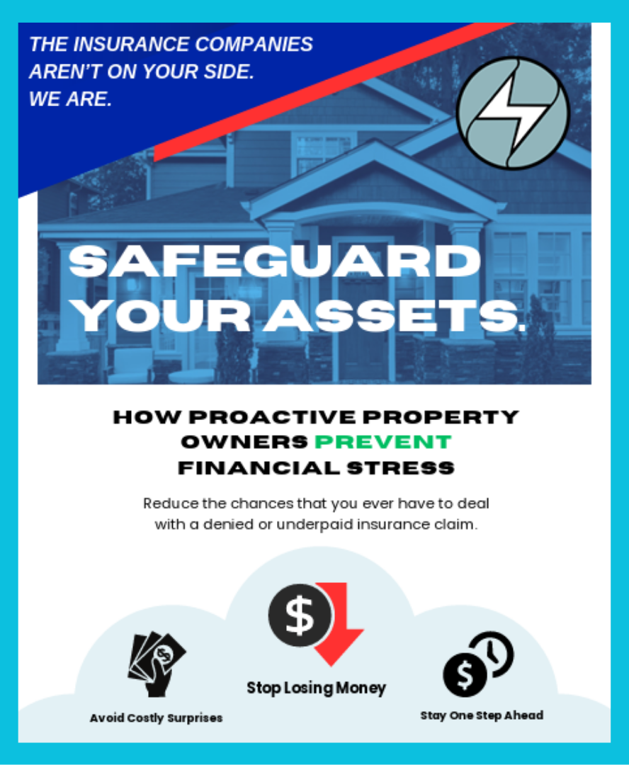
COMMERCIAL PROPERTY PROTECTION PLAN
LEAVE US YOUR CARD TO GET A COPY
Be aware of fly by night contractors after storms
Get a bid from local contractors
Contact your agent;
File claims as promptly as most policies require
Take photos and videos of all damages
Make temporary repairs

Slide 27

Find us on YouTube!
Our channel exists to help hoteliers:
Protect their property investments
Avoid preventable claim mistakes
Make informed decisions during high-pressure situations
Recover what they’re actually owed under their policy

Slide 28
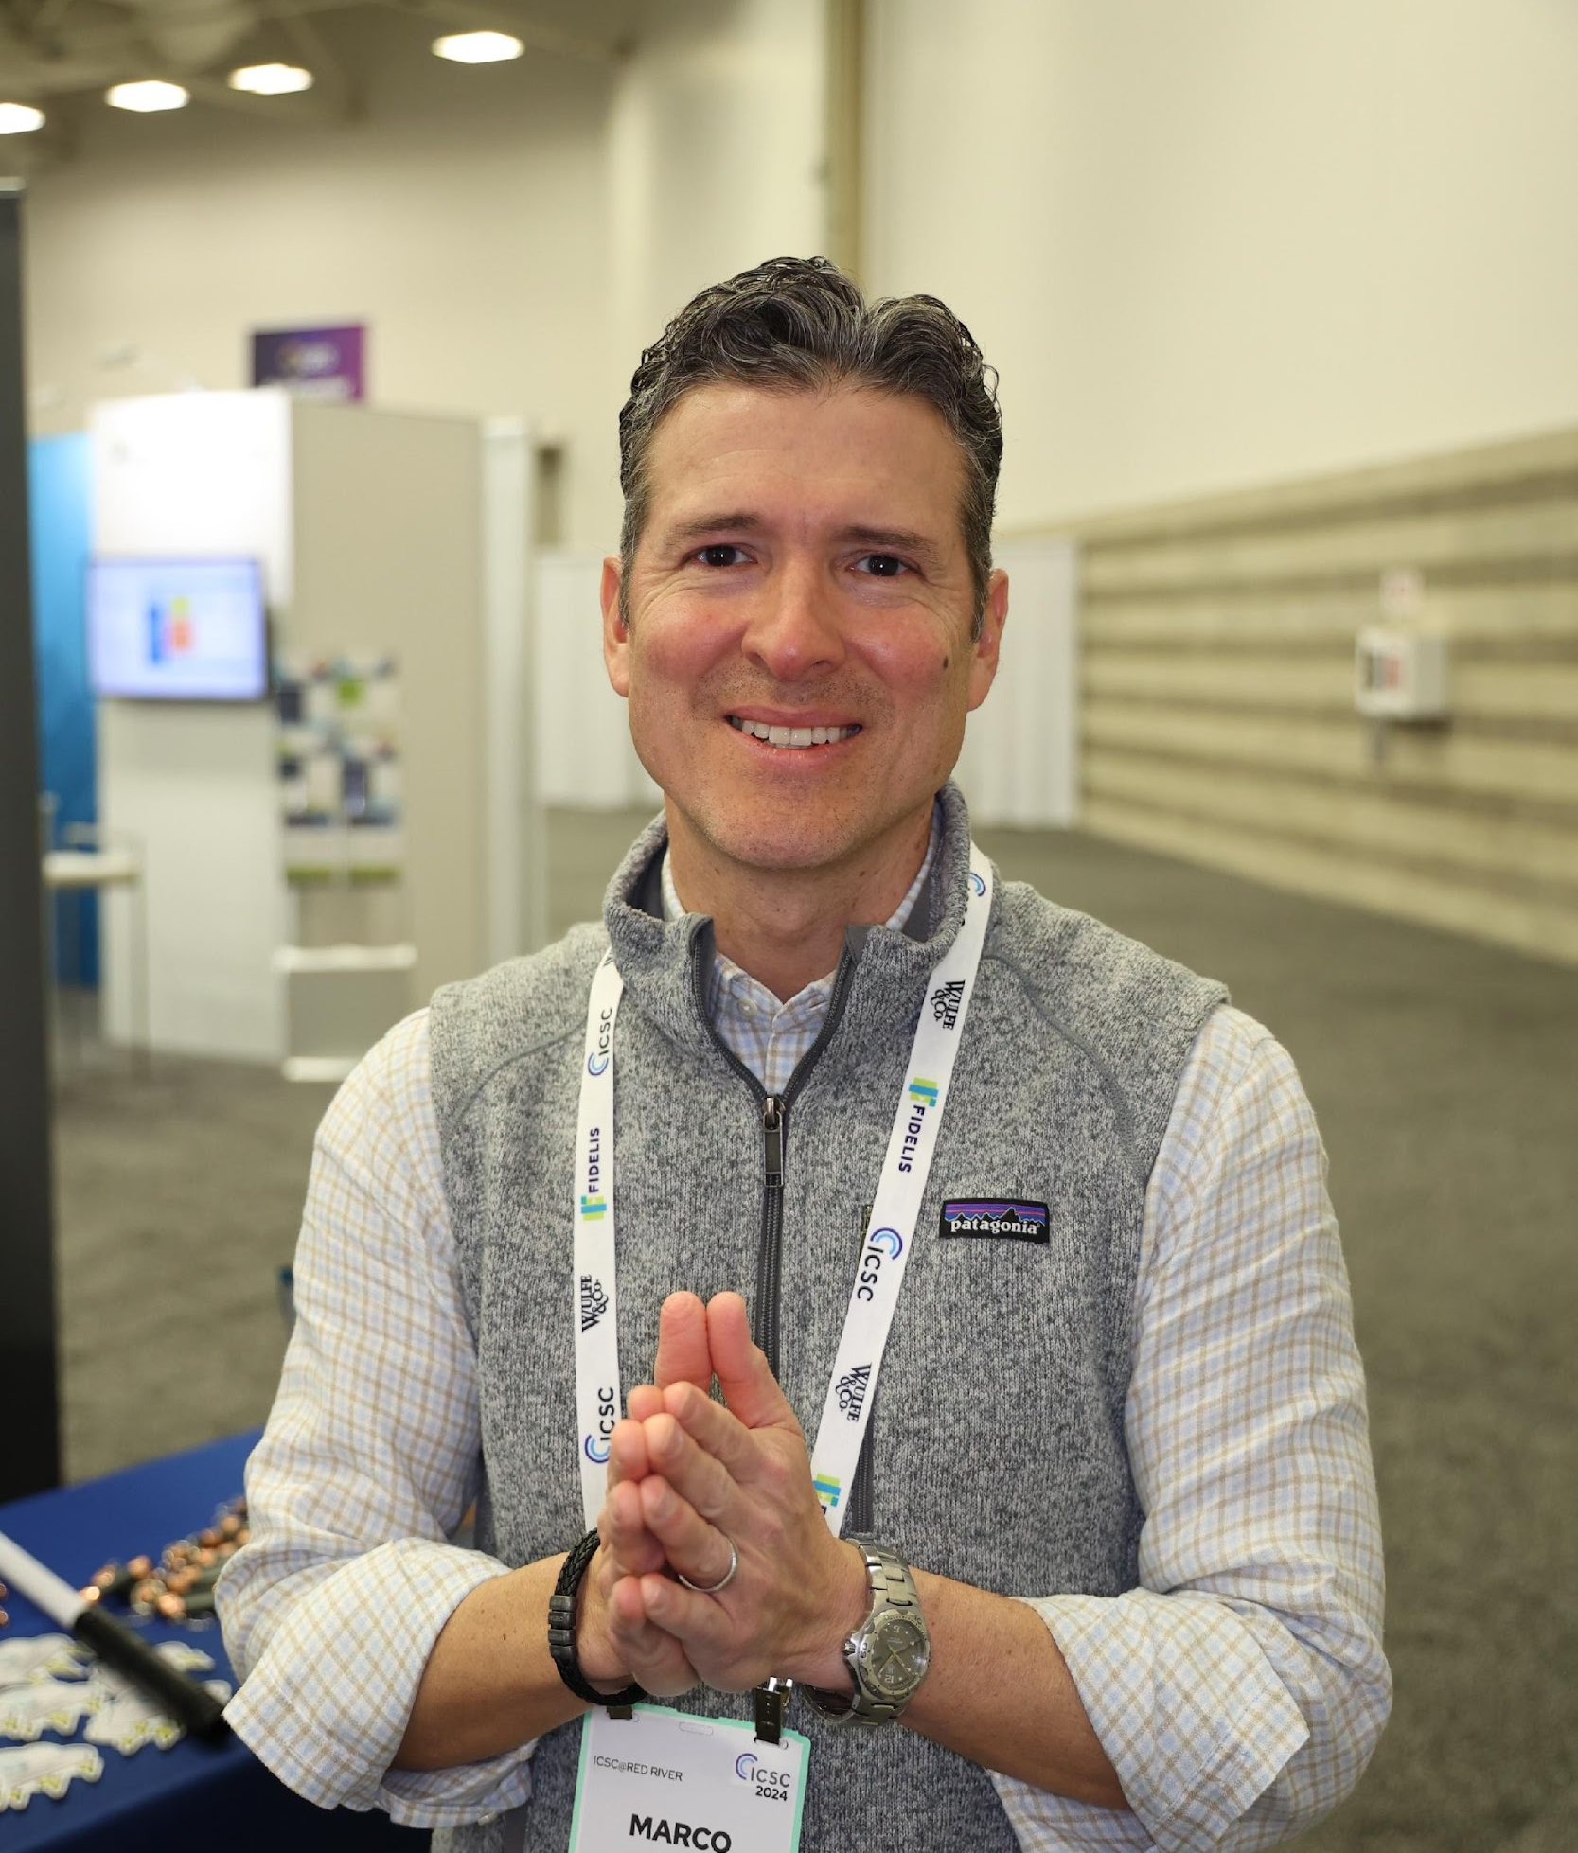
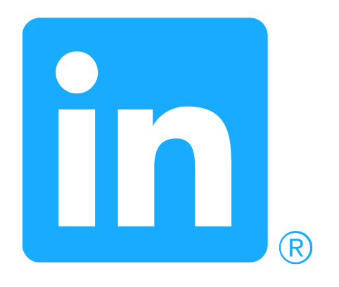
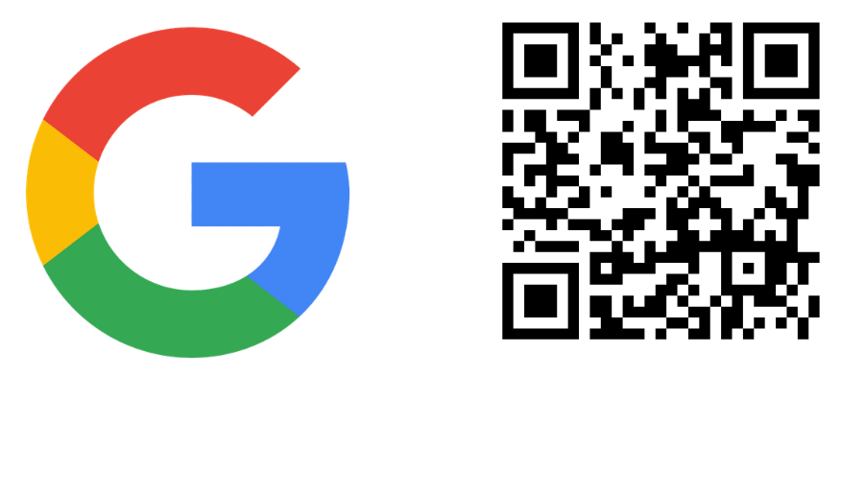
Let’s Connect!
Marco D. Flores
Stormlex Law Group
Did You Learn Something About MASTERING LARGE LOSS PROPERTY CLAIMS?

Slide 29

Marco D. Flores
mflores@stormlex.com
(214) 621-7249

