Slide 1



Service Charges Under Fire: Navigating a New Wave of Hospitality Litigation.
Amanda K. Monroe
May 13 - 14, 2026

Slide 2



Amanda K. Monroe
Partner
Labor & Employment Practice Group Leader
Michelman Robinson | Los Angeles, CA
Defends employers in wage and hour class actions, PAGA cases, and hospitality industry employment disputes
Advises on compliance, workforce reductions, mass layoffs under the WARN Act, and wage audits
Handles matters before the California Labor Commissioner, DFEH, DOL, EEOC, and OSHA, in addition to state and Federal court matters

Slide 3


Service Charges Were Never Supposed to Be This Complicated
What began as an operational tool has become a legal flashpoint.
It’s Not Just What You Charge

Slide 4

The Industry Reality
For decades, hotels, restaurants, and event operators relied on service charges to:
  Standardize pricing and revenue streams
  Manage rising labor and operational costs
  Reduce reliance on discretionary tipping models
Today, that long-standing business model is facing unprecedented legal and regulatory scrutiny

Slide 5

Why This Matters Now
  Increased regulatory and legislative scrutiny
  Aggressive plaintiffs’ bar and a rapidly expanding wave of class action litigation
  Expanding case law and heightened scrutiny regarding disclosure, distribution and use of service charges
  Consumer focus on pricing transparency
Service charges are being challenged nationwide.

Slide 6

The Core Question
Every case turns on this:
  What does the customer believe they’re paying for (i.e., is it a gratuity)?
  Who do they believe is receiving it?
  In most jurisdictions, liability is driven less by the label itself and more by the reasonable consumer’s understanding of the charge.

Slide 7
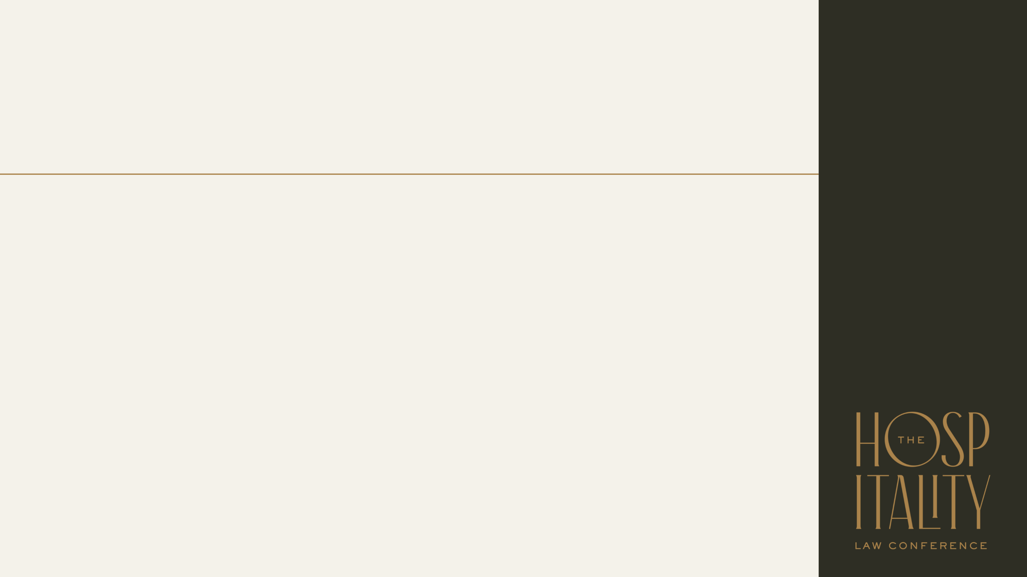
The Legal Framework:
Gratuity vs. Service Charge
  Gratuities → considered the property of employees
    Employers cannot retain or divert them
  Service charges → may generally be retained by the operator
    But only if properly structured and disclosed.

Slide 8

The Governing Standard: The Reasonable Customer Test
Would a reasonable customer understand the service charge to be a gratuity intended for service staff?
  If the answer is yes, the operator faces potential liability
  If the answer is unclear, the operator still faces significant litigation risk.
  Ambiguity works against you. Inconsistent or incomplete disclosures create exposure.

Slide 9

Where Risk Lives
Service charge language appears across the customer experience, including:
  Event contracts and banquet agreements
  BEOs
  Menus
  Invoices and receipts
  Proposals and marketing materials
  Email Communications
  On-site dining and in-room dining materials
Courts and Plaintiffs’ attorneys look at the full picture.
Where Risk Lives

Slide 10
Example 1
Where Risk Lives

Slide 11
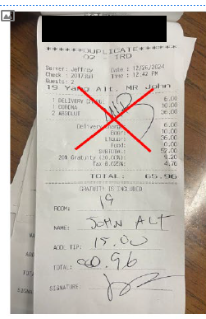
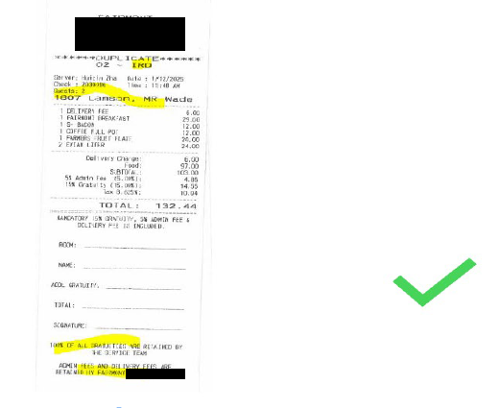
Example 2
Where Risk Lives

Slide 12
It’s Not Just What You Charge
It’s how you communicate it:
  Language used to describe the charge and any breakdown
  Placement
  Consistency across all customer touchpoints
Inconsistency = exposure
It’s Not Just What You Charge

Slide 13

Industry Shift (and What to Avoid)
Operators Are:
  Moving away from “service charge” as a catch-all
  Separating admin fees and gratuities
  Defining each clearly, including the percentage breakdown, and consistently
Avoid:
  Sales managers’ own templates
  Use of client’s own contracts or use of prior contracts
  Inconsistent disclosures and terms

Slide 14

A Defensible Structure
Administrative Fee:
  Retained by the business
  Not a gratuity
  Disclosed as a percentage
  Purpose clearly and consistently stated
Gratuity:
  Clearly labeled as paid to the service staff
  Shown as a separate line item and specific percentage
  Disclosed to the customer across all documents

Slide 15

Where This Must Be Consistent
Consistency Across:
  Menus
  BEOs
  Invoices
  Proposals
  Email Communications
If the customer sees it, it matters.

Slide 16
Disclosure: What’s the Standard?
Disclosure Must Be:
  Clear
  Conspicuous
  Consistent
Customers must understand:
  What the charge is
  How much it is
  Who receives it
  That it’s separate from pricing

Slide 17


Disclosure Doesn’t Stop With You
Event organizers may need to inform attendees
Charges must be broken out separately
Fees cannot be bundled or disguised
Transparency must carry through the entire transaction.

Slide 18
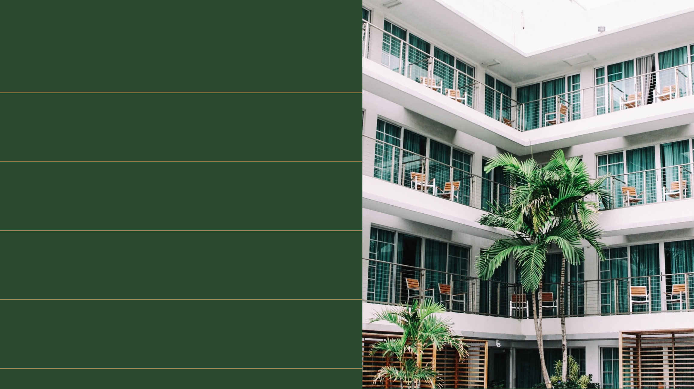
Contracting Risk
Outdated templates
Modified or client-drafted language
Reused prior contracts
Loss of control = increased risk

Slide 19
Operational Drift
Lifecycle of a typical event:
  Proposal → Contract → BEO → Menu → Invoice → Email
At each step:
  Language can drift → inconsistency → liability

Slide 20

Real-World Example: How This Goes Wrong
The Documents:
  Contract: “Administrative fee (not a gratuity)”
  Menu: “22% service charge”
  Email: “This goes to staff”
The Result:
  Customer confusion
  Mischaracterization of the charge
  Legal exposure
The Lesson:
  Every customer-facing document must use the same language
  One inconsistency can unravel an otherwise compliant structure

Slide 21
Internal Alignment & Training
Use:
  Approved templates only
  Standardized language across all materials
  Centralized updates
Train:
  All customer-facing staff
  Sales, event managers, and frontline teams
  Every explanation must match your documents.
The Human Factor:
  Sales
  Event managers
  Frontline staff
  Your biggest risk may be what your team says.

Slide 22

California as a Leading Indicator
California Standards:
  Strict gratuity protections
  Focus on customer perception
  Aggressive enforcement
  For many operators, this is where the industry is heading.
Additional Complexity: CBAs:
  Where applicable, service charge practices must align with collective bargaining agreements
Why It Matters Nationally:
  California trends often predict national direction
  Operators should monitor California decisions closely

Slide 23

Best Practices
What You Should Be Doing Now:
  Audit all customer touchpoints
  Separate mandatory administrative fee and gratuity into separate terms rather than referring to both as a service charge
  Ensure language regarding gratuity and service charges stays consistent with the CBA
  Standardize language across all materials and share with your internal teams
  Train your teams → Ensure all sales team members use the same contract templates
  Avoid using the customer’s own contract
  Use consistent language on all documents provided to the customer
  Review regularly
The Bottom Line:
  Service charges are no longer operational details.
  Clarity is your strongest defense.

Slide 24

Amanda K. Monroe | amonroe@mrllp.com
Questions? Please reach out: amonroe@mrllp.com

